Slide 1
Creating Careers in the Curriculum project supporting Benchmark 4 between University of Liverpool Maths School and Avalanche Studios.
Computer Science – A Level
Notes:
Creating Careers in the Curriculum project supporting Benchmark 4 between University of Liverpool Maths School and Avalanche Studios.
Computer Science, A Level
Lesson Objectives/Learning Intentions:
To understand the differences between the CPU and the GPU particularly parallelism.
Be able to give examples of uses for GPUs
To demonstrate the use of GPUs through a programming example.
Learning Outcomes:
Students have documented a summary of the GPU
Students have done a practical activity making use of the GPU and how its parallel power is far superior to the a multicore CPU.
Students can offer examples of other uses of the GPU outside of graphics.

Slide 2
Lesson Objectives/Learning Intentions:
To understand the differences between the CPU and the GPU particularly parallelism.
Be able to give examples of uses for GPUs
To demonstrate the use of GPUs through a programming example.
Learning Outcomes:
Students have documented a summary of the GPU
Students have done a practical activity making use of the GPU and how its parallel power is far superior to the a multicore CPU.
Students can offer examples of other uses of the GPU outside of graphics.

Slide 3
Notes:
The GameChangers Pledge brings together games studios, skills providers, charities and other organisations to develop new pathways and opportunities in the games industry in the LCR. Funded by the LCR Careers Hub, a part of the LCR Combined Authority.

Slide 4
Notes:
The average salary in the Games Industry is over £50,000. For mid-level positions, this is around £38,000. Graduates can expect to earn approx. £25,000.
82% of people working in games have at least a bachelor's degree (with 22% of those having a Masters). However, not all those degrees are games specific, with STEM Degrees topping the table and arts degrees a close third.
The industry is neurodiverse, with 18% of us having some form of neurodevelopmental condition. This is above the UK average population figure of 16%.
Skillsearch 2023
UKIE Diversity Census 2022

Slide 5
Notes:
The North West is one of the biggest games clusters in the UK. Dating back to the 1980s, the industry has continued to grow in the LCR with over 45 Games Studios (including publishers) operating.
UKIE Interactive Map Data: filter by LEP > Liverpool City Region https://map.gamesmap.uk/
A data sample (searching for game development, games publisher & video game development) found over 1000 people working in the LCR with an average salary of £39,960.
85% of people in the industry in the LCR identify as male. The diversity of the industry is heading in the right direction, but we certainly need more representation from women in the region.
Over 1000 job adverts were found across the region, with the main candidates highlighted as programmer, trainer, designer, software and design.
All this is to say that the Games Industry in the Liverpool City Region is huge and it continues to grow with more talented Games studios making the LCR their homes – providing a brilliant opportunity for careers and career progression for our young people.

Slide 7
Notes:
Avalanche Studios Group: creating innovative and unforgettable open world experiences for over 20 years.
Avalanche has a truly sustainable work environment where over 500 diverse, passionate, and collaborative creatives from all over the world now flourish, working across Stockholm, Malmö, and Liverpool.
They develop and publish their own IPs, as well as catering to third-party publishers and license holders.
Based in Liverpool since 2020, Avalanche are a founding member of ‘GameChangers’.

Slide 9
Types of processor
GPU

Slide 10
Intro
A CPU (central processing unit) works together with a GPU (graphics processing unit) to increase the throughput of data and the number of concurrent calculations within an application.
Originally design for the creation of images and processing of graphics they can actually be used to accelerate calculations involving massive amounts of data.

Slide 11
Is a GPU better than the CPU then?
No, A GPU can never replace a CPU. A GPU complements the CPU architecture by allowing repetitive calculations within an application to be run in parallel whilst the main program continues to run on the CPU.
Think of the CPU as the taskmaster of the system coordinating a wide range of general purpose tasks whilst the GPU performs a narrowing range of more specific tasks (usually mathematical) using the power of parallelism.

Slide 12
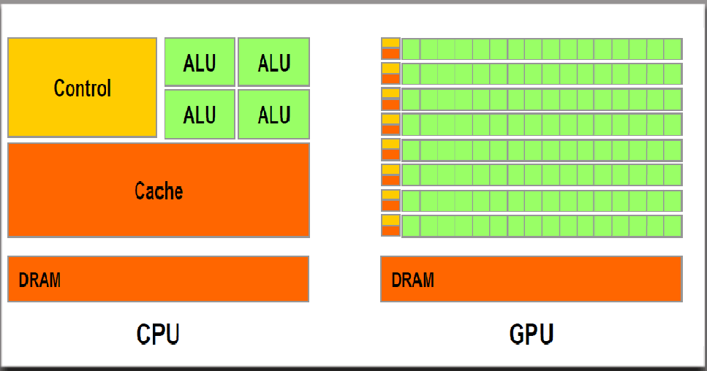
Compare the architectures

Slide 13
CPU vs GPU (theory comparison)

Slide 14
CPU vs GPU (great comparison)

Slide 15
Uses of GPUs
Some of the more obvious uses of GPUs and graphics cards include: -
Gaming
Graphic design
CAD/CAM
CGI - animation

Slide 16
Other uses of the GPU
In addition to the common uses of the GPU, there are a number of alternative uses for a GPU including: -
Cryptocurrency
Data mining
Data Science
Artificial Intelligence and deep learning.

Slide 17
Do you want to experiment with the GPU?
DirectCompute: A proprietary shader language/API from Microsoft that is part of Direct3D, starting with DirectX 10
AMD FireStream: An ATI/Radeon proprietary technology, which was discontinued by AMD
OpenGL Cross platform library for rendering 2D and 3D vector graphics by interacting with the GPU.
OpenACC: A multivendor-consortium parallel computing solution
C++ AMP: A Microsoft proprietary library for data parallelism in C++
CUDA: Nvidia’s proprietary platform, which uses a subset of the C language
OpenCL: A common standard originally designed by Apple but now managed by the consortium Khronos Group

