Slide 1
KS3 English in the World of Work
Using Persuasive Writing
LCR Lesson Plan
Notes:
Teaching staff: We’re using this lesson with our year 9 classes. They have covered persuasive writing as a topic already and we used DAFOREST as an acronym for remembering persuasive features of writing. These lessons have been designed to prepare our students for AQA GCSE English Language. Please feel free to adapt and change these resources to suit your students’ ability.

Slide 2
Can you think of any persuasive writing features? D _ F O _ _ S_
Thinking about life after school, when and why would you need to write persuasively?

Slide 3
Examples of persuasive writing
Technique | Definition
Direct Address
Alliteration
Anecdote
Facts
Opinions
Rhetorical Question
Repetition
Emotive Language
Statistics
Triples
Notes:
Teaching staff: Students can complete this individually or with a partner. You can provide some definition for students, use a different acronym or ask students to create examples for each feature to stretch and challenge.

Slide 4
Examples of persuasive writing
Technique | Definition
Direct Address | Communicating directly to the reader/s
Alliteration | Repetition of consonant sounds in nearby words
Anecdote | A short and interesting story about a real person or event
Facts | A thing that is known or proven to be true
Opinions | An idea or judgment- not always based on fact or knowledge
Rhetorical Question | A question asked for dramatic effect
Repetition | A single word or phrase used in close succession
Emotive Language | Specific word choices selected to promote specific feelings
Statistics | Numbers and figures used to convince a reader
Triples | Three items (words, phrases or sentences) to make an impact

Slide 5
Rank the effectiveness of persuasive writing
Select six features
Rank them in order of effectiveness
Be ready to discuss
your reason!
Notes:
Teaching staff: Students can complete this individually or with a partner. This allows for an opportunity to discuss.

Slide 6
Rank the effectiveness of persuasive writing
Select six features
Rank them in order of effectiveness
Be ready to discuss
your reason!
Can you think of any more features of writing that might persuade and engage a reader?
Notes:
Teaching staff: Students can start to think about other features of writing to create a bond with a reader. (collective pronouns, flattery etc)

Slide 7
The Bigger picture
Revise persuasive writing and identify features in a text
Understand the
demands of
GCSE English
Language
Paper 2
Question 5
Secure a successful career by writing about yourself and persuading your future employer
Assessment: Paper 2 - Question 5

Slide 8
Why are we doing this?
At GCSE, you will sit 2 exams for English Language GCSE
You have to write a persuasive response for Paper 1 Section B in a certain format (letter, speech etc)
You have 45 minutes to write and this ONE question is worth 25% of your entire GCSE grade
Don’t worry!
We’ll revise this style of writing in a number of ways before your exam at the end of year 11.

Slide 9
Sustainable – able to be maintained at a certain rate
Renewable-capable of being renewed
Innovate- make changes in something established
Net zero- balancing and removing greenhouse gases from our atmosphere
Notes:
Teaching staff: These can be displayed or printed. Our students have completed a ‘Green Careers’ unit of work during their PSHE / Learning for Life lessons and will have some prior knowledge about these terms.

Slide 10
A. Kimpton have been delivering exceptional mechanical and electrical (M&E) projects and heating, ventilation and air conditioning (HVAC) services across the Liverpool City Region since 1963.
B. Having installed some of the UK’s first heat pumps for Walkers Crisps in the 1970’s, Kimpton have been at the forefront of renewable technology.
C. Kimpton continue to innovate using renewable technology to help customers in the North West and UK wide reduce the carbon impact of their heating, lighting and electrical systems.
D. When Kimpton quote for new projects or maintenance contracts they must write persuasively in the form of tenders, or bids. These bids will convince other businesses that they are the right company for the job!
Notes:
Teaching staff: This could allow for a research opportunity (either in class or as a homework). Students can study the business and the key words.

Slide 11
Invitation to Bid
Bid Preparation
Bid Evaluation & Selection
Contract Awarding
Businesses will issue an invitation to tender (ITT) and provide details of the M&E (Mechanical and Electrical) project, or HVAC (Heating, Ventilation and Air Conditioning) maintenance contract, they need carrying out.
Companies, like Kimpton, who are interested in winning the work will have to provide responses to the questions set out in the tender documents, in the form of a bid.
All the submitted bids are evaluated and the responses to the questions are scored. The one with the highest score will win the contract.
The business/customer will announce the winning company and provide the score to every company that submitted a bid.

Slide 12
Task: Kimpton has received an invitation to bid for a contract to service and maintain the heating, ventilation and air conditioning in a school. The contract would be worth £10,000 a year.
To win this contract the Business Development Team needs to use persuasive writing to answer each of the questions, with the goal of convincing the school that Kimpton are the best company to carry out the work.
The bid would need to be completed within two weeks.
To have a successful bid, they need to:
Demonstrate that the engineers allocated to this contract have the appropriate training
Notes:
Teaching staff: Students can complete this individually, with a partner or as a small group. Students can plan what areas of the school need improvement and also, what language features they will start to include in their answer.

Slide 13
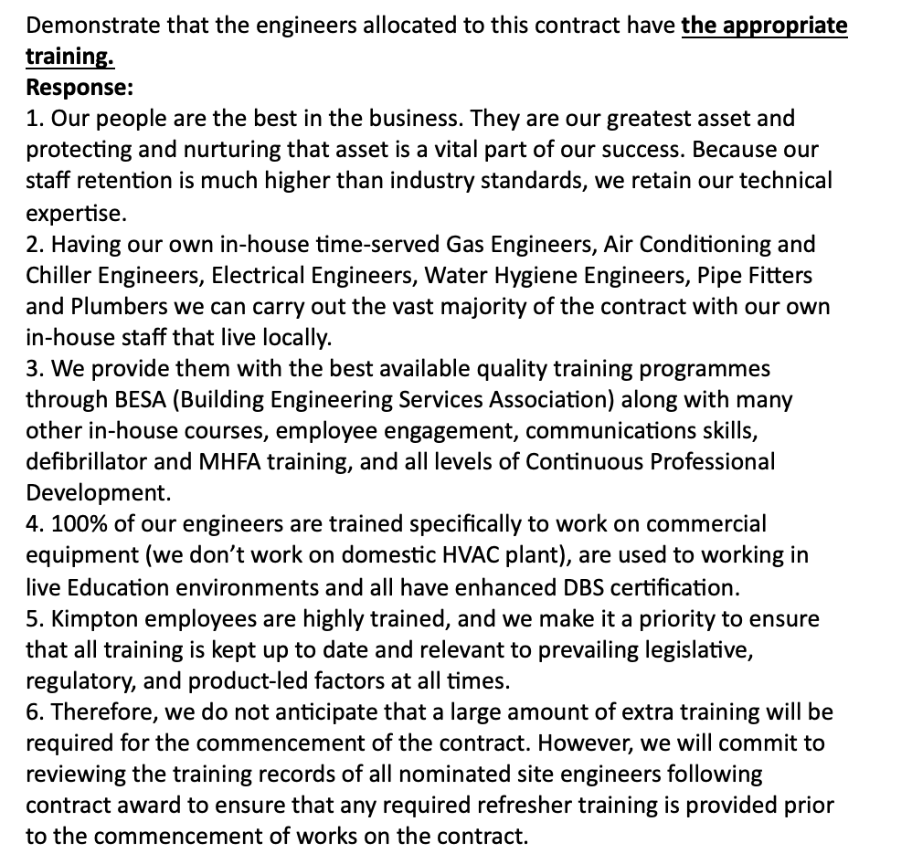
How did Kimpton write effectively and persuasively?
Success Criteria:
Used a range of persuasive features
Varied sentence types and openers
Evidence that they are appropriately trained
Notes:
Teaching staff: The resource is separate. Display instructions and allow students reading time.

Slide 14
How did Kimpton Ltd write effectively
and persuasively?
What went well?
Through the use of direct address and the collective pronouns ‘we’ and ‘our’, the writer is trying to establish a connection with the employer and create a sense of community and partnership. They’re showing their ability to work as a successful team.
Notes:
Teaching staff: Students can feedback what they discovered. Opportunity to use visualizer / smart board to annotate text together and correct any misunderstandings.

Slide 15
How could this bid be improved?
What other features could be included and why?
How could it be improved?
What other features could be included and why?
Notes:
Teaching staff: Students can feedback what they discovered and what other features could be included. Opportunity for stretch and challenge.

Slide 16
Task: You work for Kimpton and you have
been asked to write their next bid.
As an employee, you will need to write effectively and persuasively in order to secure the company’s next contract.
The Question: Provide a response outlining how you will make the school more energy efficient and help them meet their net zero goals.

Slide 17
Task: You work for Kimpton and you have
been asked to write their next bid. Your school needs to update their heating, ventilation and air conditioning systems.
Think of your school and how it requires help with their heating, ventilation and air conditioning services through using renewable technology.
You don’t necessarily need to understand the technology, but your bid needs to include persuasive language. You need to secure a contract!
In small groups, you can discuss and plan your ideas, but you’ll need to write your bids individually.
Notes:
Teaching staff: Revise persuasive features and students’ ratings. Now set students to work- can plan in small groups or write in small groups (depending on ability) or plan and write individually.

Slide 18
Task: You work for Kimpton and you have
been asked to write their next bid. Your school needs to update their heating, ventilation and air conditioning systems.
Return to your small groups and swap books.
Read your partner’s work and think about the success criteria:
Did they use a range of persuasive features effectively?
Did they vary their sentences types?
Have they used paragraphs to structure their work?

