Slide 1



Everton Football Club and
Maricourt High School & Sixth Form Centre
Careers Link – Formulas & Patterns
Spanish Lesson Plan – MFL - Key Stage 3
Created and developed by:
Maria Rodriguez: Spanish Teacher - Maricourt High School
Louise Prowse: Senior Lead - Talent & Learning - Everton Football Club

Slide 2
Spanish Lesson Plan Key Stage 3
Careers Link
When we think of Modern Foreign Languages and careers links, we often think of the most obvious, such as,
Interpreters & Translators
This lesson plan will help you and your students explore the wealth of opportunities that are available outside this area.

Slide 3
Spanish Lesson Plan Key Stage 3
Careers Link – Formulas & Patterns
Soft Skills – (transferrable skills that can be taken into the workplace)
Communication Skills - written, verbal & listening
Problem Solving
Analysis
Proof Reading
Research
Potential Careers – linked to specific lesson plan
Coding
Engineers
Data Analyst
Market Research/Insight
Social Media/ media and communications
Strategist
Programming
Accountancy
Language graduates in Everton work in the following roles:
HR (Learning and Development)
Finance
Performance Analyst
Notes:
The Concept of the curriculum is used in work via the following:
The processes used to complete the reading and writing tasks within the lesson plan challenge learners to derive meaning and nuance from written communication. The vocabulary tasks develop accuracy and proof-reading skills. The content of the lesson has an overarching theme of data analysis, pushing learners to identify patterns and deduce sequencing.

Slide 4
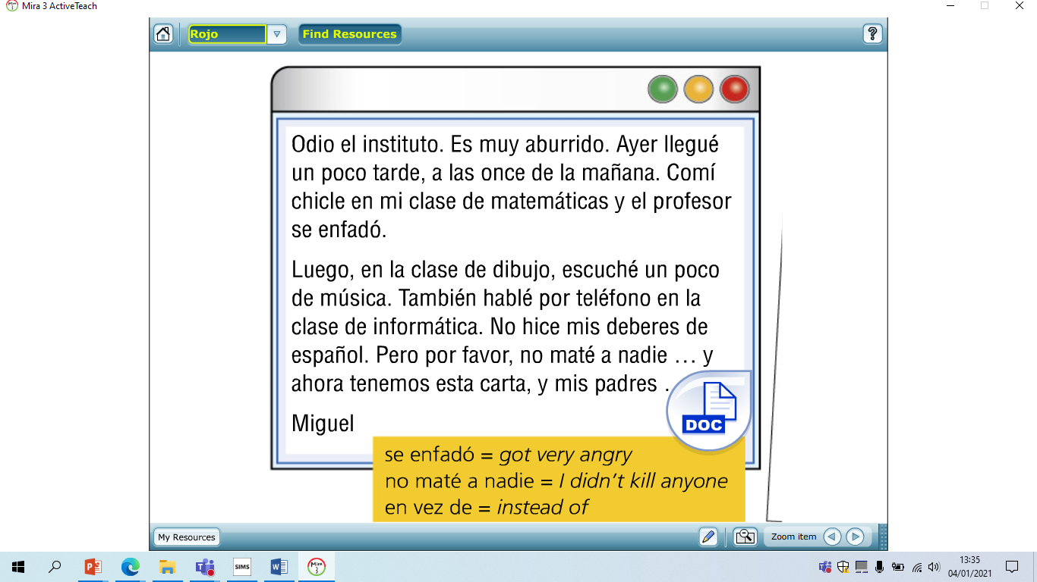


lunes el 31 de enero
Hace frio
Después del insti
Activator Prior Knowledge
LEER – Read the text and answer the questions.
What does Miguel think of school?
At what time did Miguel arrive at school?
What happened in maths?
What happened in art?
What happened in ICT?
Why is Spanish mentioned?
Se debe o no se debe?
Read through the rules and decide whether it is SE DEBE or NO SE DEBE?
Llevar joyas
Llegar a tiempo
Llevar uniforme
Llevar zapatillas de deporte
Comer chicle
Escuchar en clase
nsd
sd
sd
nsd
nsd
sd
Notes:
Reading Comprehension
By identifying key information in the text, required for this exercise students will be relying on patterns and using analytical thinking (identifying past verb endings).
Skills
You use analytical thinking to detect patterns, brainstorm, interpret data, integrate new information and make decisions based on multiple factors and options. Many careers rely on this skill for research, problem-solving and predicting trends
In order to identify patterns. These are transferable skills.
Careers/Jobs
Data Scientist
Engineering
Architecture
Social Media
Marketing & Comms
Strategists

Slide 5
Prior Knowledge: corrige el error
1. la asignaturas
2. la patio
3. vas a estudio
4. la kimica
5. el choro
Notes:
Identify Spelling Mistakes
Once students become familiar with the patterns involved, spotting mistakes will become more intuitive.
Skills
Being able to spot rules & patterns. Proof reading for accuracy.
Careers/Jobs
All employers will value accurate written communication as inaccurate and poor quality emails and documents can reflect poorly on the organisation, and even lead to financial loss or custom.

Slide 6
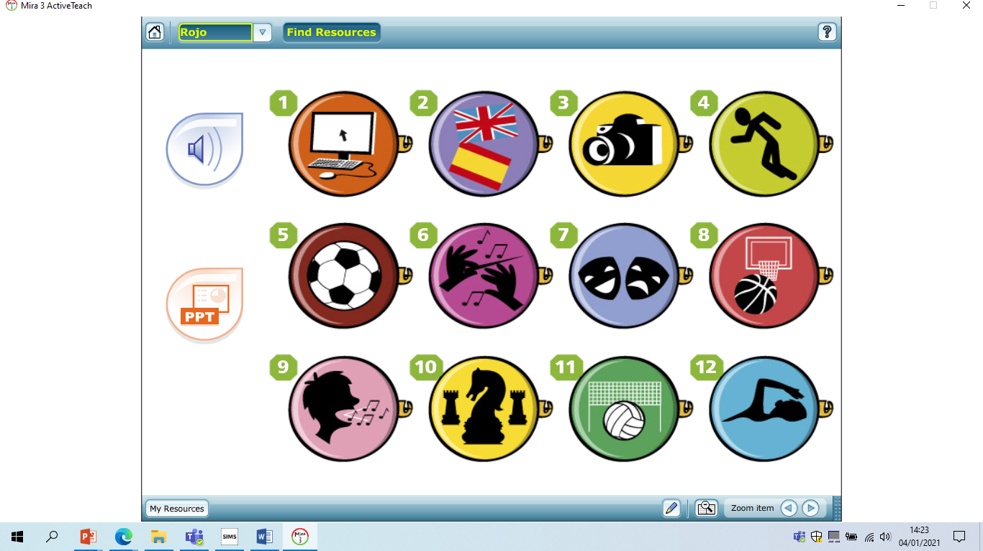
El club de informática
El club de idiomas
El club de fotografía
El club de atletismo
El equipo de fútbol
La orquesta
El teller de teatro
El equipo de baloncesto
El coro
El club de ajedrez
El equipo de voleibol
El equipo de natación

Slide 7
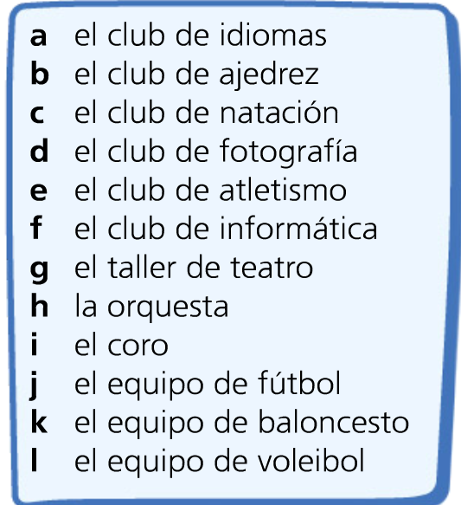

Listening
Empareja los pins con la actividad correcta.
(match the image to the correct activity 1-12)

Slide 8
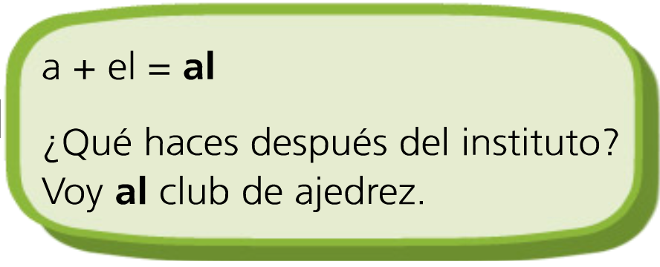
Voy a I go
Vas a You go
Va a He/she goes
Vamos a We go
Vais a You go
Van a They go
Use the above two boxes to help you translate the following;
1. I go to the language club.
2. We go to the athletics club.
3. He goes to the ICT club.
4. They go to the camera club.
Notes:
Formulating Sentences
Adhere to rules and patterns to achieve a positive outcome.
Skills
Identify and use patterns to formulate sentences.
Careers/Jobs
Programming
Coding
Scheduling

Slide 9
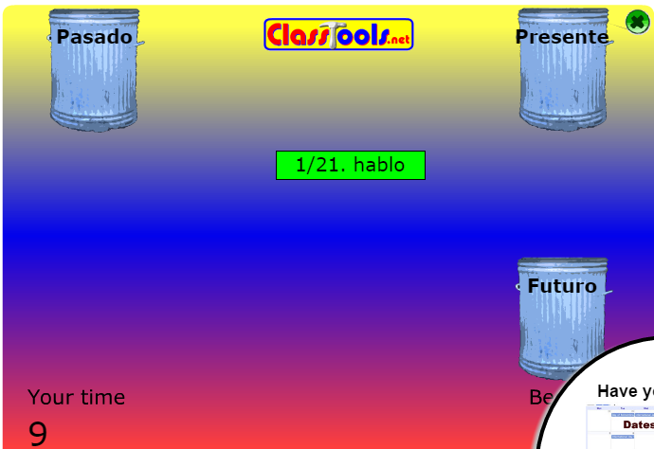
http://www.classtools.net/widgets/dustbin_7/zss6Z.htm
Ahora en pasado, presente o futuro…
Notes:
Identify Patterns
Students will quickly classify words based on verb endings. This requires attention to detail, pattern recognition and analytical thinking
Skills
Quickly identify and categorize data
Careers/Jobs
Data administration
Data analysis

Slide 10
Completa la tabla- (All in the I form)
Inglés (infinitive) | Español (infinitive) | presente | pasado | futuro
To talk |  | hablo
To sing |  |  |  | Voy a cantar
To play (sports)
To play (an instrument) | tocar |  | toqué
To go | ir
To do |  |  | hice
Notes:
Referencing
Using a verb list to identify patterns to create
Skills
Methodical formulation
Pattern recognition
Pattern analysis
Careers/Jobs
Data administration
Data analysis
Strategist
Accountancy

Slide 11
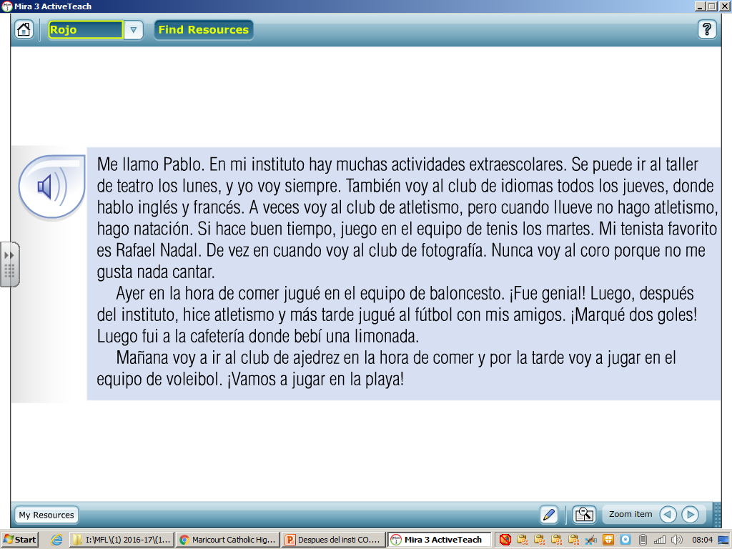
¿Presente, pasado o futuro?
Answer the questions in English:
What does he do on Mondays, Tuesdays and Fridays?
What does he do when it rains?
What does he do from time to time?
4. What does he never do?
5. What 4 things did he do yesterday?
6. What 2 things will he do tomorrow?
7. What is he excited about?
Notes:
Text Passage
Reading the passage students will identify key information and summarize what is required in order to answer the questions.
Skills
This is a useful everyday skill to condense information so we can relay this to others in a way that feels manageable. For example, giving someone a synopsis (brief summary or general survey of something) of a book or tv programme is ‘summarising in action’.
Reasons for Summarising can include:
To inform your audience who might not have read the original text you are summarizing
To support an idea you are discussing in your work
To demonstrate your understanding of the text
To establish ideas you want to discuss
Careers/Jobs
Being able to summarise information is relevant in most jobs. Summarising saves time and allows you to adjust the content and the way in which the information is delivered based on your audience, whether this be informal or formal delivery. When delivering presentations, summary and concise delivery of information is crucial.

Slide 12
Escucha y escribe los datos.
Ejemplo: Yolanda – ayer en la hora de comer – taller de teatro
Escuchar 4 p.33
Yolanda – ayer en la hora de comer – taller de teatro
- ayer después del insituto – club de atletismo
Enrique - durante el recreo – club de informática
- después del instituto – club de ajedrez
Pedro - ayer durante el recreo – club de fotografía
- ayer en la hora de comer – club de natación
Raquel - ayer en la hora de comer – orquesta
- ayer después del instituto – club de idiomas
Luis Miguel – ayer durante el recreo – equipo de baloncesto
- ayer después del instituto – equipo de fútbol
- ayer más tarde – equipo de voleibol
Notes:
Listening Task
Skills
Listening for key information or fact finding is crucial to understand and get this task correct.
Jobs/Careers
Listening Skills are required in all jobs to ensure the correct information is relayed to people in the right way, speed and context. Some obvious jobs that require listening skills are:
Sales (identifying customer need)
Counsellor
Nurse
Doctor
Teacher
Human Resources
Learning & Development
Trainer
Care Worker
People Management

Slide 13
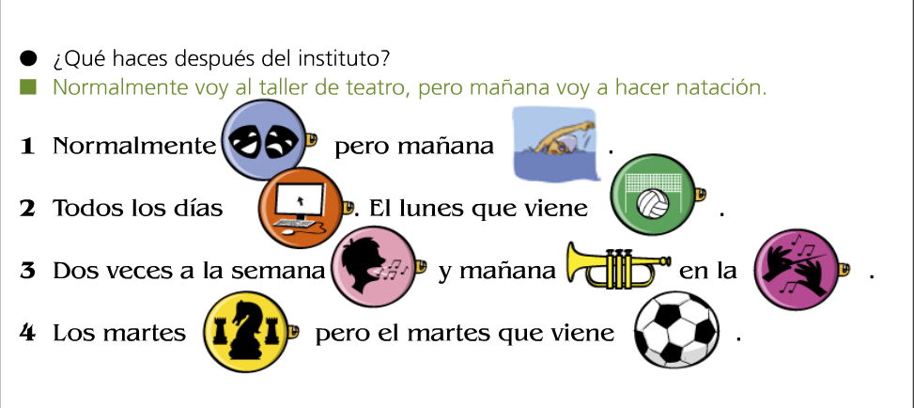
WRITING ACTIVITY 1 – REPLACE THE PICTURES WITH WORDS.
REMEMBER
☺ CHALLENGE! TRANSLATE THE SENTENCES INTO ENGLISH ☺
Notes:
Writing Activity
Skills
This task requires students to produce sentences based on formulas and by using references; it encourages problem solving. It could be classed as a puzzle.
Careers/Jobs
Coding
Programming

Slide 14
Y para terminar- un repaso
https://wordwall.net/resource/10039757

Slide 15
WRITING ACTIVITY 2 – NOW CAN YOU WRITE 3 OF YOUR OWN SENTENCES SAYING WHAT CLUBS YOU GO TO AND WHEN.
YOU CAN MAKE IT UP!

