Slide 1
Welcome
Liverpool City Region
Student Careers Champions
‘Preparing the future workforce for jobs in growth industries’

Slide 2
What is a Career Champion?
Liverpool City Region Careers Hub
Objectives of the role
You will:
Support the Careers Leader with the school careers calendar
Receive regular updates and information about your growth sector
Take part in networking and events
Opportunities to engage with employers and visit companies
Work with other career champions to complete set activities over the coming years
Share your knowledge of local labour market information with teachers, pupils and parents
Maintain your sector careers display
The benefits for you
Develop your understanding of the local economy, this will help you with your own career planning
The experience will look great on your CV!
Develop workplace skills such as: Teamwork, Leadership, Communication
Develop your qualities such as: Confidence, Reliability, Self-Motivation
Receive certificates for your record of achievement
Receive a pin badge for your blazer!
Watch the LCR Careers Champion launch video - here

Slide 3
Liverpool City Region Careers Hub
What is a Growth Sector?
A sector is another name for a professional category that describes the types of businesses that exist within it.
A growth sector is a part of an economy which experiences a higher-than-average growth rate as compared to other sectors. Their growth is a result of demand for new products or services offered by companies in the field.
The Liverpool City Region Growth Sectors are:
Advanced Manufacturing
Construction & Built Environment
Digital & Creative
Green Growth
Health & Life Sciences Maritime & Logistics
Professional & Business Services
Visitor Economy
Within each of these growth sectors exist many job opportunities!

Slide 4
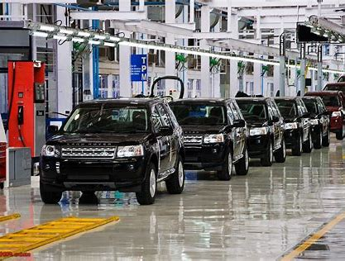
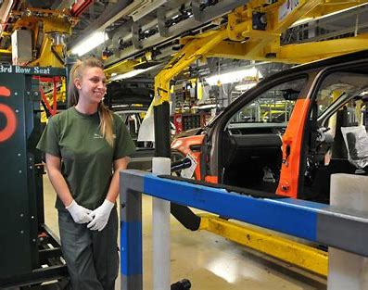
Advanced Manufacturing
Liverpool City Region Careers Hub
The Advanced Manufacturing sector includes areas such as: Automotive Manufacture; Aerospace; Pharmaceutical/ Chemical; Food and Drink; Engineering & Machining.
There are some fantastic employers to work for locally including world-renowned brands such as Jaguar Land Rover, Unilever, Pilkington, Inovyn, Astra Zeneca, Alstom, ABB Group.
What types of jobs are available?
Design & Development Engineers, Electrical Engineers, Mechanical Engineers,
Plant & Machine operatives, IT Business Analysts, System Architects,
Systems Designers
and many more.
What skills are useful to have in this industry?
Critical and Analytical thinking
Project management
Excellent attention to detail
Teamwork
ICT skills
Resilience
Patience and problem-solving
Literacy and Numeracy
STEM - Science, Technology, Engineering, and Maths

Slide 5
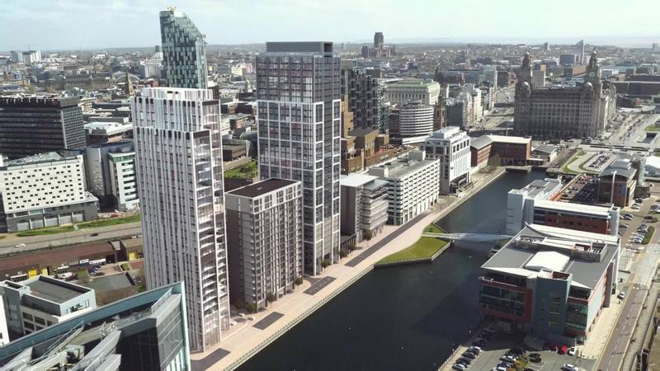
Construction & The Built Environment
Liverpool City Region Careers Hub
Construction is vital to delivering the infrastructure and buildings needed for the future growth of the Liverpool City Region.
There are some fantastic employers to work for locally including: Laing O'Rourke, Morgan Sindall Group, Graham Construction, Wates Group & many more.
What types of jobs are available?
Architects, Bricklayers & Masons, Carpenters & Joiners, Chartered Surveyors, Civil Engineers, Electricians, Glaziers, Painters, Plumbers.
What skills are useful to have in this industry?
A willingness to learn
Critical thinking and reasoning
Literacy and Numeracy
Written and Oral Communication Skills
Teamwork and working with others
Coordination
Stamina and resilience to overcome challenges
Organisational Skills
STEM - Science, Technology, Engineering, and Maths

Slide 6
Digital & Creative
Liverpool City Region Careers Hub
The Digital and Creative Sector is at the heart of the Liverpool City Region’s ambitions to be a world-leading creative and digital economy.
There are some fantastic employers to work for locally including: CNC Robotics, hi-impact, CGA Simulation, Red Ninja, Mashbo, SysGroup, Sony & Many more.
What types of jobs are available
Photographers, audio-visual and broadcasting equipment operators, Graphic Designers, Telecommunications Engineers, IT User Support Technicians, IT Business Analysts, Architects, Systems Designers & Many more.
What skills are useful to have in this industry?
Problem solving
ICT (including coding skills)
Creativity
Being able to meet deadlines and good time management
Attention to detail
Communication
Negotiation
STEM - Science, Technology, Engineering, and Maths

Slide 7
Green Growth
Liverpool City Region Careers Hub
The Green Growth Sector consists of businesses and services that provide solutions necessary to support the transition towards a low carbon economy.
There are some fantastic employers to work for locally including: Cadent (Gas) Orsted, Renewable UK, Ulemco, Siemens, Innogy and many more.
What types of jobs are available? Wind Turbine technicians, Offshore wind maintenance, Recycling, Solar PV Installation and Maintenance, Welding Trades, Engineering Technicians, Environment Professionals, Electricians and many more.
What skills are useful to have in this industry?
Problem solving
Data and analytical
Research
Planning and Construction
Team work
STEM - Science, Technology, Engineering, and Maths

Slide 8
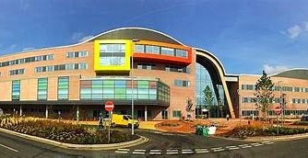
Health & Life Science
Liverpool City Region Careers Hub
Whether you’re treating poorly patients or conducting life-saving research, working in the health and care sector means you’ll be making a real difference to the lives of others.
Liverpool City Region is home to many important Life Sciences and Health orgainsations all undertaking life changing work: Novartis Vaccines, NHS, Unilever, Perfectus Biomed, Farm Urban, Redx Pharma, Astra Zenica and many more.
What types of jobs are available?
Paramedic, Dental practitioner, Doctors, Nurses, Physiotherapists, Care Worker, Midwife, Laboratory work, Chemical Engineer, Biochemist, Biomedical Science.
What skills are useful to have in this industry?
Empathy
Listening Skills
Project Management
Managing and Motivating
other staff
Communication skills
Problem solving- being creative
and finding solutions
Timekeeping
STEM - Science, Technology, Engineering, and Maths

Slide 9
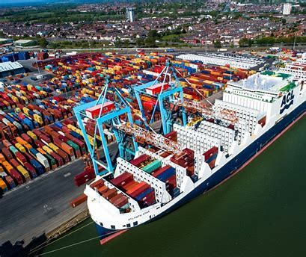
Maritime & Logistics
Liverpool City Region Careers Hub
The Maritime and Logistics sector is a key employment sector for the Liverpool City Region it's about moving people and goods over land, water, air and rail. A modern and efficient Maritime and Logistics sector is vital to support global supply chains across a wide range of other key sectors in the Liverpool City Region and beyond.
Key employers include Peel Ports; Stobart Group; TJ Morris; QVC; Liverpool John Lennon Airport; Wincanton; Stena Line, Atlantic Container Line UK Ltd.
What types of jobs are available?
Air-craft pilots, flight engineers, Shipping officers, Transport and Distribution clerks, postal workers, Large goods vehicle drivers, warehousing workers and many more.
What skills are useful to have in this industry?
Communication Skills
Problem solving
Teamwork
Organisation
Time Management
Attention to detail
Project management
STEM - Science, Technology, Engineering, and Maths

Slide 10
Professional & Business Services
Liverpool City Region Careers Hub
The Professional and Business Services (PBS) sector is a major component of the UK economy and a key growth area for the Liverpool City Region. The sector consists of financial, real estate, legal and insurance activities.
Key employers include: ARUP; Rathbones; Barclays Wealth; MAM Funds; Investec; Shore Capital; Hill Dickinson; Keppie Massie; Mott McDonald; and KPMG.
What types of jobs are available? Human Resources, Legal professionals, Accountants, Financial Managers, Call & contact centre occupations and many more.
What skills are useful to have in this industry?
Accuracy and attention to detail
English and maths
Project management
Report writing
ICT/Digital
Critical and Analytical thinking
Teamwork
Problem solving
Communication and Influencing Skills
Resilience and Motivation

Slide 11
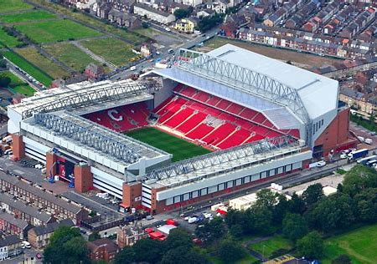
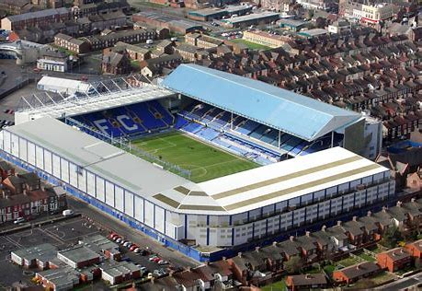
Visitor Economy
Liverpool City Region Careers Hub
The visitor economy is a major driver of economic growth and prosperity in the Liverpool City Region. The visitor economy comprises a whole eco-system made up of museums, theatres, venues, restaurants, hotels, bars, shops and transport operators.
This combination of assets makes the Liverpool City Region a great visitor attraction location.
Key employers include: John Lennon Airport,Echo Arena and BT Convention Centre, Football Clubs, Museums & Art Galleries, Aintree Racecourse and many more.
What types of jobs are available? Travel Agents, Restaurant & Hotel staff, Sales & Retail assistants, Leisure & Sport Managers,Chef, Air travel assistant and many more.
What skills are useful to have in this industry?
Good communication and social skills
Customer service
Teamwork and working with others
Resilience, patience and overcoming challenges
Reliability and Punctuality
Literacy and Numeracy
Foreign Language Skills - Bilingual or Multilingual

Slide 12
Other areas of the UK
Liverpool City Region Careers Hub
Each region in the UK has a different economic landscape and different growth sectors.
Take a look at this video showing a group of year 9 pupils talking about their local economy in the North East.
Questions to consider when watching this…
Did the pupils explain the sectors well?
Are any of the sectors in the North East the same as here within the North West?
Would your peers enjoy learning about sectors in this way?
Our Region, Your Future - YouTube

Slide 13
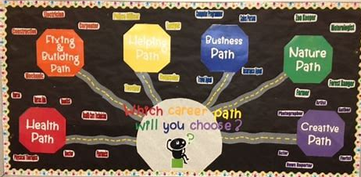
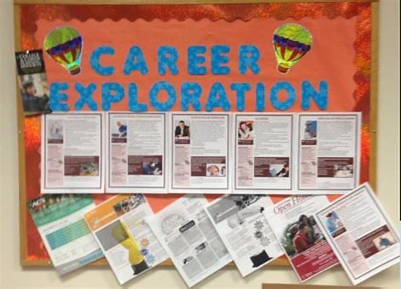
Activity 1.
Liverpool City Region Careers Hub
Design and plan a display board that will be put up in your school to help students learn about growth sectors and opportunities.
Final Designs will be displayed on a school notice board for pupils, teachers and parents to view.
Look at your Student Careers Champions workbook to help you with this
Find more activities within the Student workbook

Slide 14
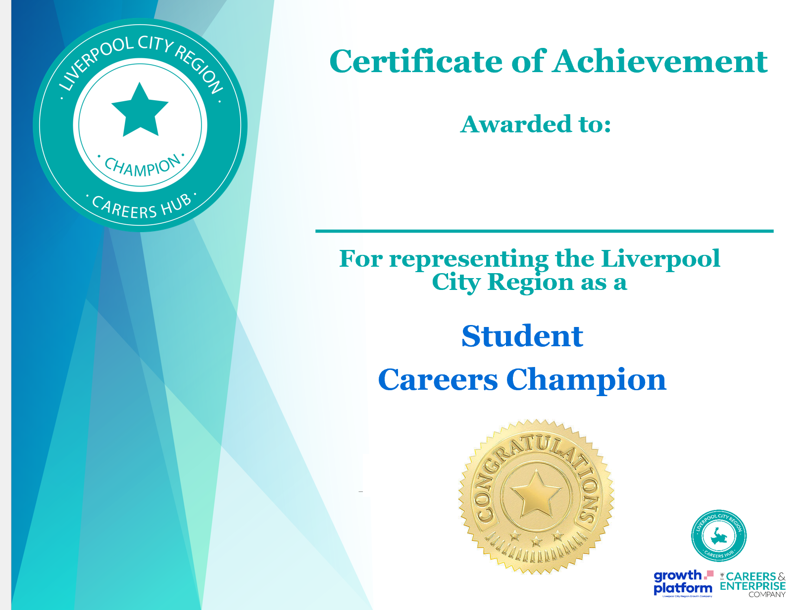
Merchandise
Certificate
Liverpool City Region Careers Hub

