Slide 1
Welcome
Liverpool City Region
Student Careers Champions
‘Preparing the future workforce for jobs in growth industries’

Slide 2
What is the Careers Champion Programme?
Liverpool City Region Careers Hub
What is the Further Education Careers Champion Programme?
The Careers Champion programme has been launched by the Liverpool City Region (LCR) Careers Hub and is designed to improve student, staff and parents understanding of labour market information (LMI) linked to growth sectors and FE curriculum areas.
A Careers Champion is a student ambassador who will represent a college curriculum area and commit to work with the tutors, wider careers team and other champions to promote specific opportunities and disseminate relevant information to the wider college population.

Slide 3
Benefits for you
Liverpool City Region Careers Hub
Benefits for the student
Opportunity to contribute towards college careers programme
Develop knowledge of career pathways and growth sectors
Build your skills and provide evidence for your CV and university/apprenticeship or job applications.
Develop key employability skills
Opportunity to extend your personal and professional network
Merchandise - Notebook/tote bag/pen/pin badge
Certificate of participation
Digital badge for CV or Linkedin
Invites to regional business events

Slide 4
What will you do?
Liverpool City Region Careers Hub
What will you do?
2 students per curriculum area.
Develop their knowledge of the local economy and growth sectors and share this information with all stakeholders
Research opportunities for training and employment in this sector and share and promote these in college
Engage with national and local careers events and activities.
Build links with employers in key sectors
Network and attend events
Complete set tasks in a workbook

Slide 5
Example activity:
Liverpool City Region Careers Hub
Design and plan a display board that will be put up in your department to help students learn about careers and opportunities.

Slide 6
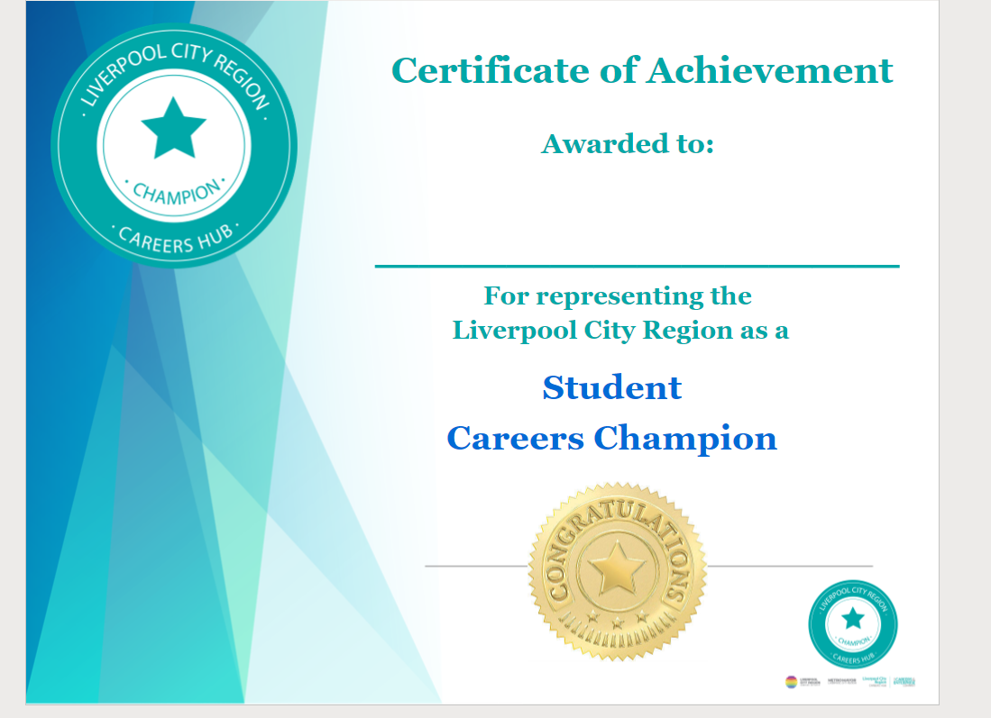
Merchandise
Certificate
Liverpool City Region Careers Hub

Slide 7
What key skills and qualities do employers look for?
Group task:
In your curriculum groups, mind map how being a Student Career Champion will help you strengthen these key skills.
Think about how this experience will help you with future employment.
Liverpool City Region Careers Hub
Problem Solving | Creativity | IT skills | Time Management
Research and Planning | Presentation | Organisation | Self - Motivation
Leadership | Teamwork | Communication | Attention to detail

