Slide 1
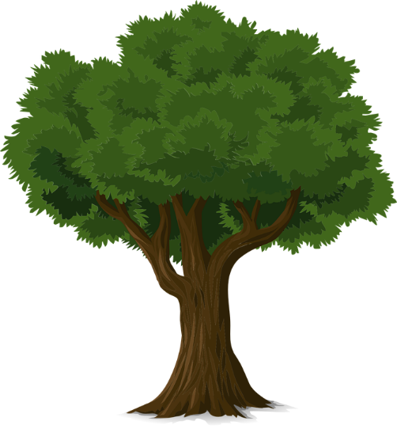
KS4 Maths Tree Project
developed in partnership with

Slide 2
THE BUILT ENVIRONMENT

Slide 3
All about me
(Add your photo))
My name is Bethany and I work in Quantity Surveying.
Within my role I manage the cost of a project throughout all the stages of design and construction and make sure a client is paying a fair amount.
The key skills I find useful for my role are good communication and negotiation skills, work well in a team, skills in excel and measuring buildings.
Education and career path
University of Reading: Quantity Surveying BSs – 2011-2014
Work experience Mace Commercial Management - 2013
Joined the Mace Graduate Scheme – 2014
Promoted to Assistant Manager – 2015
Why did I choose to go into construction? “I have always enjoyed maths and working as a Quantity Surveyor allows me to use my maths and apply it to something I can see.”
What do I like most about my role? “I like that I am able to work on multiple interesting projects and work with lots of different people.”

Slide 4
The human-made space in which people live, work, and play on a day-to-day basis
What do we mean when we say ‘The Built Environment’?
“When my placement ended, I felt incredibly motivated and eager to do all that’s necessary to work in this field of work in the near future.”
Notes:
What do we mean when we say “the Built Environment”?
If appropriate, encourage audience to raise hands and contribute ideas.
Talk through ‘more obvious’ answers – buildings, schools
Reveal definition and read it out.
Say ‘yes’, the obvious is true, but it’s also parks, stadiums, infrastructure, roads, rail etc.
Ask – “Is anyone thinking of going into a career in the built environment?”

Slide 5
Preparation and Brief
Design
Construction
Handover and In Use
Cost Consultants
Building Services Engineers
Crane Operators
Landscape Architects
Geospatial Modeller
Solicitors
Interior Designers
Electrical Engineers
3D Visualisers
CSR Managers
Skilled Tradespeople
Bid Managers
Facilities Managers
Project Managers
Environmental Advisors
Purchasing Agents
HR Managers
Geotechnical
Engineers
Quantity Surveyors
CAD Operatives
BIM Technicians
Health and Safety Advisors
Town Planners
Civil Engineers
Receptionists
Marketing and PR Managers
Land Buyers
Building Technicians
Geologists
Structural Engineers
Architects
Health and Safety Advisors
Notes:
“The first stage is preparation. This is about making sure the project is possible and can be done. This is through planning out what you would like to build, where, why and how much you have to spend.” For example, the preparation for the project we just looked at – the Shard, was key.
“The second stage is Design, many jobs came into play during these very early stages, including Designers, Engineers, Quantity Surveyors and Project Managers. The design of the shard was unique:
What do you think a Project Manager does?
Somebody who manages the whole team and makes sure everyone sticks to the plan for getting the project built.
How about an Engineer?”
“Stage three, Construction. During this time it is all about getting ready to start the construction work. So many things can be done, including demolition to flatten the land and preparing for construction to start.” This was a very challenging part of the Shard project because… “After all the stages of planning now we’re on to stage four, construction! This is where all the hard work and number of roles come together.”
“And lastly stage five, Handover and in use- this is where the finished project is given back to the client.” Management of the facility.

Slide 6
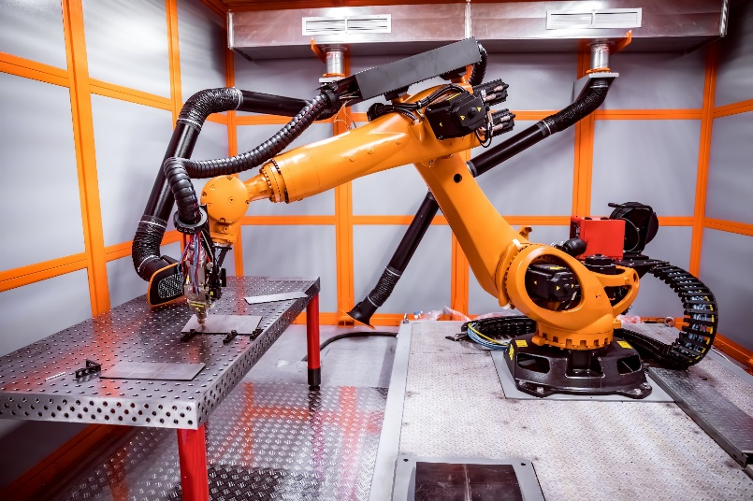
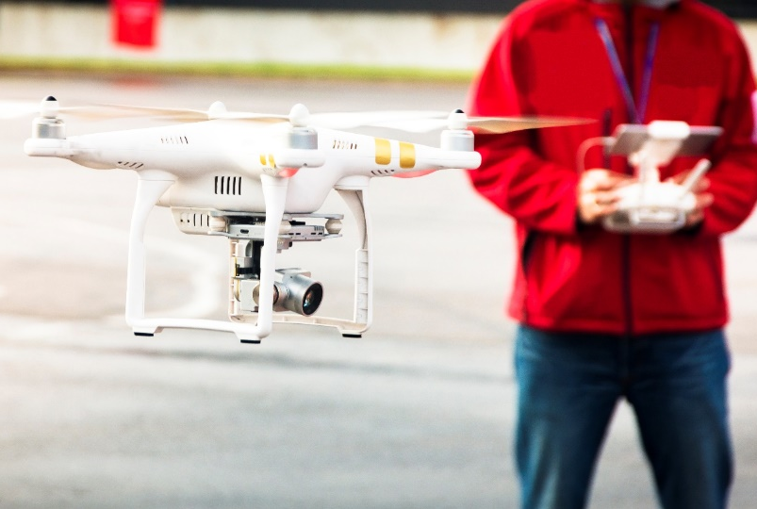
What will construction look like in the future?
Notes:
Talking Slide
And how we go about constructing this new breed of building will also be very different:
Robots will help build these blocks in factories as well as on site using 3d printing.
We already use robots to go where humans cannot: they are used for tearing down old nuclear facilities and checking for cracks inside pipes.
Virtual reality headsets will let people walk around the building before it’s even built.
Most of a building will be built off-site in factories, and then assembled in large chunks on site.
Self-driving vehicles will deliver materials to site.
We’ll use drones to survey hard-to-reach places.
People predict in the far-off future we will send robots to habitable planets ahead of humans so that they can build liveable facilities before we arrive.
And we need young people to design this new breed of building, manage the self-driving vehicles, develop these smart materials and technologies, and operate the robots and drones.
Construction is changing, and you have the opportunity to help shape its future.
Denise Chevin
Editor
020 7490 5595
denise@atompublishing.co.uk

Slide 7
It’s worth thinking about a career in the Built Environment!
“When my placement ended, I felt incredibly motivated and eager to do all that’s necessary to work in this field of work in the near future.”

Slide 8
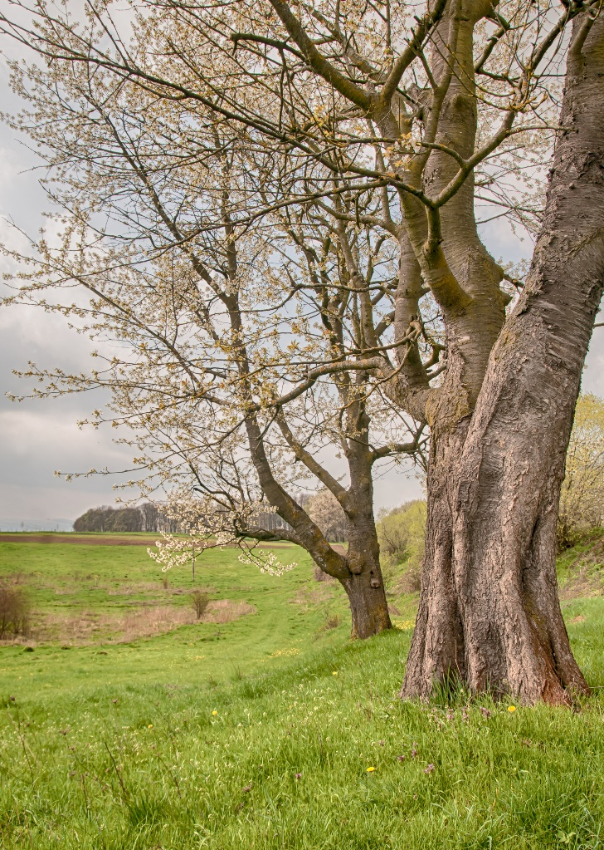
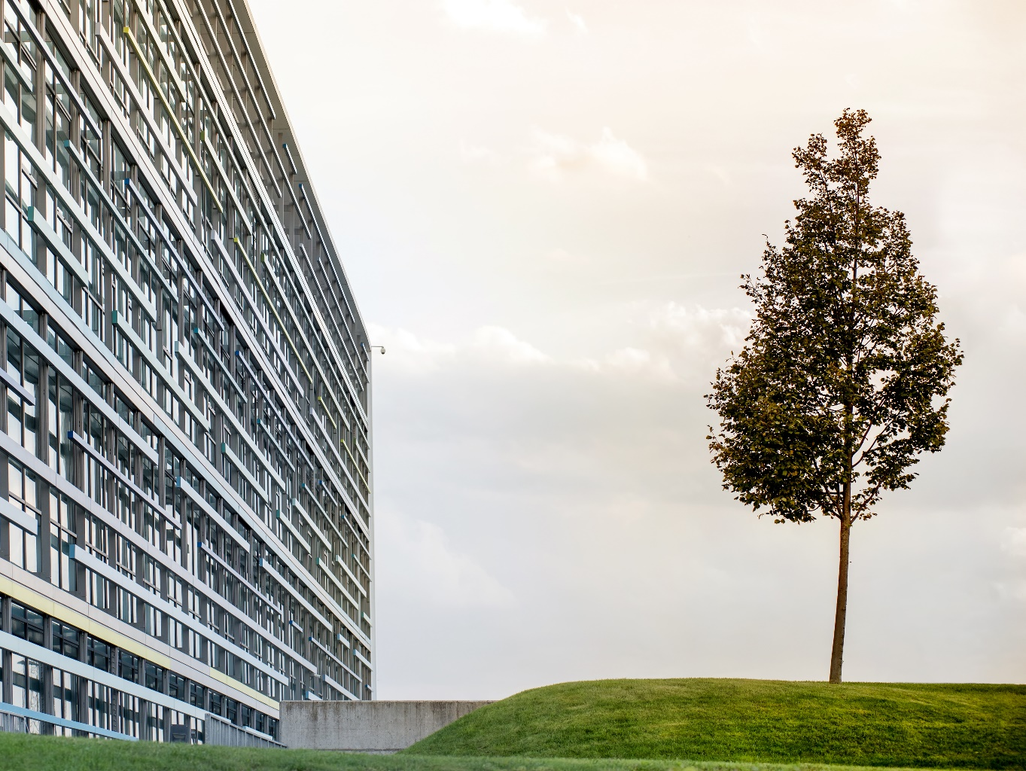
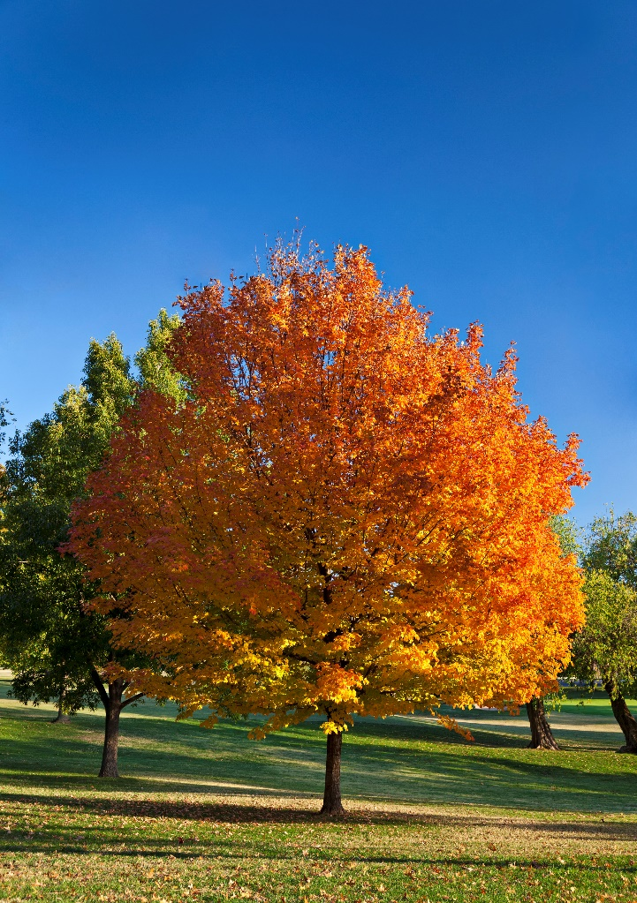
Trees
Trees

Slide 9
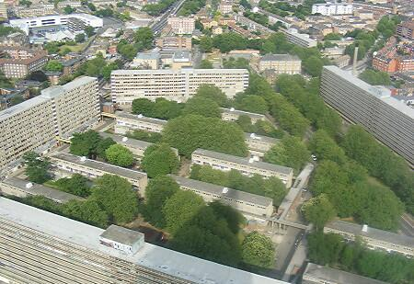
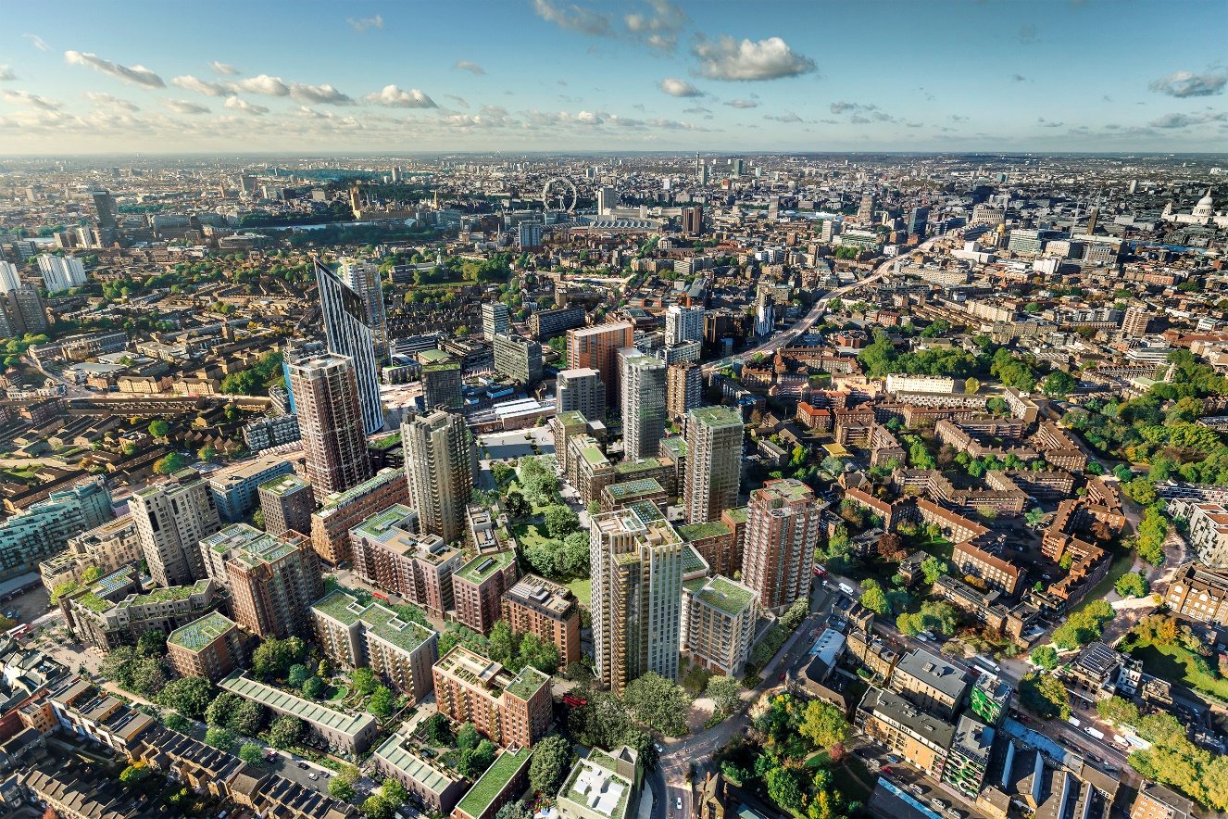
The land is being redeveloped as 'Elephant Park’. Construction started in 2014 and is due to end in 2025.
The Heygate Estate was a large housing estate in Elephant and Castle, Southwark demolished in 2012
Notes:
Introduction to set the scene on importance of trees and relationship to construction:
Have you walked past a tree on your way in today?
Original Heygate Estate (demolished 2012) – you can see that the estate contained many trees. In total, there were 406 mature trees in Heygate.
At the start of the redevelopment process, the developer considered felling (chop down) all of the trees, but following engagement with local residents (who love the trees), they agreed to keep 123 of the original mature trees, and plant as many trees as they felled on the site.
The developer has planted 900 new trees away from the site in Southwark.
Why did local residents want to keep trees in their area?
What benefits do trees bring us and why is it important to keep them around?
We will explore these questions on the next slide.

Slide 10
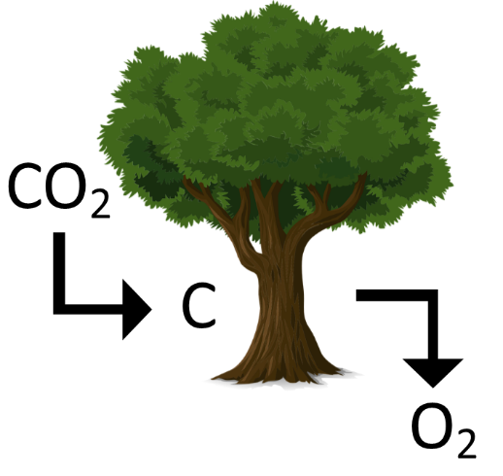
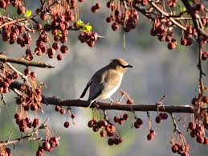
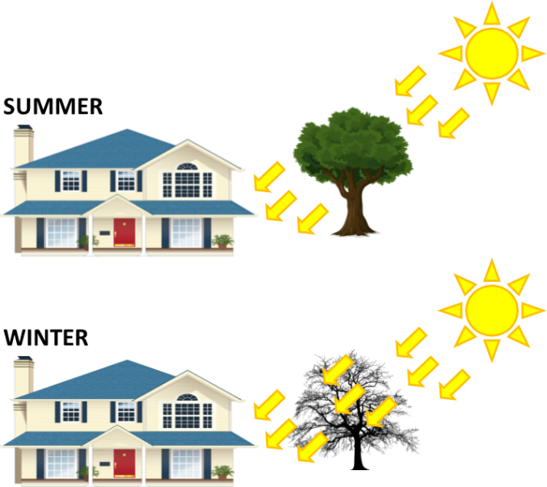
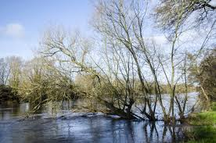
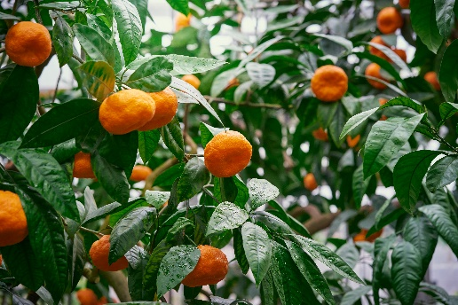
Why are trees important?
Why are trees important?
Think
Pair
Share

Slide 11
Word Bank
blocking
newly-planted
development
winds
monetary
Why are trees important…
…to construction and the built environment projects?
Trees contribute visually to a finished project. Existing and newly-planted trees can help define the character of a new development and create a ‘sense of place’.
Trees reduce energy use in buildings by blocking cold winds, therefore reducing the need for heating.
All of this means that trees provide monetary value to locations.

Slide 12
Tree expert
Job Description
Tree expert: job description
Professionals who focus on trees during construction projects are called arboricultural consultants.
Arboricultural consultants will be involved in the design phase of a project, and will help companies adhere to environmental and sustainability targets that they may have to keep to.
They will advise on any laws surrounding tree protection, and how much value trees are providing on site.

Slide 13
?
Correct the FALSE/ Improve the TRUE
Trees increase energy use in buildings by blocking cold winds, therefore increasing the need for heating.
Tree experts are called Arbo consultants
Tree experts advise on law surrounding matters to construction companies.

Slide 14
?
Correct the FALSE/ Improve the TRUE
Trees reduce energy use in buildings by blocking cold winds, therefore reducing the need for heating.
Tree experts are called arboricultural consultants
Tree experts advise on law surrounding matters to construction companies. They also state how much value trees are providing on site.
Notes:
Who knows French? Un arbre – tree
Or Spanish? Un árbol – tree
Comes from Latin - arbor

Slide 15
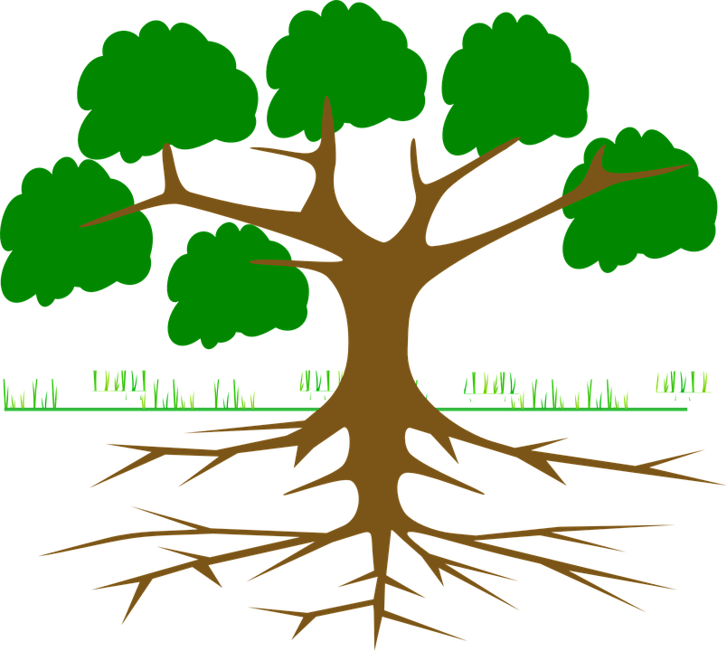
A tree’s roots and Root Protection Area
A tree’s roots draw in nutrients from the soil and stop it from falling over, so they are vital for keeping trees alive
The RPA of a tree is the (circular) amount of space that a tree’s roots take up naturally.
They need this space order to develop healthily
Notes:
For a tree around 20m tall, the roots only go 3m deep.
If too much of a tree’s RPA is encroached upon or taken away, for example during construction, then the tree will not be able to reach its full growth potential.
It is a very important role of a tree expert working on construction projects to protect the roots of existing trees and new trees on site, and to leave enough space for their roots.

Slide 16
Radius Diameter Circumference
The distance from the centre of a circle to its outer edge
The length of a line segment that passes through the centre of a circle—the circle’s exact height and width
The distance around the edge of a circle

Slide 17
This is where it gets a tiny bit complicated…
If you come across a tree in the wild and you want to work out how much space its roots take up (and therefore its Root Protection Area), you can do this using the diameter of its trunk.
This is because a tree’s Root Protection Radius is 12 x the diameter of its trunk.
But, there’s a problem.
How can we accurately find the diameter of a tree’s trunk in order to calculate this?
We don’t want to chop the tree down and measure its trunk that way.
Any ideas? What about the tree’s trunk can we measure accurately?
Notes:
ANSWER – Measure the circumference of the tree’s trunk, then use Pi to calculate the diameter.

Slide 18
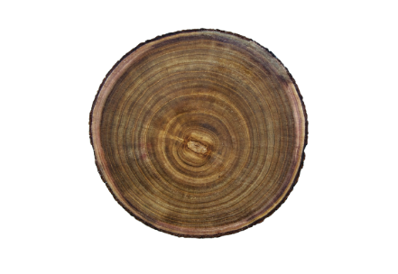
ROOT PROTECTION RADIUS (RPR)
Diameter of tree
X 12
Radius of RPA
=
The RPR of a tree is the amount of space that a tree’s roots need in order to develop healthily.
Notes:
Intro via scenario – if you don’t know how much space a tree’s roots take up, and you want to work it out, this is how you do it.

Slide 19
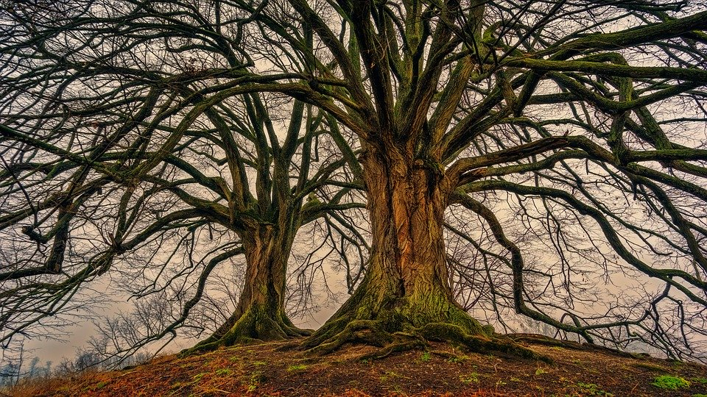
Example
Workout the root protection radius (RPR) of this tree using the calculation:
RPR = Diameter x 12
1.7m
20.4m

Slide 20
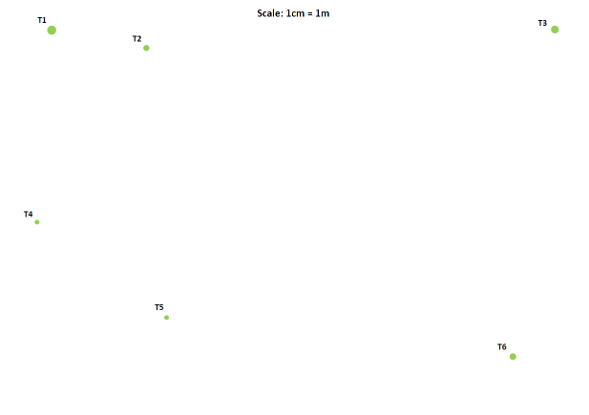
Task – Tree Expert
You will be given an aerial plan of a proposed site for development. On the proposed site, there are 6 trees.
Your aim is to work out the developable area of the proposed site.
The non-developable area of the site will be within any of the trees’ RPAs, or near to the roads.
Notes:
Hand out worksheet + site plan

Slide 21
The build project
HOW TO DRAW ON THE TREES’ RPAs
Use the table handout to find the radius of the RPAs
With a compass, measure out the length of the RPAs’ radiuses and then draw out the RPA for each tree, placing the point of your compass in the centre of the tree.
The RPA for one tree may overlap the RPA of another tree.
Be careful using compasses.
Shade in undevelopable area.
Your RPAs should look similar to this:
RPA
T1

Slide 22
Answers
Tree | Circumference (m) Physical measurement from trees To 2 decimal places | Diameter (m) (Circumference ÷ 3.14) To 2 decimal places | Radius of Trees’ RPA (m) (Diameter x 12) To 1 decimal place
1 | 1.98 | 0.63 | 7.6
2 | 1.32 | 0.42 | 5.0
3 | 1.70 | 0.54 | 6.5
4 | 1.13 | 0.36 | 4.3
5 | 1.00 | 0.32 | 3.8
6 | 1.44 | 0.46 | 5.5

Slide 23
The build project
Now you can plan out what you want to put on your developable area.
Choose from the following list of buildings/structures to install on your site plan.
They are all rectangular.
4-bedroom house – 13m x 17m
Skate park – 25m x 9m
Block of flats – 22m x 8m
2-bedroom house – 13m x 12m
Multi-use games area – 19m x 9m
Garage unit – 5m x 5m
Remember that your planned build projects cannot touch any of the trees’ RPAs.
You will have to make choices as you cannot fit everything in to your developable area.

Slide 24
Routes into this sector
Routes into this sector
Local courses:
Myerscough College: https://www.myerscough.ac.uk/
Courses available at both Croxteth and Preston campuses.
Courses available across the country:
Merrist wood: https://www.merristwood.ac.uk/Home.aspx
Caple Manor: https://www.capel.ac.uk/
Tree Life: https://www.treelifeac.co.uk/training

Slide 25
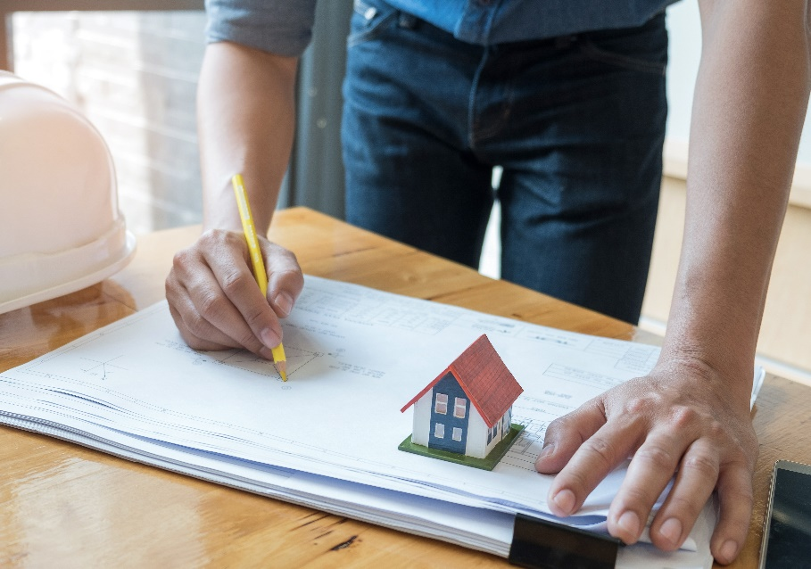
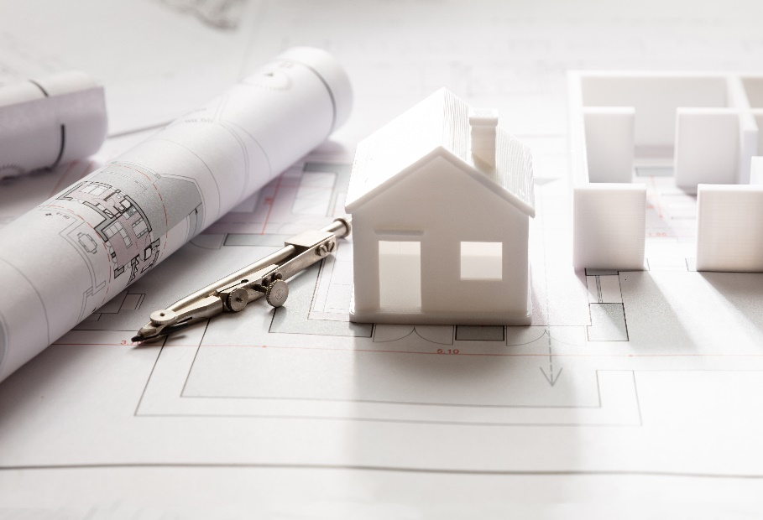
Questions to consider
Why do we need to protect the roots of the trees?
What implications can this have on the size of potential houses being built?
Would this mean less houses could potentially be built in an area where there are many large trees?
How would this affect community needs and projects?
How would this affect future investments in an area where development is needed?
Should all trees be protected?

Slide 26
Treezilla
Treezilla
“THE MONSTER MAP OF TREES”
https://www.treezilla.org/

