Slide 1
National Apprenticeship Week 2022 Liverpool City Region Cornerstone Employers
Housekeeping Cameras and mics off
Ask questions via the chat box
Ask as many questions as you’d like!
Twitter @LCRCareersEnt
TikTok lcr_careers_hub

Slide 2
National Apprenticeship Week 2022
7th – 11th February with Cornerstone Employers
Monday 7th February @ 10am ASK - What is an apprenticeship? | Tuesday 8th February @10am Housing Sector | Wednesday 9th February @ 10am Engineering/ Rail Sector
Thursday 10th February @ 10am Green Skills | Friday 11th February @10am Construction/ STEM Sector – Including Women into engineering construction | Times: All sessions are between 45 mins to 60 mins: 10:00am-11:00am. Join the session at any time - we appreciate that lesson times vary. Teacher notes: Although this is focused on Years 11 and 13, all year groups are welcome to join us and listen to apprentices from Liverpool City Region share their experiences. Click this Zoom link to join all sessions Meeting ID: 895 4186 1077 Passcode: 473082

Slide 3
National Apprenticeship Week 2022
7th – 11th February with Cornerstone Employers: Pre work and useful links
What’s the difference between T Levels, Traineeships and Apprenticeships? - Click here The Learning Foundry - Click here Jamie-Leigh’s journey from school to trainee to apprentice - Click here Rory’s story as a trainee - Click here We Are The Learning Foundry: not like school or college - Click here | The Regenda Group - Education, Training and Careers - Click here The Sovini Group Careers - Click here | United Utilities Apprenticeships - Click here Alstom Careers - Click here
United Utilities Apprenticeships - Click here Keepmoat Homes Apprenticeships - Click here | Jaguar Land Rover Careers Apprentices - Click Here EFT Group Ltd Apprenticeships - Click here United Utilities Apprenticeships - Click here | The Pay Index helps students, professionals, educational institutions and businesses make informed decisions by providing transparency and analysis through its salary comparison reporting tool. Their up-to-date market data and cutting-edge software puts important salary and career prospect information into the hands of those who need it. The Pay Index for Colleges and Students - Click here The Pay Index - Sign up here

Slide 4
Introduction to Housing Sector
10.00 am Welcome
10.05 am Introduction to 2 Businesses:
The Regenda Group
The Sovini Group
10.20 am Meet the Apprentices
10.50 am Q & A Session
11.00 am Finish

Slide 5
A career that will change lives

Slide 6
Who we are!
The Regenda Group
We regenerate places and create opportunities for people
We work in places where we can make a difference.
We operate across the housing and construction sector, in care and support, and in education, training and careers.
At The Sovini Group:
We believe in providing good quality, affordable homes for rent and to buy, helping to create thriving and inclusive communities.
We create opportunities and change lives through collaboration.
Notes:
Number of employees
Number of companies- what they are?
Number of roles
Best companies – accolades
Number of homes
Number of apprentices

Slide 7
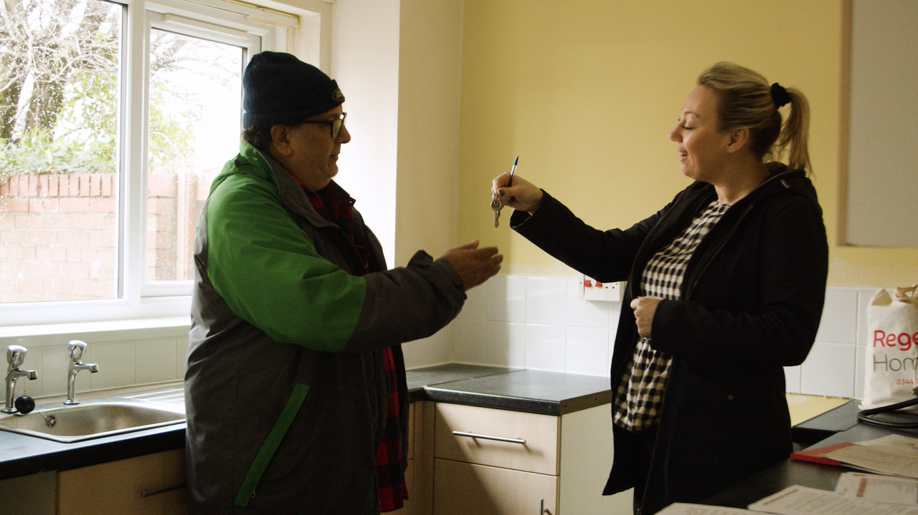
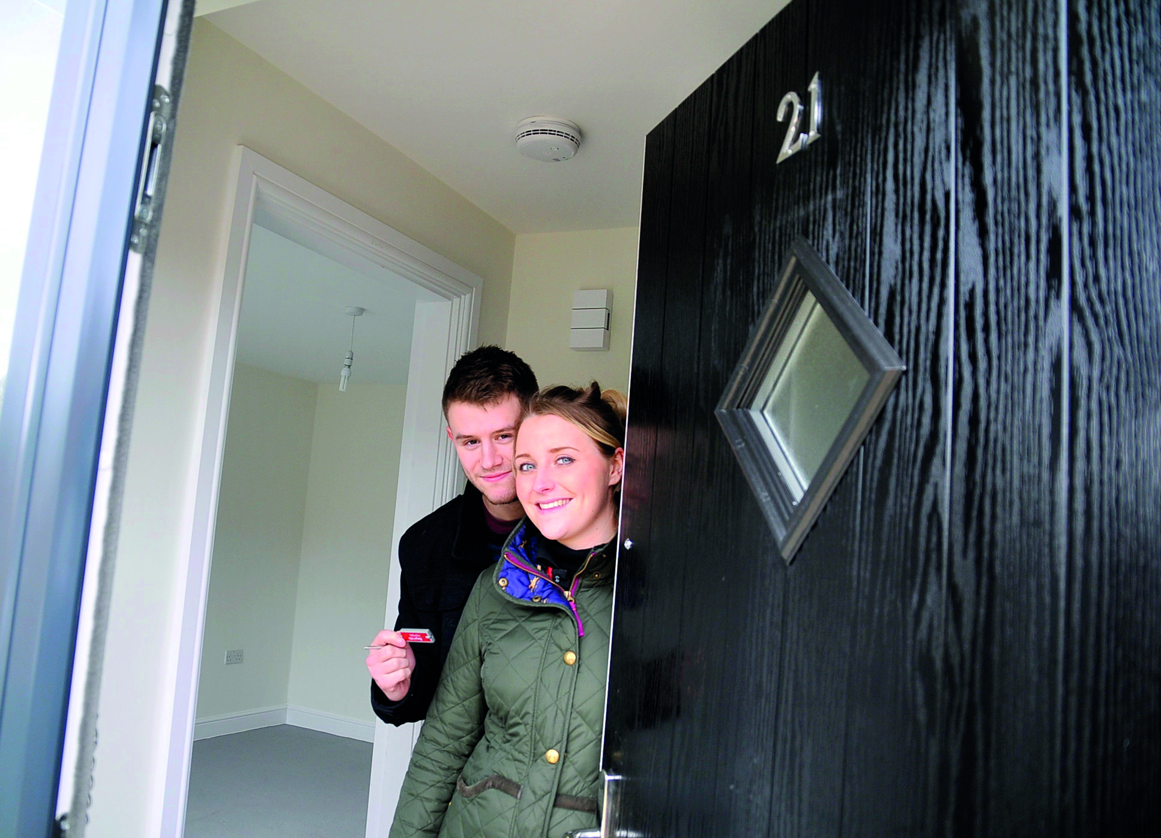
What is Social Housing?
Social housing is there for people that need it.
Social homes provide affordable, secure housing option for people across the country
Housing is provided by housing associations or a local council.
We provide homes that:
Are more affordable than private renting
Provide more secure, long-term tenancies
Notes:
(not-for-profit organisations that own, let, and manage rented housing- like Regenda and Sovini)

Slide 8
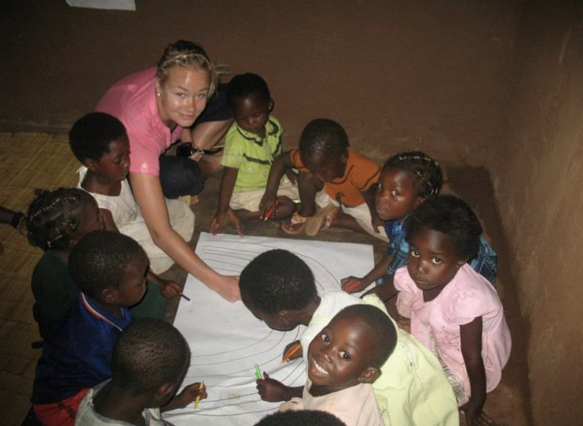
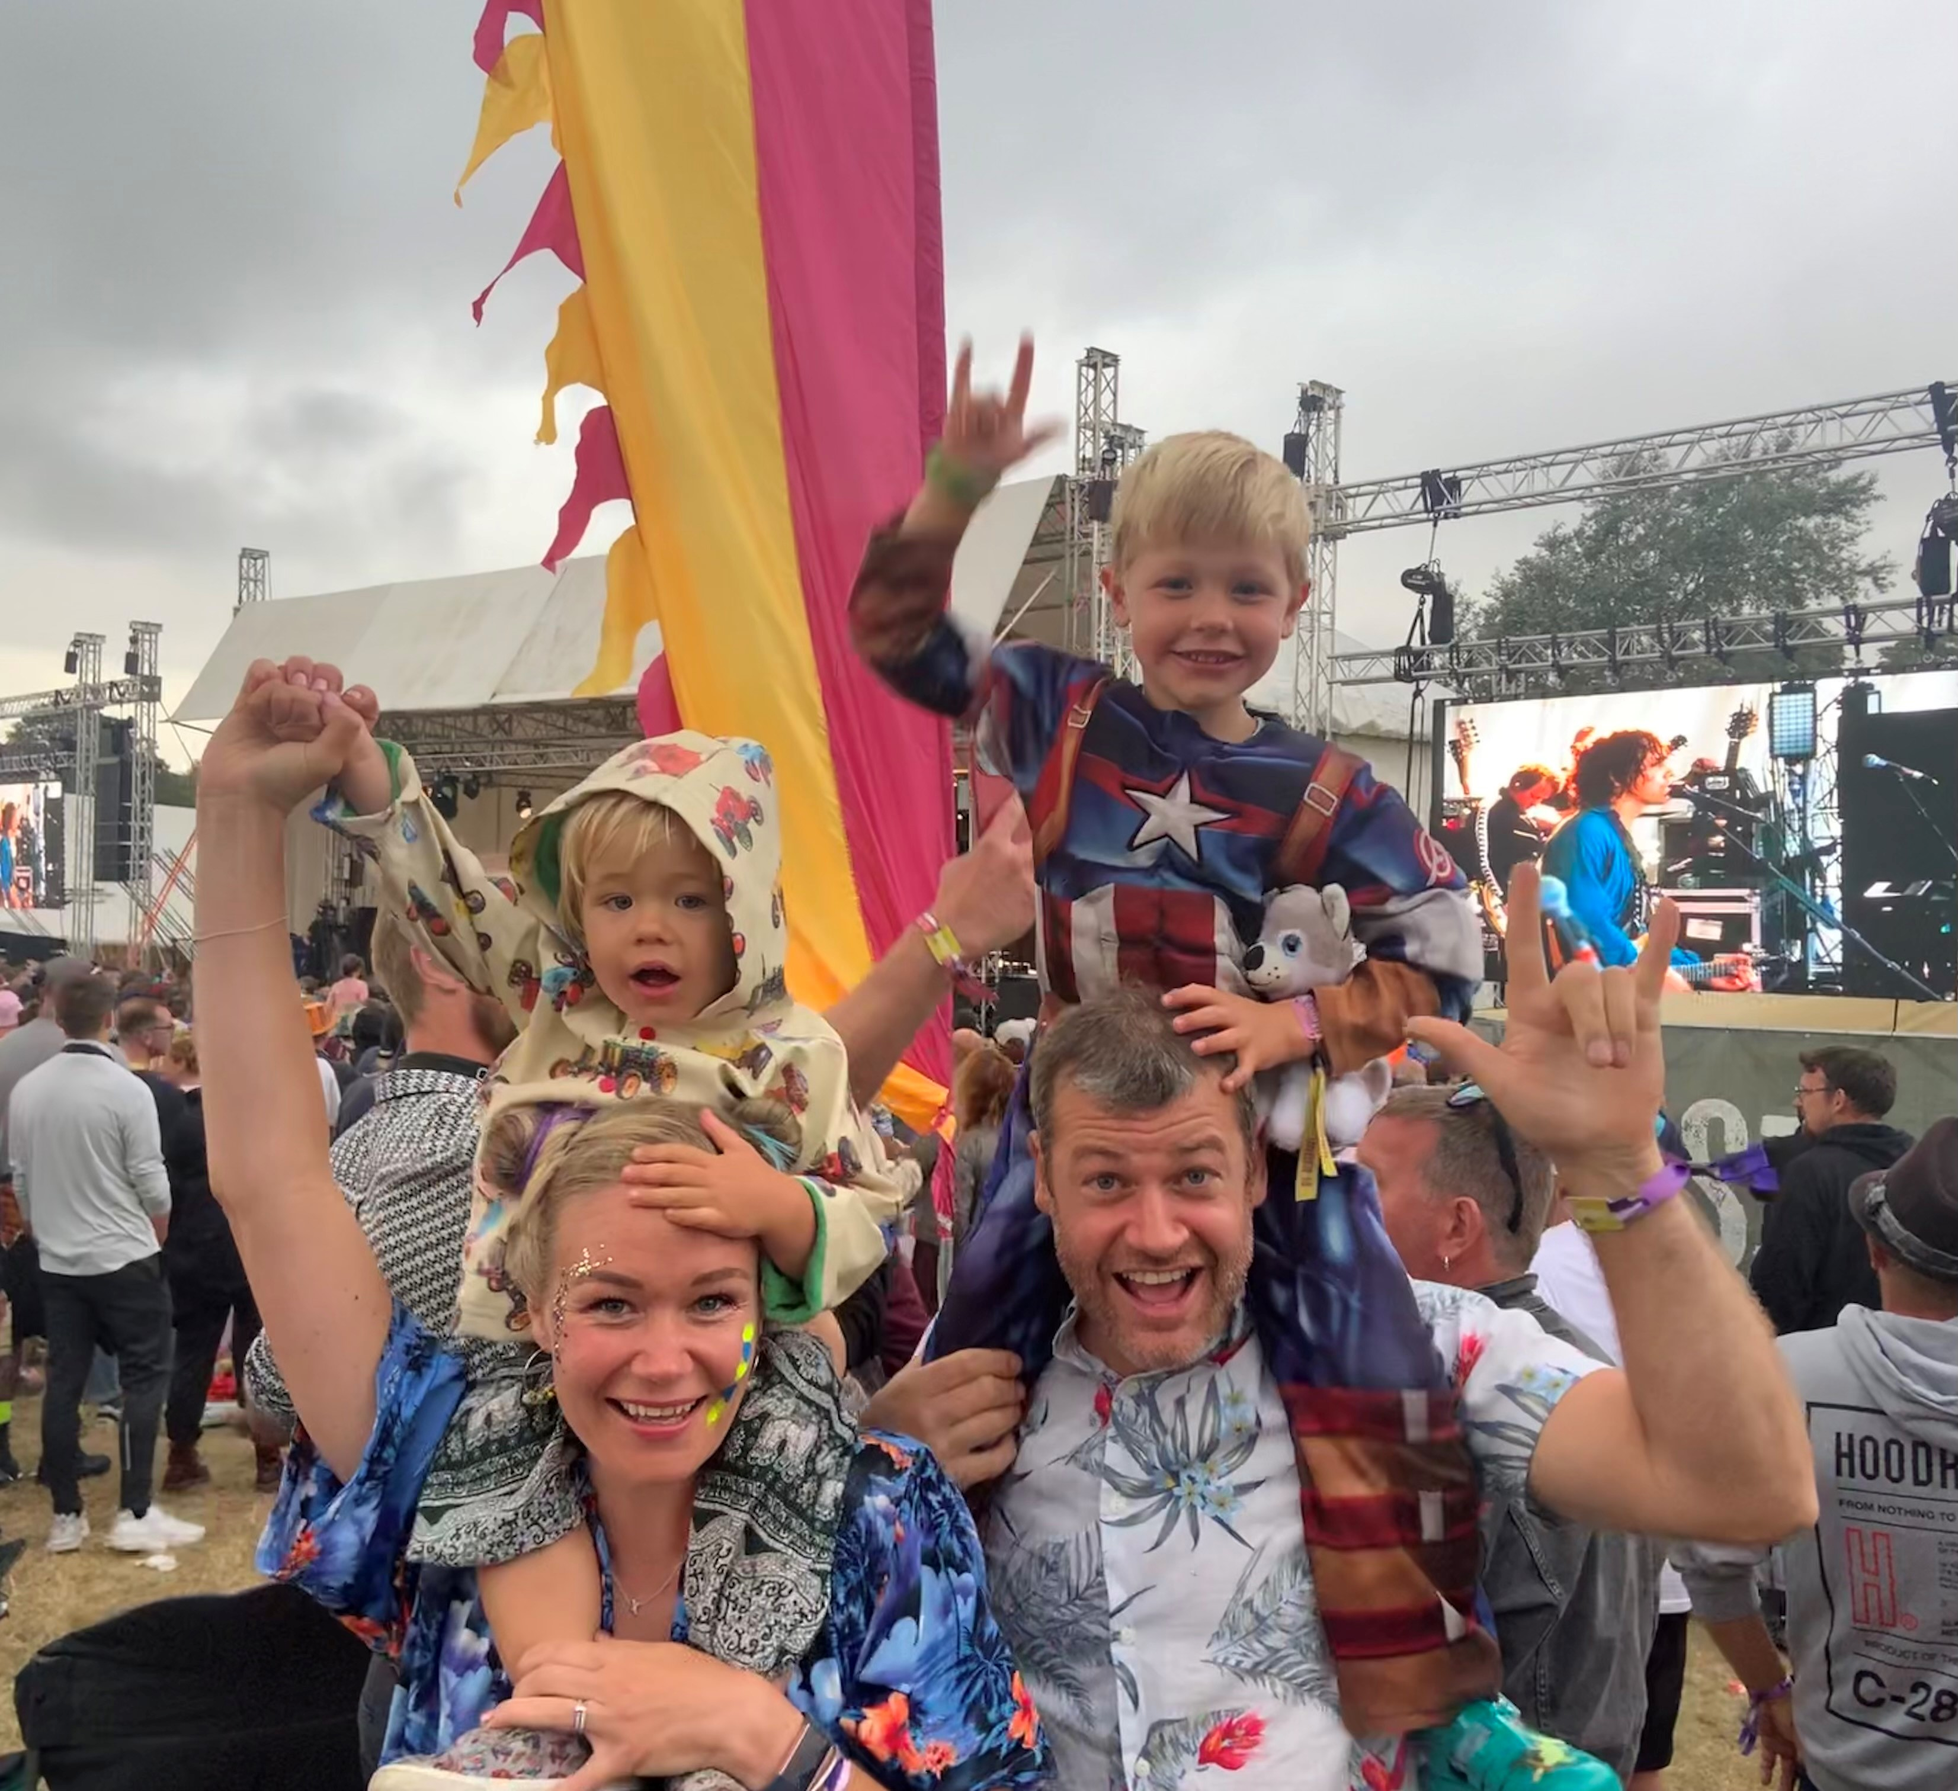
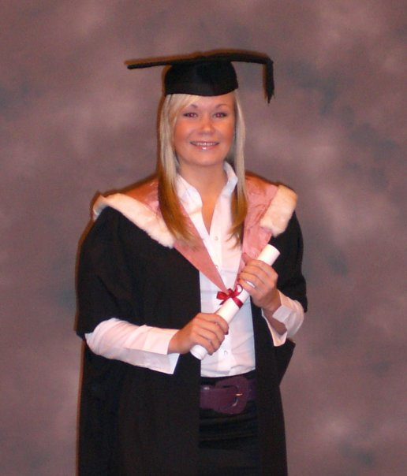
Our stories
Danielle – Head of Learning and Development
Christina- Learning and Development Manager
Notes:
Our journey!
What brought us to housing
It’s a good place for anyone to start!
Offers career progress, rewards and great people.
Skills can transfer to any other role.
Learn how people live and how to communicate.
Everyone is willing to help.
You will always be learning.
I DID A DEGREE, CIH L3 AND NOW MASTERS IN HR!

Slide 9
Meet our Apprentices!
Lauren Bundu
People and Learning Assistant
The Regenda Group
Tracy Lin
Bilingual Housing Assistant
Pine Court Housing Association
Susie Muholland
Digital Content Apprentice
The Regenda Group
Jamie Leigh
Digital Content Apprentice
The Regenda Group
Notes:
Introduction- who you are and your journey (career) so far!
1. What is an apprenticeship?
2. Why do you love/ did you love, being an apprentice?
3. How do I find out more?
4. Why should I sign up ?

Slide 10
Love the sound of a career in Housing?
Speak to The Learning Foundry.
The Learning Foundry are part of the Regenda Group and can provide information, advice and guidance on apprenticeships and more.
Their email address is workforce@thelearningfoundry.co.uk or call the team on 0300 123 8088.
Notes:
Need a link for info to be shared following this.

Slide 11
Questions?

