Slide 1














National Apprenticeship Week 2022
Liverpool City Region
Cornerstone Employers
Housekeeping
Cameras and mics off
Ask questions via the chat box
Ask as many questions as you’d like!
@LCRCareersEnt
TikTok @lcr_careers_hub

Slide 2



National Apprenticeship Week 2022
7th – 11th February with Cornerstone Employers
Monday 7th February @ 10am ASK - What is an apprenticeship? | Tuesday 8th February @10am Housing Sector | Wednesday 9th February @ 10am Engineering/ Rail Sector
Thursday 10th February @ 10am Green Skills | Friday 11th February @10am Construction/ STEM Sector – Including Women into engineering construction | Times: All sessions are between 45 mins to 60 mins: 10:00am-11:00am. Join the session at any time - we appreciate that lesson times vary. Teacher notes: Although this is focused on Years 11 and 13, all year groups are welcome to join us and listen to apprentices from Liverpool City Region share their experiences. Click this Zoom link to join all sessions Meeting ID: 895 4186 1077 Passcode: 473082

Slide 3

National Apprenticeship Week 2022
7th – 11th February with Cornerstone Employers: Pre work and useful links
What’s the difference between T Levels, Traineeships and Apprenticeships? - Click here The Learning Foundry - Click here Jamie-Leigh’s journey from school to trainee to apprentice - Click here Rory’s story as a trainee - Click here We Are The Learning Foundry: not like school or college - Click here | The Regenda Group - Education, Training and Careers - Click here The Sovini Group Careers - Click here | United Utilities Apprenticeships - Click here Alstom Careers - Click here
United Utilities Apprenticeships - Click here Keepmoat Homes Apprenticeships - Click here | Jaguar Land Rover Careers Apprentices - Click Here EFT Group Ltd Apprenticeships - Click here United Utilities Apprenticeships - Click here | The Pay Index helps students, professionals, educational institutions and businesses make informed decisions by providing transparency and analysis through its salary comparison reporting tool. Their up-to-date market data and cutting-edge software puts important salary and career prospect information into the hands of those who need it. The Pay Index for Colleges and Students - Click here The Pay Index - Sign up here

Slide 4
Introduction to Green Skills
Welcome
Introduction to 2 Businesses:
    Keepmoat Homes
    United Utilities
    Meet the Apprentices
Finish

Slide 5

GREEN JOBS AND SKILLS IN HOUSEBUILDING
NATIONAL APPRENTICE WEEK 10.2.22 10am

Slide 6
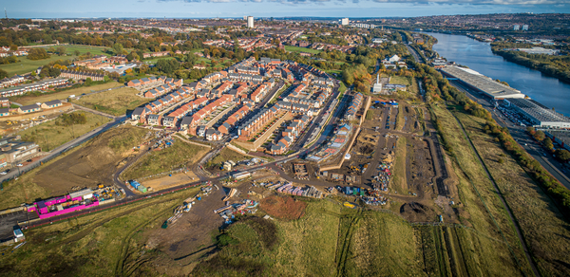
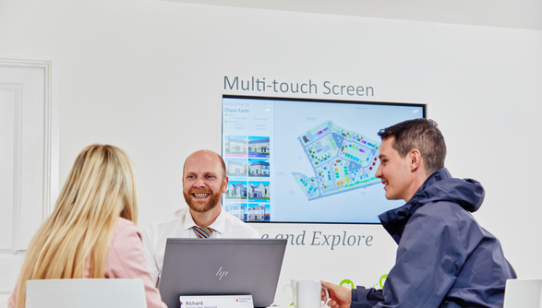

Buy land
Design houses and places
Build them
Sell them
National Apprentice Week
What do ALL housebuilders do?
FOR SALE

Slide 7
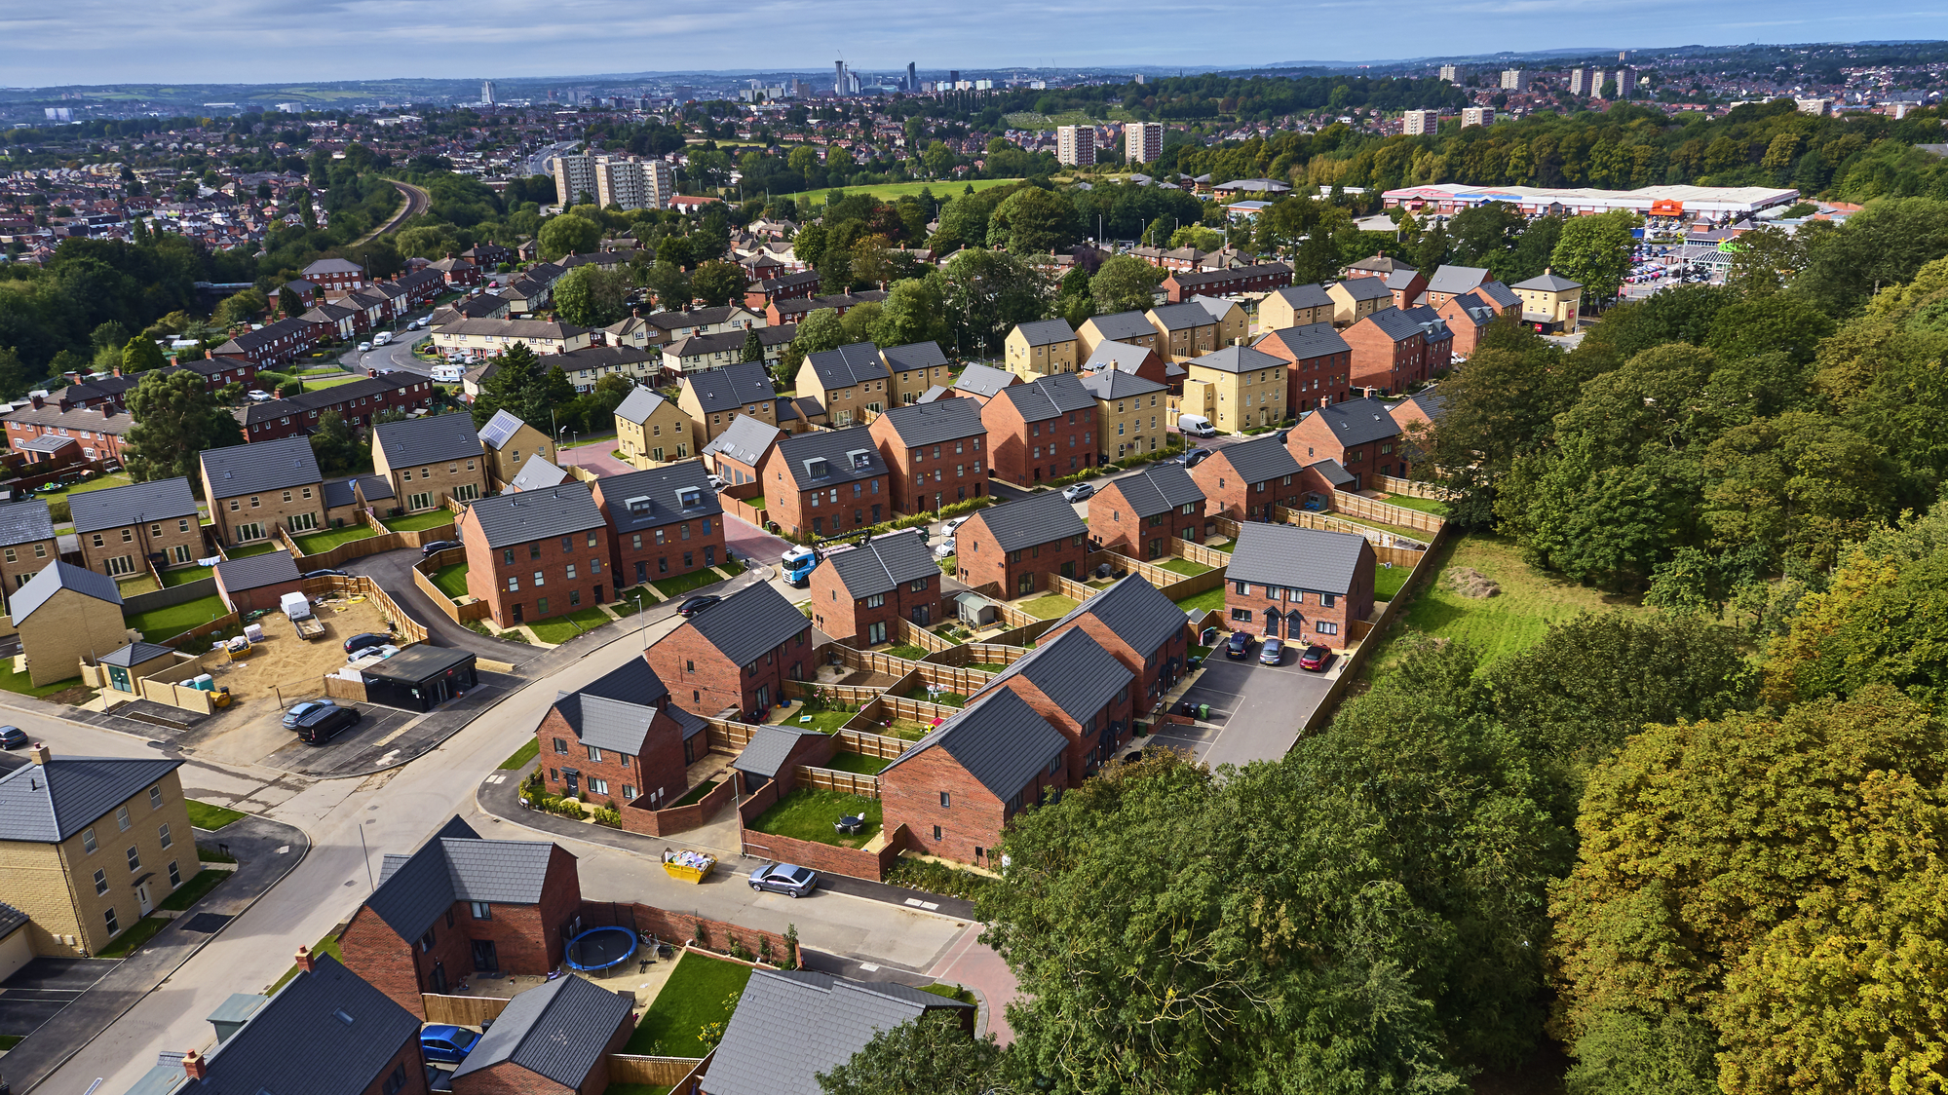
HOW KEEPMOAT BUILDS HOUSES
National Apprentice Week
WE BUY CHEAP LAND THAT’S BEEN BUILT ON BEFORE
WE WORK TOGETHER WITH LOCAL COUNCILS TO PROVIDE WHAT THE AREA NEEDS
Building Communities. Transforming Lives.
WE SELL HOMES AT AFFORDABLE PRICES IN THOSE IMPROVED PLACES
LIKE JOBS, OPPORTUNITIES, A MORE PLEASANT ENVIRONMENT

Slide 8








National Apprentice Week
Keepmoat homes
5*
HBF Customer Satisfaction
£165,000
Average sale price
We get the job done in the most efficient and effective way. We are friendly, open and honest.
We care about what we do. We put pride and energy into delivering results.
We work together in partnership to deliver the very best customer experience. Partnership working is key to our business.
We are proactive, flexible and resourceful. We listen, learn and deliver solutions.
4,035
Homes completed
FY19
70%
Brownfield

Slide 9



National Apprenticeship Week
Green jobs AND SKILLS
‘New’ jobs
Heat pump installer
Electric car charger installer
Existing jobs greened
Land buyers/ bidders
Builders
Sustainability / social value jobs
Ecologists
Technical designers
Materials
buyers
HR
Finance
???
Changes in housebuilding
Basically everything!
Homes 30% greener from NOW
Positive impact on nature from 2023
Homes 80% greener from 2025
c.15m old homes greened by 2030
(huge green building jobs demand)
ENTIRE UK ZERO CARBON BY 2050

Slide 10
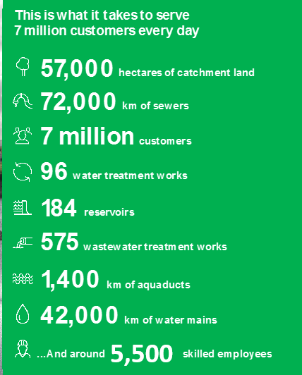



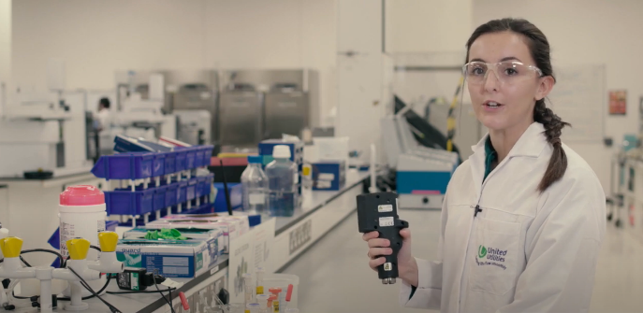



Who are United Utilities?
We are responsible for the water and wastewater services across the North West of England. We provide an essential service to our customers across the region, whilst being at the forefront of tackling some of the biggest climate and environmental challenges in a generation. All our people are essential in achieving our net zero targets and creating a more resilient North West.
As an apprentice, you will not only be a part of the 7th ranked most Inclusive UK Company as awarded by Inclusive Companies, but you could also be working towards an Ofsted awarded apprenticeship programme. Our employees rated us 4.5/5 on glass door, we really are a fantastic place to work.
Hear what our CEO Steve Mogford has to say about a career at United Utilities.
We’re more than just a water company. Check out all the amazing facilities we have available!

Slide 11
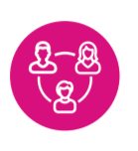
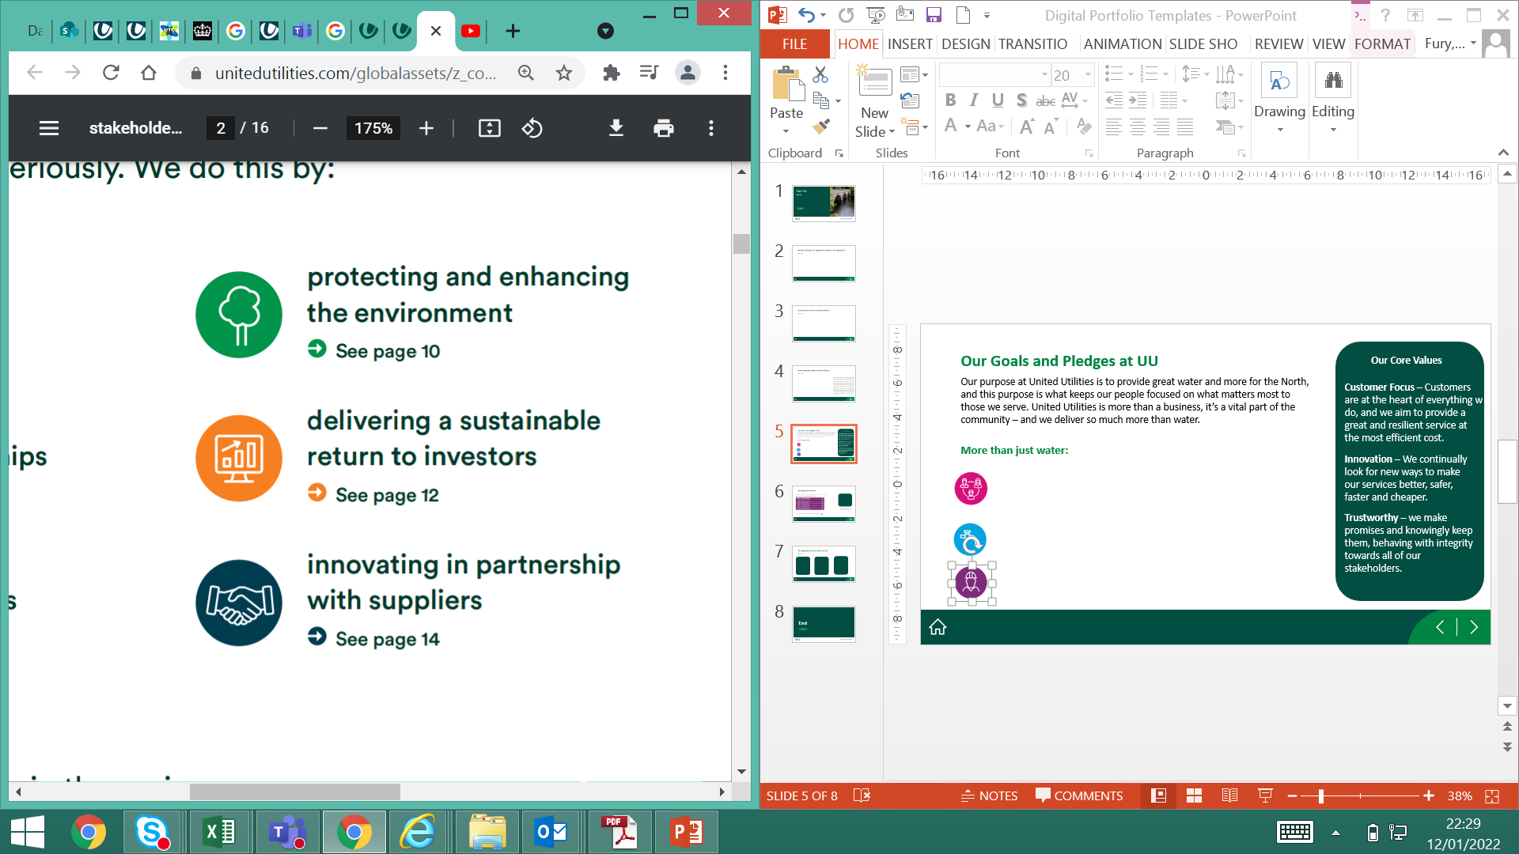
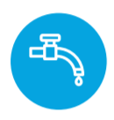
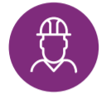
Our Goals and Pledges
Our purpose is ‘to provide great water and more for the North West’, and this purpose is what keeps our people focused on what matters most to those we serve. United Utilities is more than a business, it’s a vital part of the community – and we deliver so much more than water, including all of our fantastic work to make sure that the North West is greener, healthier and stronger.
Our core values
We are more than just water …
Customer Focus – Customers are at the heart of everything w do, and we aim to provide a great and resilient service at the most efficient cost.
Supporting our communities to be stronger
Protecting and enhancing the environment
Caring for customers through trusted relationships
Delivering a sustainable return to investors
Innovation – We continually look for new ways to make our services better, safer, faster and cheaper.
Creating a great place to work for all our employees
Innovating in partnership with suppliers
Trustworthy – we make promises and knowingly keep them, behaving with integrity towards all of our stakeholders.

Slide 12
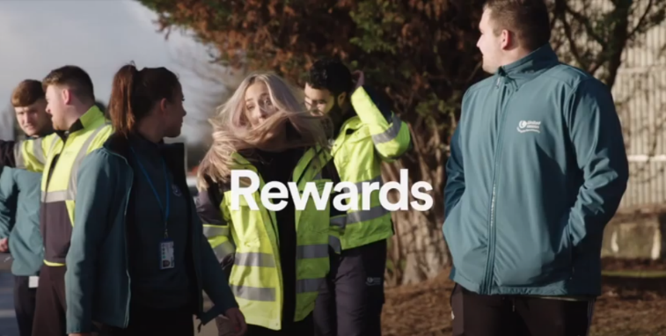
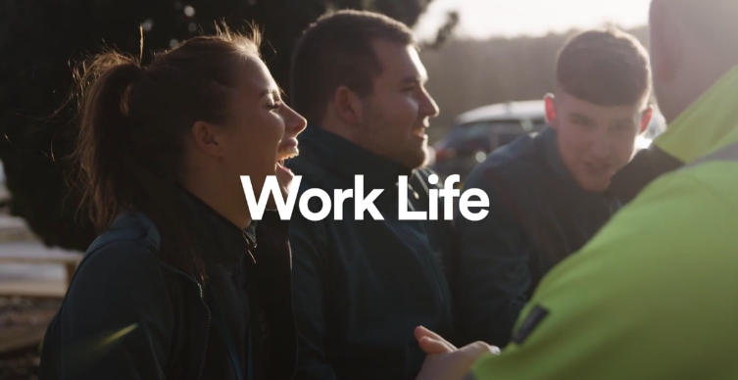
Benefits of being a UU Apprentice
As an apprentice at United Utilities, you will have the opportunity to fulfil your potential, starting work in FTSE100 company. After successfully applying for the role of your choice, you will be immersed into professional training relating to your role, learning new skills and exploring exciting areas of the business.
What’s in it for you? Aside from the amazing development opportunities on offer, check out the above video to learn all about the rewards we offer our apprentices.
Salaries start from £12,500 with up to £5,000 annual performance based increases.
You will start with 26 days of Annual Leave, with the option to buy or sell more!
Learning to drive? We will pay for up to 10 driving lessons to help you get on the road!
Join our private healthcare scheme to help cover medical and dental costs. We even have an onsite gym!
Don’t just take it from us. Check out the above video to see what our current apprentices think of opportunities on offer!

Slide 13
Green Apprenticeships at United Utilities
Apprentice Water Process Controller
Apprentice Wastewater Process Controller
Apprentice Scientist
Apprentice Tanker Driver
Apprentice Field Service Engineer
Apprentice Production Engineer
Apprentice Fleet Technician
Apprentice Data analyst/scientist
As an apprentice, you will play a key role in supporting our local environment, and protecting our green resources. Water is more than just what comes out of our taps – it is the North Wests most precious resource. It makes our region greener, healthier, stronger, boosting our communities and ecosystems, and enhancing our breathing catchment areas. We want to do our part to ensure that the North-West is better today, tomorrow and in the future.
Want to become a net-zero hero? Here’s how UU is aiming to become carbon Neutral by 2030:
UU is the first UK water company given gold standard stamp of approval for carbon targets
Already, 30% of our electricity is generated on our own sites via solar farms, wind turbines and biomethane
We have made a commitment to plant one million trees and create 550 hectares of woodland
We have made a commitment that all our vehicles will be electric or alternative fuel by 2028
To Learn more about our Environmental Pledges and our journey Net-Zero by 2030, check out our website.

Slide 14
Apprenticeship roles available
Find out more about our September 2022 opportunities

Slide 15
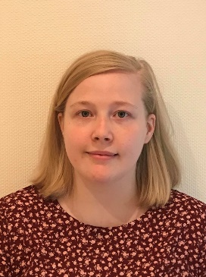

Apprentice Data Analyst (Modelling)
Produce plans and schedules using geographic information systems (GIS) to support the modelling team
Look after the network model library database to ensure the status and location of all models are recorded and managed
How did you find the recruitment process?
“Being dyslexic I thought that the process would be very difficult and I would have issues but it turned out the opposite. I found it easy to apply and progress through the stages.”
Build network models using GIS and modelling tools
Learn how to manipulate and link different data sets as required
- Rose, Data Analyst in Modelling
Click here to apply for the role or to find out more information

Slide 16
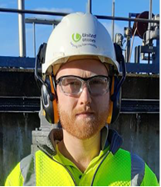
Apprentice Field Service Engineer
Mechanical (Water & Wastewater)
Assist with the production of accruals, monthly accounting and other requirements in line with regulatory guidelines
Work as part of the financial analyst team to support the lead management accountant and business areas
What advice would you give to some body applying for the apprenticeship scheme?
“Do some research on the company and research your chosen discipline. Knowing background information on the job you’re applying for will always impress the interviewer.”
Own and control relevant financial models used to assist business performance
Liaise with HR to ensure alignment to the resource plan and reconciliation of headcount and will need to meet strict month end deadlines
- George, Apprentice FSE (Mechanical)
Click here to apply for the role or to find out more information

Slide 17
Apprentice Fleet Technician
Ensure that our vans and trucks are maintained and are in road legal condition at all times
Service and repair mechanical faults on our vehicles as well as fault diagnosis using the latest computer software packages
Follow our rigorous health and safety standards, keeping yourself and others safe
Work as part of a dedicated team focused on ensuring that our vehicles and plants are maintained efficiently
Carry out routine maintenance, making sure our vehicles are always running in tip top condition
Click here to apply for the role or to find out more information

Slide 18
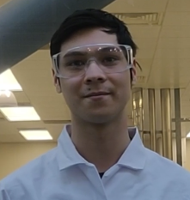
Apprentice Laboratory Scientist
Learn key scientific skills and how to ensure that the water that comes out of the tap is of the highest quality
What is your favourite thing about your current role?
Ion Chromatography
Colorimetry
“Everything I’m learning day to day is directly applied. That’s something that frustrated me so much during school, that I’d learn things that I’d have no idea how or when to actually use, but in my current role I can make use of everything I’ve learnt right away.”
Spectrometry
During your five year apprenticeship, you’ll get to grips with lots of different systems and activities that take place in our science department including …
- Evan, Apprentice Scientist
Click here to apply for the role or to find out more information

Slide 19
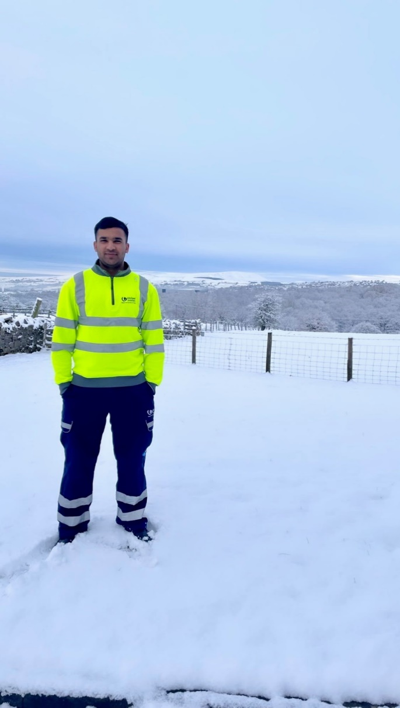
Apprentice Process Controller
(Water & Wastewater)
What is your favourite thing about your current role?
Work as a team to ensure our wastewater treatment works run smoothly and comply with strict health and safety and compliance regulations
Follow our site procedures and standards to ensure that all of the processes that we use are working to their full potential
“I enjoy the Process Controller role as no two days are the same. I have previously worked on production lines and in workshops. Eventually the work became very repetitive carrying out the same mundane tasks daily. Whereas as Process Controller I am involved with different tasks and different people daily.
All of my colleagues have made me feel very welcome, I feel part of a team which are very supportive and are willing to help me out wherever or whatever I need. No job or question I ask them is too big for them which I am very appreciative of.”
Be involved in fault investigation and problem solving
Learn how to operate our systems and the equipment we use to treat our wastewater
- Shahbaz, Apprentice Process Controller
Click here to apply for the role or to find out more information

Slide 20
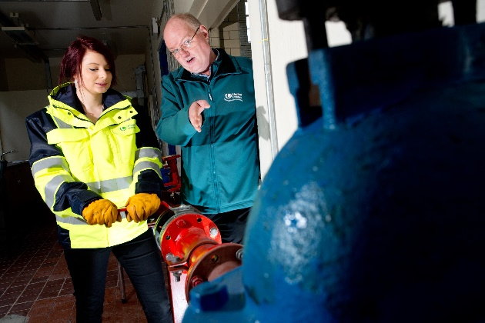
Apprentice Production Engineer
Learn how to make our Bioresource treatment processes run smoothly
Learn how to operate our systems and equipment to maximise the energy potential from the Bio solids
Be involved across the full asset life cycle from commissioning new innovative technologies to decommissioning existing assets
Play a key role in designing, planning and implementing new processes and procedures
Be proactive in identifying and supporting engineering solutions to challenging problems, be able to identify areas for business improvement and propose innovative ideas
Click here to apply for the role or to find out more information

Slide 21
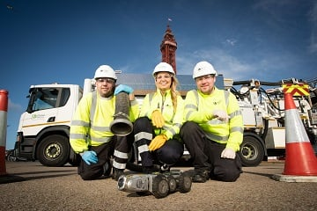
Apprentice Tanker Driver
Transporting treated or untreated liquid sludge via road tanker or tipper between United Utilities sites
Loading and unloading bulk tipper trucks using silo loading systems and or loading shovels
Providing an efficient, cost effective and quality service for internal and external customers
Driving both rigid and articulated bulk sided tipper trucks, collecting sludge cake from various UU sites then delivering and stockpiling at agricultural outlets
Ensuring you're compliant with all relevant legal requirements i.e. making sure you do your daily vehicle checks, and report any problems with the vehicle
Click here to apply for the role or to find out more information

Slide 22
Apprentice Data Scientist
Create insight from data, predicting future trends by connecting data sources and manipulating different data types
Work with business teams to identify requirements and understand where analytic insight can add value
Develop analytic insight based on functional designs and user requirements
Develop a technical understanding and knowledge of key infrastructure and analytics tools
Communicate findings via data visualisation to a range of technical and non-technical audiences
Click here to apply for the role or to find out more information

Slide 23
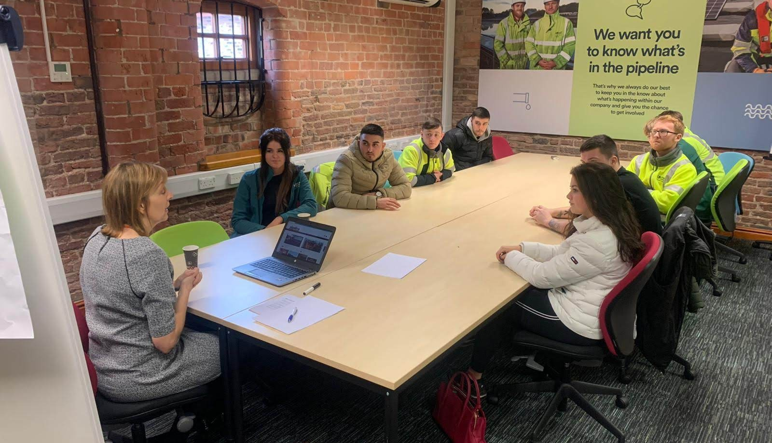
Apprentice Data Analyst
Work as part of a dedicated team focused
Manipulate and link different data sets as required
Interpret and apply data and information security standards, policies and procedures to data management activities
Collect and compile data from different sources
Identify, collect and migrate data to/from a range of internal and external systems
Click here to apply for the role or to find out more information

Slide 24
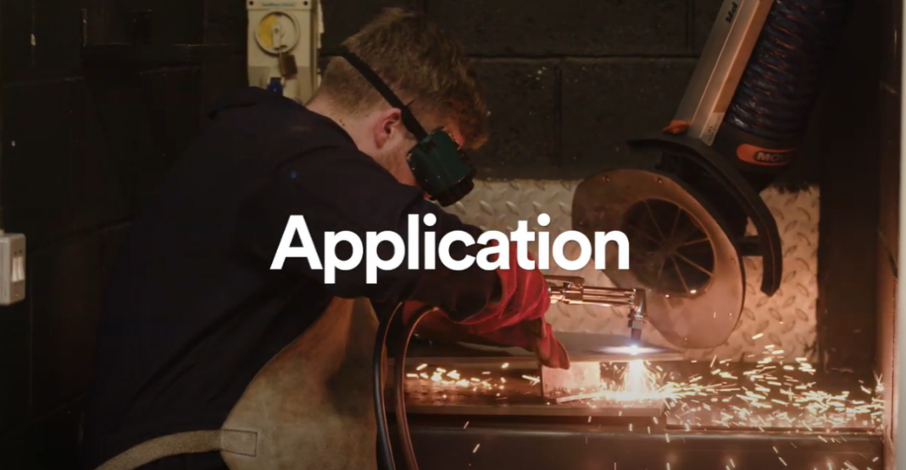
The Application Process
1. Application Submission and Review
2. Online Situational Judgement Test
3. Video Interview
4. Online Aptitude Test
Want to know how our current apprentices’ found their application process? Check out the above video to learn more!
5. Virtual Assessment Centre
To see our application process in more detail, head to our website

