Slide 1
Creating Careers: Ask Us Anything
Season Two
Occupational Therapy and Physiotherapy
Thursday 9th December 2021
4.30 pm – 5.30 pm
Student Pre-work

Slide 2
Pre-work
1a) Click to learn more about the roles of occupational therapists and physiotherapists.
1b) Are you more interested in a career in physiotherapy or occupational therapy? Explain your answer.
Hint: Consider day to day tasks, qualifications and skills that are needed for each job. Which one suits you more?
Both occupational therapists and physiotherapists need to have excellent communication skills.
2 a) What are communication skills?
Read this short article to help to you understand more.
2b) Why are communication skills so important to physiotherapists and occupational therapists? Explain your answer.
Hint: Use the links that you explored in Q1a and Q2a to help you.
2c) What examples can you give to show that YOU have strong communication skills?
Explain why you have chosen each example.
Hint: Think about your school life and your personal life. Do you volunteer or go to any after-school clubs? How do you communicate with the people in your life?
Questions to ask
Using what you have learned from your pre-work, think of three questions that you would like to ask at our event.
Is there anything you don’t understand or would like more information on? You may even come up with more questions as you watch the webinar.
1.
2.
3.
Useful careers tips
Whilst listening, note down any inspirational or interesting advice that you hear which could help you on your careers journey
Now head over to your Creating Careers Roadmap to evaluate today’s event…

Slide 3
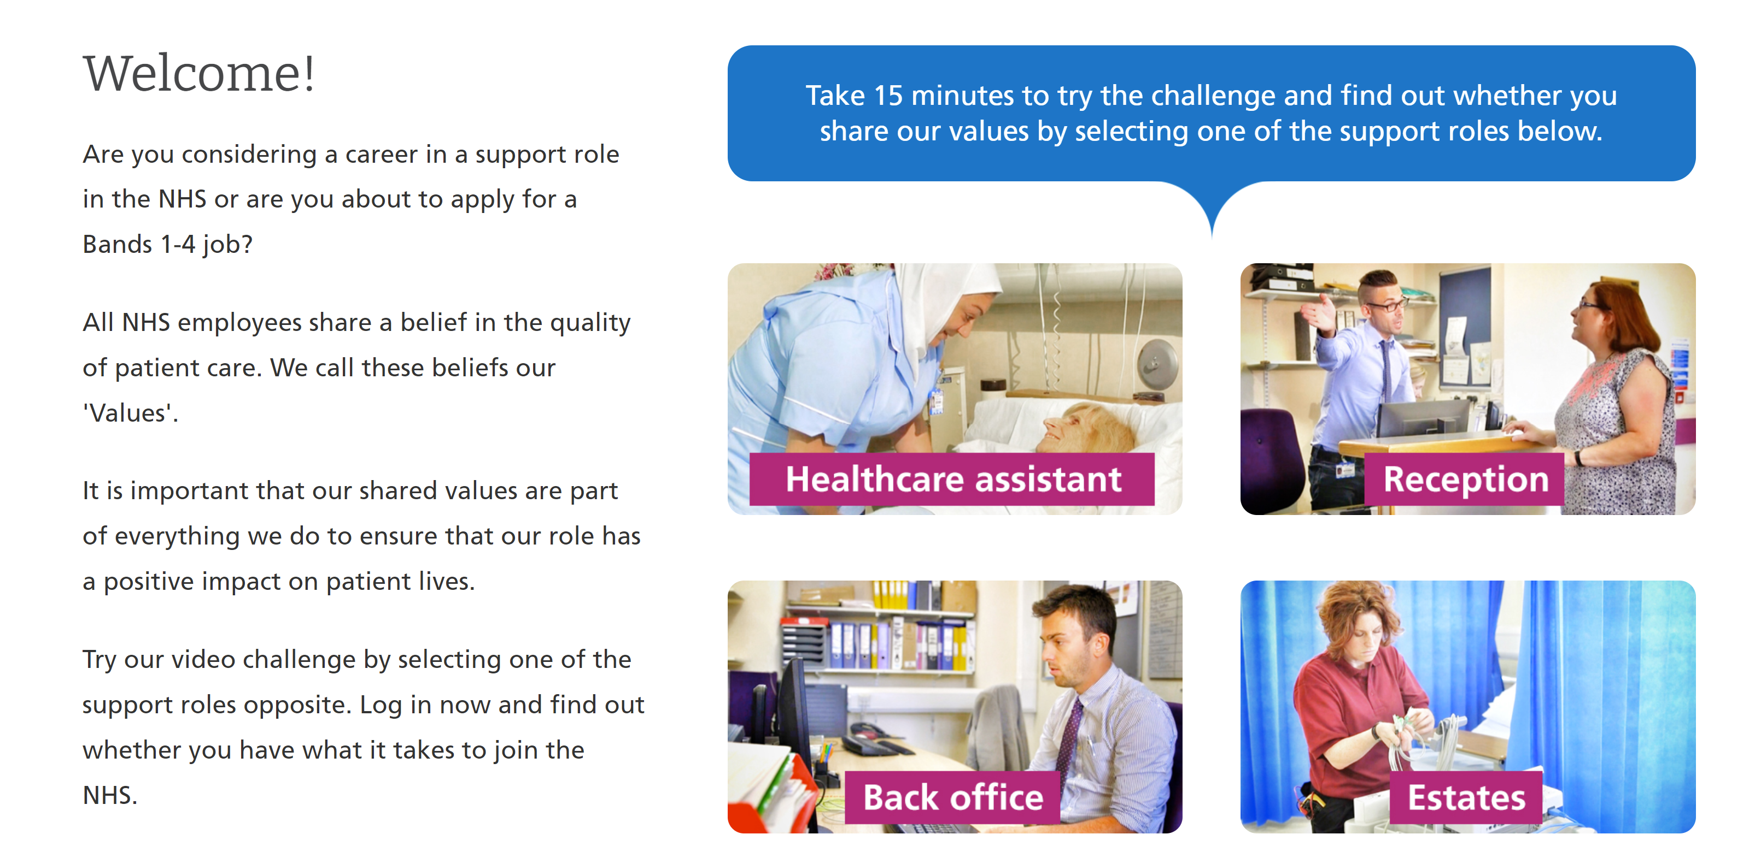
Values Challenge - click here to begin!
Values of the NHS Constitution
If you're applying for a job either directly in the NHS or in an organisation that provides NHS services, you'll be asked to demonstrate the values of the NHS Constitution and how they would apply in your everyday work.
You can find out more about NHS values here.
Complete the values challenge to see if you share the NHS’ values!

Slide 4
This programme is more than one day…
By joining this webinar, you are now a part of the Creating Careers family.
This includes The Liverpool City Region Careers Hub, Health Education England, GM Higher, Shaping Futures, NHS Careers NW, Lancashire Future U, Cumbria Hello Future and Cheshire and Warrington’s commitment to sharing opportunities that enable you to train towards a career in health and social care.
You can also independently sign up to Cheshire and Warrington Higher Horizons, Youth Hub by Be More and Cheshire and Warrington Opportunities who can help you to access these webinars and support you going forward.
Do you have any questions?
You can ask us about GCSE options, Sixth-Form or College choices and everything university related. Talk to the Shaping Futures team via live chat here or click on any of the above links for your area.
Creating Careers: Ask Us Anything - Health and Social Care Webinars
Build your health and social care knowledge! Even if you have an interest in one career role, these webinars are an opportunity to see how the 350+ NHS roles interlink to create a world-class health and social care system.
For more information, please see the next slide.

Slide 5
Creating Careers: Ask Us Anything
Health and Social Care Webinars
Season Two
Sign up here
Thursday 13th January:
Dietician, Speech & Language
and Drama Therapy
Thursday 27th January:
Orthoptics and Prosthetics
Thursday 10th February:
Diagnostic and
Therapeutic Radiography
Thursday 10th March:
Podiatry, Art and
Music Therapy
Thursday 24th March:
Operating Department
Practitioners and Paramedics
Develop your health and social care knowledge and receive free individual careers support across North West England
Each session is live from 4.30 pm - 5.30 pm
Year 9-13 students, North West England
Parents, carers and guardians are welcome
Find out more about the 350+ exciting careers in the NHS here.
Additionally, watch our Creating Careers video series to learn about the interesting health and social care career pathways that Liverpool City Region has to offer.
Don’t forget to check out the pre-work and Creating Careers Roadmap that accompany each episode!
Follow @LCRCareersEnt for the latest careers updates and events.

Slide 6
Coming Soon On
Creating Careers: Ask Us Anything
2022
Ambulance Services
Dentistry
Pharmaceutical
Estates & Facilities
Healthcare Science
Find out more about each of these careers here.
Got a question?
Get in touch:
careershub@
growthplatform.org

