Slide 1
Creating Careers: Ask Us Anything
Season Two
Operating Department Practitioners
& Allied Health Support Roles
Thursday 24th March 2022
4.30 pm – 5.30 pm
Student Pre-work

Slide 2
Our next webinar focuses on Operating Department Practitioners (ODPs). ODPs work in operating theatres caring for patients before, during and after surgery.
There are three areas that ODPs specialise in. Next to each area, write down what it is and why it is so important to the safety of the patient.
Hint: Include relevant key words in your search such as hospital, operating theatres or NHS.
Anaesthetics
Surgical Scrubbing
Recovery Room
Edge Hill University offer a three-year ODP degree course. Part of this course involves training in Edge Hill’s state of the art Clinical Skills and Simulation Centre.
Click here to find out more about the Simulation Centre and view the interactive 360° tour of operating theatres.
What is the Clinical Skills and Simulation Centre?
Why is this centre so important to students who are training for roles within the NHS?
Apprenticeships offer an alternative route into the ODP profession. Currently, you must already be working in the NHS to get a place on their apprenticeship schemes. Most people start off in entry-level jobs such as the Healthcare Assistant role before applying.
Click here to find out more about the ODP apprenticeship.
Which route appeals you more – the degree apprenticeship or the traditional degree?
Explain your answer.
Extension: Click here to find out more about allied health support roles.
Prepare some questions that you could ask about these roles ready for the live webinar.
Questions to ask
Using what you have learned from your pre-work, think of three questions that you would like to ask at our event.
Is there anything you don’t understand or would like more information on? You may even come up with more questions as you watch the webinar.
1.
2.
3.
Useful careers tips
Whilst listening, note down any inspirational or interesting advice that you hear which could help you on your careers journey
Now head over to your Creating Careers Roadmap to evaluate today’s event…

Slide 3
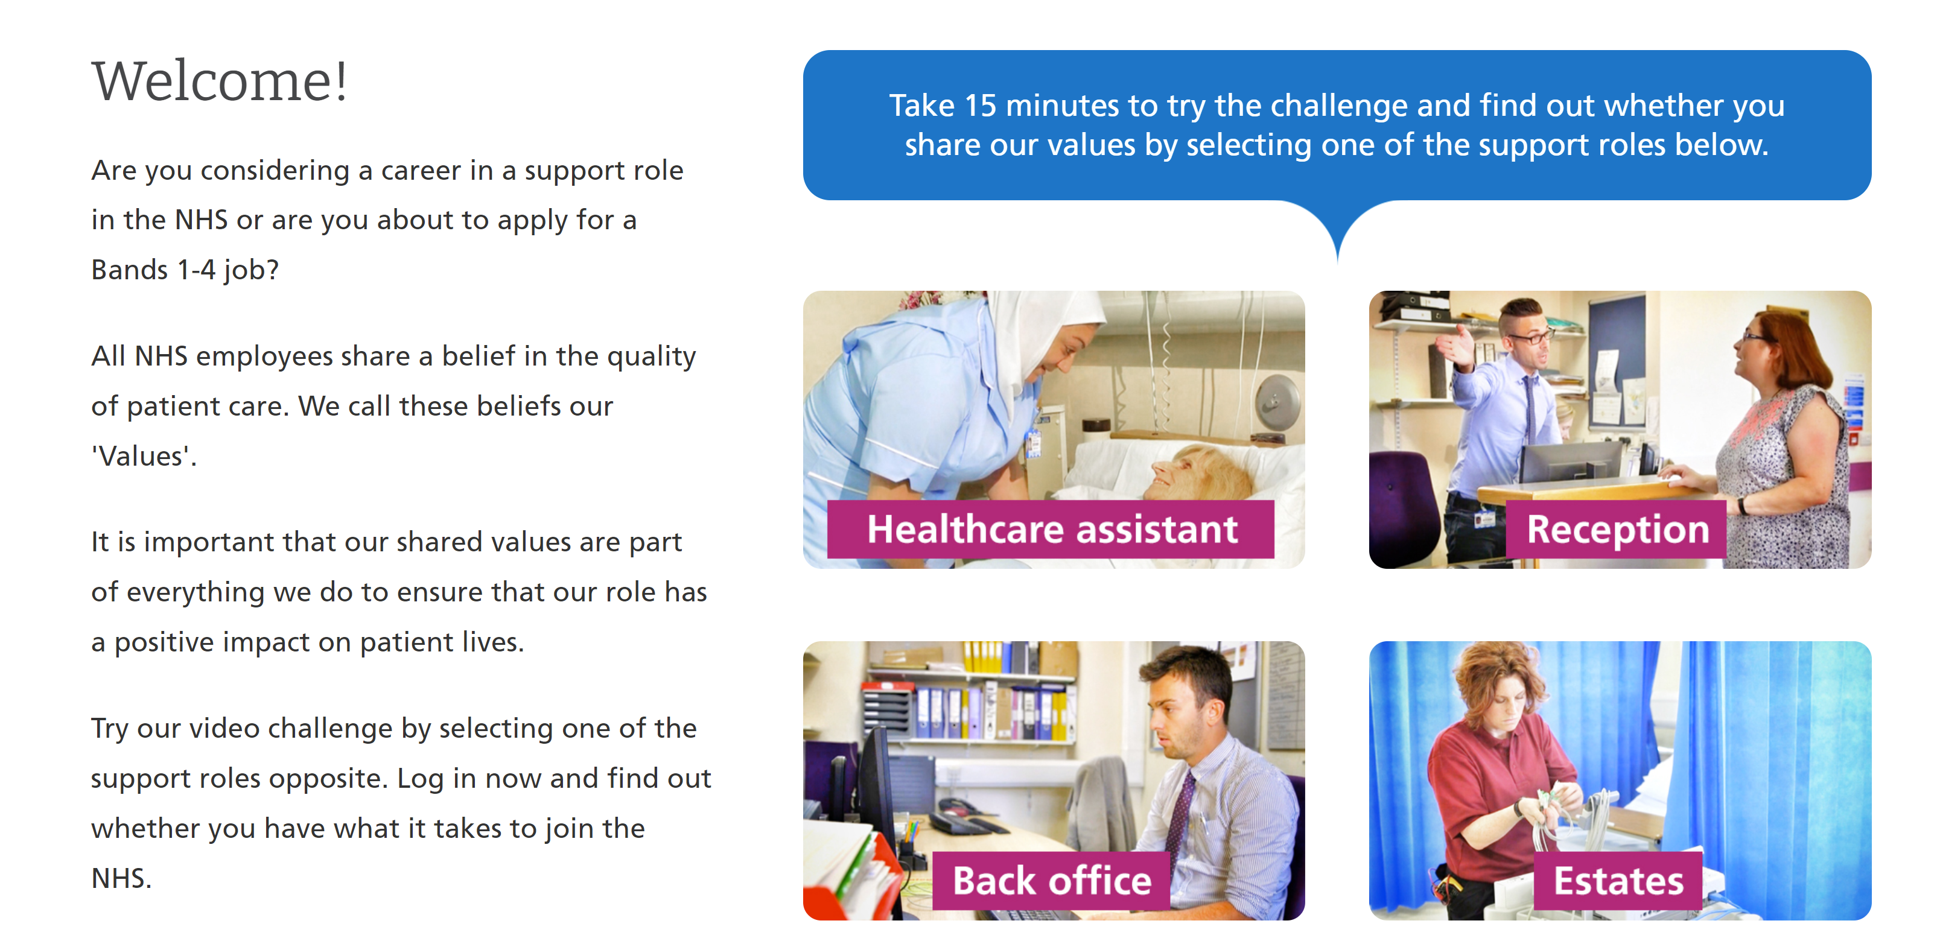
Values Challenge - click here to begin!
Values of the NHS Constitution
If you're applying for a job either directly in the NHS or in an organisation that provides NHS services, you'll be asked to demonstrate the values of the NHS Constitution and how they would apply in your everyday work.
You can find out more about NHS values here.
Complete the values challenge to see if you share the NHS’ values!

Slide 4
This programme is more than one day…
By joining this webinar, you are now a part of the Creating Careers family.
This includes The Liverpool City Region Careers Hub, Health Education England, GM Higher, Shaping Futures, NHS Careers NW, Lancashire Future U, Cumbria Hello Future and Cheshire and Warrington’s commitment to sharing opportunities that enable you to train towards a career in health and social care.
You can also independently sign up to Cheshire and Warrington Higher Horizons, Youth Hub by Be More and Cheshire and Warrington Opportunities who can help you to access these webinars and support you going forward.
Do you have any questions?
You can ask us about GCSE options, Sixth-Form or College choices and everything university related. Talk to the Shaping Futures team via live chat here or click on any of the above links for your area.
Creating Careers: Ask Us Anything - Health and Social Care Webinars
Build your health and social care knowledge! Even if you have an interest in one career role, these webinars are an opportunity to see how the 350+ NHS roles interlink to create a world-class health and social care system.
For more information, please see the next slide.

Slide 5
Creating Careers: Ask Us Anything
Health and Social Care Webinars
Season Two
Sign up here
Thursday 24th March:
Operating Department
Practitioners and
Allied Health Support Roles
Thursday 28th April:
Ambulance Services and
Paramedics
Thursday 19th May:
Dental
Thursday 9th June:
Pharmacy
Thursday 23rd June:
Estates and Facilities
Thursday 7th July:
Healthcare Science
Develop your health and social care knowledge and receive free individual careers support across North West England
Each session is live from 4.30 pm - 5.30 pm
Year 9-13 students, North West England
Parents, carers and guardians are welcome
Find out more about the 350+ exciting careers in the NHS here.
Additionally, watch our Creating Careers video series to learn about the interesting health and social care career pathways that Liverpool City Region has to offer.
Don’t forget to check out the pre-work and Creating Careers Roadmap that accompany each episode!
Follow @LCRCareersEnt for the latest careers updates and events.

