Slide 2
Careers in Nursing
Pre-work
1a) What does the term nursing mean to you? Write an explanation of what you think a nurse is.
b) Using this link, explore the different nursing professions that are on offer in the UK. Once you have completed your research, use what you have learned to re-write your explanation of nursing. Has your understanding of nursing changed?
2a) The NHS offer staff mental health and wellbeing support around the country.
Click the links to explore the support on offer to NHS workers in our local region.
Cheshire and Merseyside
Greater Manchester
General support for NHS staff
Explain why it is important that the NHS offers this support to nurses and the rest of their staff.
b) Considering the nature of nursing and the support that is on offer to them, is this a career route that you can see yourself following? Explain your answer.
Hint: Use what you have learned from Q1b to explain if there are any specific nursing roles that you are interested and why.
Extension: My Possible Self is free app set up by healthcare professionals to provide support with mental health. This includes meditation, motivational messages, mood trackers and much more.
Sign up to My Possible Self and explore the support tools that are on offer.
Which feature of the app do you think would be most helpful to NHS workers and why?
3a) More women in the UK are nurses than men. Why do you think this is?
b) Read this article and add ideas to your notes of why you think more women are nurses than men.
c) What do you think society* could do to encourage more men to get into nursing?
Hint: Think about how schools, students, parents, The Government and the NHS could all help.
Questions to ask
Using what you have learned from your pre-work, think of three questions that you would like to ask.
Is there anything you don’t understand or would like more information on? You may even come up with more questions as you watch the webinar.
1.
2.
3.
Useful careers tips
Whilst listening, note down any inspirational or interesting advice that you hear which could help you on your careers journey
Now head over to your Creating Careers Roadmap to evaluate today’s session…

Slide 3
This programme is more than one day…
By joining this webinar, you are now a part of the Creating Careers family.
This includes The Liverpool City Region Careers Hub, Health Education England , GM Higher and Shaping Futures’ commitment to give you access to opportunities that enable you to train towards a career in Health and Social Care.
You can also independently sign up to Cheshire and Warrington Higher Horizons or Lancashire Future U & Cumbria Hello Future who could support you to access these webinars and support you going forward.
Do you have any questions?
You can ask us about GCSE options, Sixth-Form or College choices and everything university related. Talk to the Shaping Futures team, via live chat, here or click on any of the above links for your area to access support .
Creating Careers: Ask Us Anything - Health and Social Care Webinars
Build your knowledge around all things Health and Social Care! Even if you have an interest in one career role its an opportunity to see how the 350+ roles interlink to ensure that we have a world class Health & Social care system.
For more For more Information please see the flyer on the next page.

Slide 4
Creating Careers: Ask Us Anything
Health and Social Care Webinars
Sign up here
Thursday 18th March:
AHP Taster Day
Follow Up Session
Thursday 22nd April:
Step into Social Care
Thursday 20th May:
Careers in Nursing
Thursday 17th June:
Non-Medical NHS Careers
Thursday 15th July:
Careers in
Healthcare Science
Designed to teach you more about careers within Health and Social Care, our monthly webinar series allows you to ask key questions, hear from professionals and develop your understanding of the sector
Each session will run live from 4.30 pm - 5.30 pm
Open to Year 11-13 students and parents, carers or guardians
For further support, you can find out more about the 350+ exciting careers in the NHS here.
Additionally, watch our Creating Careers video series to learn about the interesting health and social care career pathways that Liverpool City Region has to offer.
Don’t forget to check out the pre-work and Creating Careers Roadmap that accompany each episode!
For the latest careers updates & events, follow our Twitter page @LCRCareersEnt

Slide 5
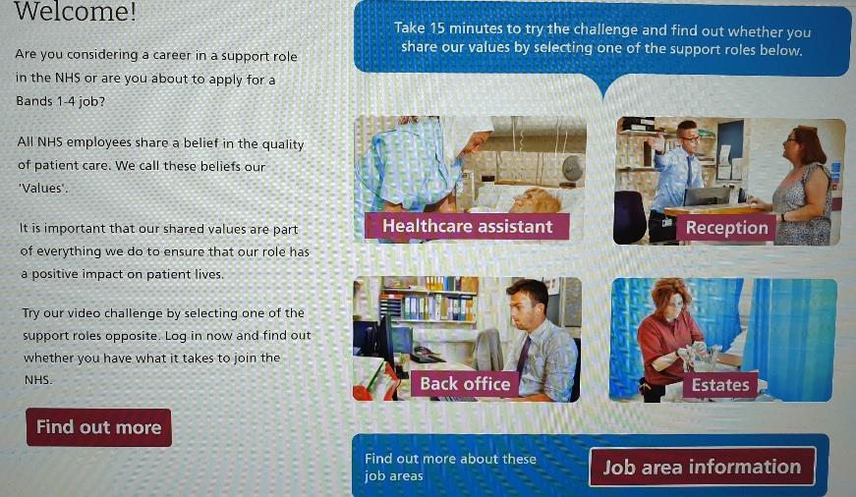
Values Challenge - click the slide to begin!
Creating Careers: Ask Us Anything
Health and Social Care Webinars
Bonus Page
Know the 6Cs
Save or screenshot your results and keep as part of your Personal Statement development.

