Slide 2
Non-Clinical NHS Careers
Pre-work
350 Careers, One NHS, Your Future
Whatever your skills, qualifications or interests, there is a career for you in the NHS.
This webinar focuses on the non-medical/clinical roles within the NHS. These occupations do not offer medical treatment to patients.
1 a) Take the Step into the NHS Careers Quiz to identify which of the 350 NHS roles are most suited to your interests and skills.
b) Review your results and click the links to find out more about the non-clinical careers that are matched to you.
Do any of these roles interest you? Explain your reasons?
Non-clinical roles are essential to the success of the NHS and offer a huge variety of rewarding career pathways. This can include analysing accurate data records in Informatics or working in the Finance Department to ensure that NHS budget is spent wisely. You could also work in Communications and Digital promoting the NHS through social media or join Estates who look after NHS buildings and the grounds around them, so they are safe and pleasant for patients and staff.
2 a) Using this link, watch the NHS video and explore the wider website to find out what the NHS is like as an employer.
b) Explain why you think people in non-clinical roles would choose to work in the NHS rather than work for other types of organisations/businesses that offer the same career?
Questions to ask
Using what you have learned from your pre-work, think of three questions that you would like to ask.
Is there anything you don’t understand or would like more information on? You may even come up with more questions as you watch the webinar.
1.
2.
3.
Useful careers tips
Whilst listening, note down any inspirational or interesting advice that you hear which could help you on your careers journey
Now head over to your Creating Careers Roadmap to evaluate today’s session…

Slide 3
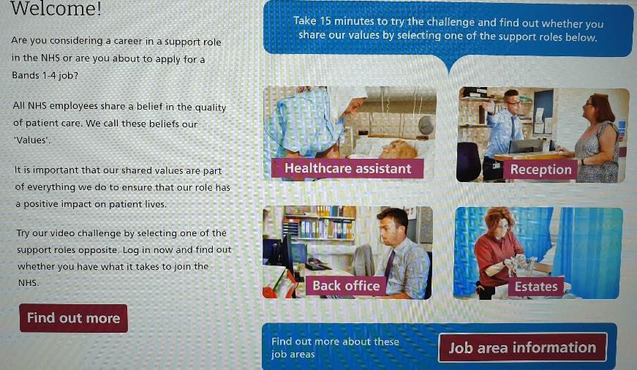
Values Challenge - click the slide to begin!
Values of the NHS Constitution
If you're applying for a job either directly in the NHS or in an organisation that provides NHS services, you'll be asked to demonstrate the values of the NHS Constitution and how they would apply in your everyday work.
You can find out more about NHS values here.
Complete the values challenge to see if you share the NHS’ values!
Save or screenshot your results and keep as part of your Personal Statement development.

Slide 4
This programme is more than one day…
By joining this webinar, you are now a part of the Creating Careers family.
This includes The Liverpool City Region Careers Hub, Health Education England , GM Higher and Shaping Futures’ commitment to give you access to opportunities that enable you to train towards a career in Health and Social Care.
You can also independently sign up to Cheshire and Warrington Higher Horizons or Lancashire Future U & Cumbria Hello Future who could support you to access these webinars and support you going forward.
Do you have any questions?
You can ask us about GCSE options, Sixth-Form or College choices and everything university related. Talk to the Shaping Futures team, via live chat, here or click on any of the above links for your area to access support .
Creating Careers: Ask Us Anything - Health and Social Care Webinars
Build your knowledge around all things Health and Social Care! Even if you have an interest in one career role its an opportunity to see how the 350+ roles interlink to ensure that we have a world class Health & Social care system.
For more Information, please see the flyer on the next page.

Slide 5
Creating Careers: Ask Us Anything
Health and Social Care Webinars
Sign up here
Thursday 18th March:
AHP Taster Day
Follow Up Session
Thursday 22nd April:
Step into Social Care
Thursday 20th May:
Careers in Nursing
Thursday 17th June:
Non-Medical NHS Careers
Thursday 15th July:
Careers in
Healthcare Science
Designed to teach you more about careers within Health and Social Care, our monthly webinar series allows you to ask key questions, hear from professionals and develop your understanding of the sector
Each session will run live from 4.30 pm - 5.30 pm
Open to Year 11-13 students and parents, carers or guardians
For further support, you can find out more about the 350+ exciting careers in the NHS here.
Additionally, watch our Creating Careers video series to learn about the interesting health and social care career pathways that Liverpool City Region has to offer.
Don’t forget to check out the pre-work and Creating Careers Roadmap that accompany each episode!
For the latest careers updates & events, follow our Twitter page @LCRCareersEnt

