Slide 1
Creating Careers: Ask Us Anything
Season Two
Midwifery and Neonatal Nursing
Thursday 11th November 2021
4.30 pm – 5.30 pm
Student Pre-work

Slide 2
Pre-work
1a. Click to learn about the role of a midwife and of a neonatal nurse.
1b. In your own words, explain the difference between a midwife and a neonatal nurse.
2. Genomics plays an essential part in the role of a midwife. But what is it?
A genome is an organism’s complete set of DNA or, in other words, a human’s complete genetic code.
Genomics is the study of our complete genetic code. Medical professionals study the body’s genes, their functions and their influence on the growth, development and working of the body.
Watch the first minute of this video to help your understanding of genomics.
How do you think a midwife would use genomics in their role?
Use this link to watch the short cartoon to help you with your answer.
3a) More women in the UK are nurses than men (including neonatal nurses). Why do you think this is?
b) Read this article and add ideas to your notes of why you think more women are nurses than men.
c) What do you think society could do to encourage more men to get into nursing?
Hint: Think about how schools, students, parents, The Government and the NHS could all help.
Questions to ask
Using what you have learned from your pre-work, think of three questions that you would like to ask at our event.
Is there anything you don’t understand or would like more information on? You may even come up with more questions as you watch the webinar.
1.
2.
3.
Useful careers tips
Whilst listening, note down any inspirational or interesting advice that you hear which could help you on your careers journey
Now head over to your Creating Careers Roadmap to evaluate today’s event…

Slide 3
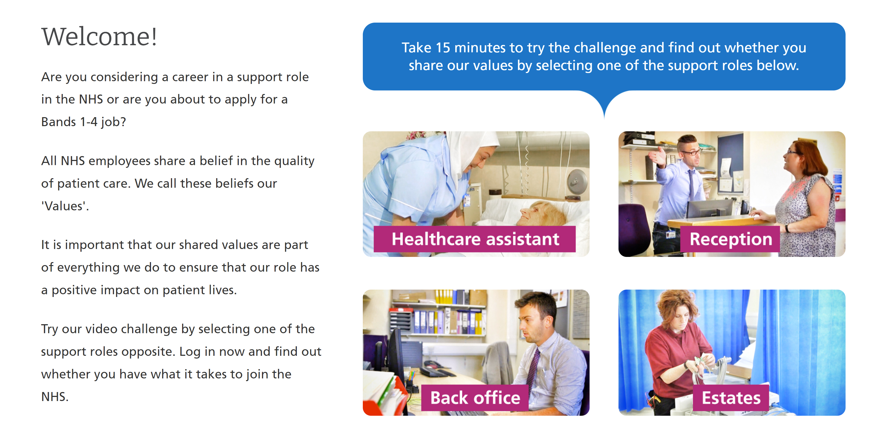
Values Challenge - click here to begin!
Values of the NHS Constitution
If you're applying for a job either directly in the NHS or in an organisation that provides NHS services, you'll be asked to demonstrate the values of the NHS Constitution and how they would apply in your everyday work.
You can find out more about NHS values here.
Complete the values challenge to see if you share the NHS’ values!

Slide 4
This programme is more than one day…
By joining this webinar, you are now a part of the Creating Careers family.
This includes The Liverpool City Region Careers Hub, Health Education England, GM Higher, Shaping Futures, NHS Careers NW, Lancashire Future U, Cumbria Hello Future and Cheshire and Warrington’s commitment to sharing opportunities that enable you to train towards a career in health and social care.
You can also independently sign up to Cheshire and Warrington Higher Horizons, Youth Hub by Be More and Cheshire and Warrington Opportunities who can help you to access these webinars and support you going forward.
Do you have any questions?
You can ask us about GCSE options, Sixth-Form or College choices and everything university related. Talk to the Shaping Futures team via live chat here or click on any of the above links for your area.
Creating Careers: Ask Us Anything - Health and Social Care Webinars
Build your health and social care knowledge! Even if you have an interest in one career role, these webinars are an opportunity to see how the 350+ NHS roles interlink to create a world-class health and social care system.
For more information, please see the next slide.

Slide 5
Creating Careers: Ask Us Anything
Health and Social Care Webinars
Season Two
Sign up here
Thursday 21st October:
Nursing
Thursday 11th November:
Midwifery & Neonatal
Nursing
Thursday 25th November:
Social Care
Thursday 9th December:
Occupational Therapy and
Physiotherapy
Develop your health and social care knowledge and receive free individual careers support across North West England.
Each session is live from 4.30 pm - 5.30 pm
Year 9-13 students, North West England
Parents, carers and guardians are welcome too!
Find out more about the 350+ exciting careers in the NHS here.
Additionally, watch our Creating Careers video series to learn about the interesting health and social care career pathways that Liverpool City Region has to offer.
Don’t forget to check out the pre-work and Creating Careers Roadmap that accompany each episode!
For the latest careers updates & events, follow our Twitter page @LCRCareersEnt

Slide 6
Coming Soon On
Creating Careers: Ask Us Anything
2022
Dietitians
Speech and Language Therapists
Orthoptists
Osteopaths and Prosthetics
Diagnostic & Therapeutic Radiotherapists
Art & Music Therapists
Podiatrists
Operating Department Practitioners
AHP Support Workforce
Ambulance Services
Dentistry
Pharmaceutical
Estates & Facilities
Healthcare Science
Sign up details to be released December 2021
Find out more about each of these careers here.
Got a question?
Get in touch:
careershub@
growthplatform.org

