Slide 1
Jacobs Engineering Apprenticeship Opportunities
NATIONAL CAREERS WEEK
Wednesday 9th March, 10 AM – 11 AM
Zoom link
What is an Apprenticeship?
Jake Croxton - Apprenticeship Support by Be More
Meet the Jacobs Team
Who we are, what we do, our values, local projects
Explore Apprenticeship Opportunities
Meet and greet with Jacobs Apprentices
Jacobs are looking to attract over 100 Apprentices from all STEAM disciplines to their business in 2022. And the intake starts now!
We Live Inclusion! It is at the core of our mission, whether it is linked to educational background, geographical location, industry experience, working hours, work patterns, race, ethnicity, culture, religion, gender, sexual orientation, social-economic status or other.
This event is linked to our Action Plan for Advancing Justice and Equality, focused on increasing the number of Black talent in our company to reflect the societies that we serve, as well as creating inclusive conditions for this workforce to grow and thrive.
Jacobs Website visit www.jacobs.com

Slide 2
Jacobs Engineering Early Careers National Careers Week Wednesday 9 March 2022
Housekeeping Cameras and mics off
Ask questions via the chat box
Ask as many questions as you’d like!
Twitter @LCRCareersEnt
TikTok lcr_careers_hub

Slide 3
Introduction to Engineering
10.00 am Welcome
10.05 am What is an Apprenticeship?
10 .20 am Meet the Jacobs Team
Meet the Apprentices
11.00 am Finish

Slide 4
Apprenticeship Support
by Be More
Apprenticeship Skills Broker – Jake Croxton
Funded by the European Social Fund (ESF) and the Liverpool City Region Strategic Investment Fund (SIF)

Slide 5
WHAT WE DO
“Be More Be An Apprentice” has joined forces with the Liverpool City Region (LCR) Apprenticeship Hub. We can;
Provide advice and guidance about Apprenticeships to schools, young people, parents and residents.
Provide 1-1 support for all residents.
Provide a platform for Apprenticeship Vacancies
Notes:
Discuss our role
2

Slide 6
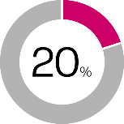
WHAT IS AN APPRENTICESHIP?
JOB – You will be employed throughout the apprenticeship
LEARNING – Both on the job and 20% off the job
WAGE – paid while you are working and while you are learning
Notes:
Ask the question and see if anyone can tell you what an Apprenticeship is.
3

Slide 7
Full-time job (some part time available) and minimum pay £4.15 per hour
Approved training organisations working alongside employers.
Minimum of 13 months with progression routes available up to degree level
Over 500 different types of Apprenticeships for ages 16 up
Fully funded – there is NO cost to the Apprentice.
Notes:
Go through the key facts about Apprenticeships.
4

Slide 8
WHAT COMPANIES OFFER APPRENTICESHIPS?
Notes:
5

Slide 9
WHO IS INVOLVED, AND WHAT WILL I GAIN?
Employer
Maths and English if required
Work alongside industry experts
Knowledge
Skills
Behaviour
Apprentice
Training Provider
Notes:
5

Slide 10
STANDARDS – GATEWAYS AND END POINT ASSESSMENTS
Some Apprenticeship Standards don’t contain mandatory qualifications.
Employers and Training Providers can deliver training in a different way.
You will go through “Gateways” to continue to assess progression and complete an End Point Assessment (EPA) to achieve the Apprenticeship

Slide 11
HOW MUCH WILL IT COST?
No contribution towards the qualification regardless of level, including DEGREE!
All learning material equipment provided. No paying for textbooks or online resources.
All necessary PPE (Personal Protection Equipment) supplied to keep you safe if necessary for the apprenticeship.
Notes:
7

Slide 12
ACCESS AND PROGRESSION
Degree and Masters Levels 6&7
may contain bacherlors degree
Higher Levels 4 & 5 Equivalent or
contains HNC, HND, FD
Advanced Level 3
Equivalent to 2 A-Levels
Intermediate Level 2
Equivalent to 5 GCSEs
Notes:
8

Slide 13
HIGHER AND DEGREE LEVEL APPRENTICESHIPS
Programme offered by Higher Education Institutions
You may achieve a full Bachelors or Masters Degree
Employers, Higher Education and Professional bodies working in partnership
Employed throughout with part time study – sometimes block release
Between 3 to 6 years depending on Apprenticeship and level

Slide 14
WHAT SHOULD I ASK MYSELF?
Can I commit to 4 years plus if needed?
Which Higher Education Institute will I attend?
If it’s a level 6, will I receive a Bachelors degree or equivalent?
Will I be happy to work full time PLUS study for a higher qualification?

Slide 15
APPRENTICESHIP OR UNIVERSITY?
HAIR / BARBERING
POLICE CONSTABLE
ACCOUNTANT
Apprenticeship - you could continue to a Management Degree
Degree Apprenticeship available
Degree Apprenticeship available
NURSING
ARCHITECT / CIVIL ENGINEER
TRAVEL APPRENTICESHIPS
Degree Apprenticeships Available
Degree Apprenticeships available
You can progess to a Management Degree
Notes:
Quick quiz, go through all the job roles asking the students is they can tell you to be qualified in these areas is it an Apprenticeship route or University route you would traditionally follow?
11

Slide 16
APPRENTICESHIP CAREERS
Business & Administration
Childcare & Education
Construction
Creative & Design
Digital
Engineering & Manufacturing
Health & Science
Legal, finance & accounting
Protective Services (Police, Armed Forces etc)

Slide 17
WHERE DO I LOOK?

Slide 18
Notes:
Discuss the Be-more website, local website, pulls through local vacancies from gov.uk and any other vacancies we know of in the patch (including employer brokerage team).
18

Slide 19
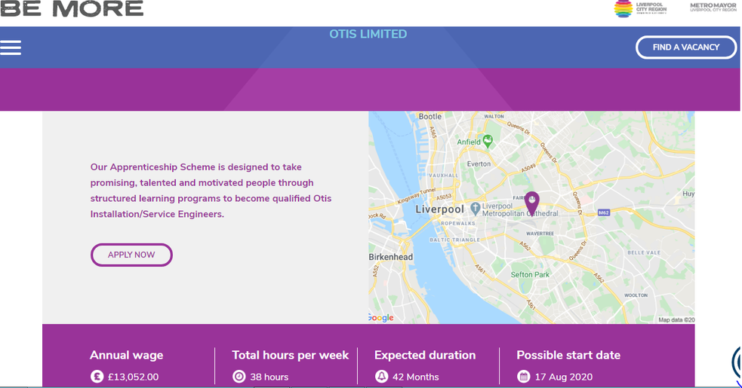
Notes:
Gov.uk website
19

Slide 20
JOIN US ON SOCIAL MEDIA!
@be_lcr
@lcr.bemore
@lcr_be_more
www.be-more.info
Notes:
Any questions and ask them to follow us on our social media platforms for news on the latest apprenticeships and events.
23

Slide 21
Apprentice Careers At Jacobs March 2022
Dan Money
Talent Acquisition Lead
Sam Turnbull
UK Apprenticeship Consultant

Slide 23
Markets We Serve

Slide 25
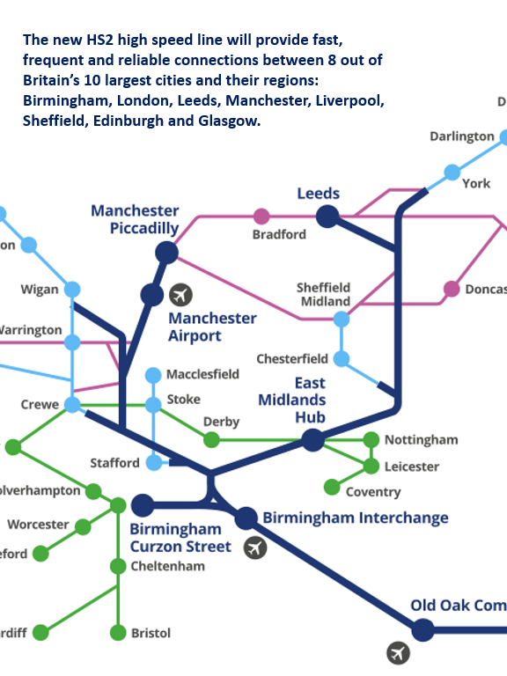

Slide 29
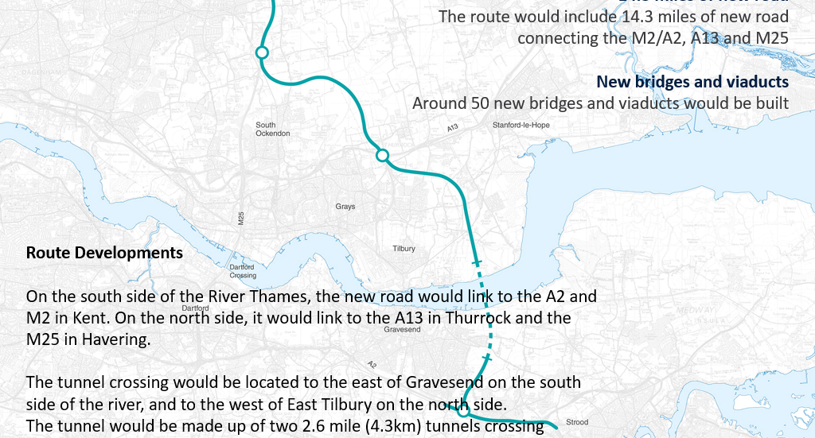

Slide 30
Civil Engineer
Electrical Engineer
Mechanical Engineer
Environmental Engineer
River Engineer
Coastal Engineer
Traffic Engineer
Fire Engineer
Economist
Business Analyst
Strategic Analyst
Mathematician
Transport Planner
Construction Manager
Quantity Surveyor
Project Controls
Risk Manager
Software Developer
Data Scientist
GIS Analyst
Graphic Designer

Slide 31
What do we look for:
Technical skills:
Maths
Physics
STEAM
Personality traits:
Resilience
Curiosity
Self-discipline
Learning agility
Ownership
Authenticity

Slide 32
Apprentice Choices
Can you name any famous people who were apprentices?
Gordon Ramsay. TV star Gordon started his successful career as a catering apprentice, and is now one of the most famous names in the catering world owning multiple restaurants and TV shows.
Sir Alex Ferguson. Former Manchester United manager Sir Alex Ferguson actually started his career as a shipyard apprentice.
Stella McCartney.
Her career began with an apprenticeship with a tailor on Saville Row. She picked up all the skills needed that would see her one day be labelled as “Fashion Royalty.” And she is now considered one of the most successful fashionistas in the world.
Michael Faraday. He began as an apprentice bookbinder at a workshop. His main discoveries include the principles underlying electromagnetic induction (how motors work).
Now considered one of the fathers of electricity.
©Jacobs 2021

Slide 33
What is an apprenticeship?
Practical on the job training
Qualifications
20% of your working week paid to train (ie. One day a week, block release or first year off the job)
Earn while you learn
Transferable skills
Work experience
Route into full time employment
Progression opportunities
This Photo by Unknown Author is licensed under CC BY-SA
This Photo by Unknown Author is licensed under CC BY-NC

Slide 34
Duration and Levels
All Engineering Level 3s – Entry requirement typically x5 GCSEs grade 4-9 including Maths and English – typically over 4 years
Business Admin Level 3 – Entry requirement, Maths and English GCSE – over 2 years
Levels 4 to 6 – Entry requirement A levels, subjects depending upon Apprenticeship, typically over 4 to 5 years.
Apprenticeship opportunities - https://careers.jacobs.com/
You can search on the ‘Institute for Apprenticeship’ website for more details and search apprenticeships available: https://www.instituteforapprenticeships.org/apprenticeship-standards/?

Slide 35
Our Apprentices
We currently have around 320 apprentices
in the UK (England, Scotland, Wales and Ireland) at
around 28 different locations
Assigned a line manager and a business coach to
support your progression and development
These are just some of our apprenticeships
on offer. Others are:
Digital and cyber security
Engineering Design
Welding
Maintenance
In total we have around 50 different subjects and levels
of apprenticeships on programme

Slide 36
Priority 1
Amplify culture of belonging
Action Plan for Advancing
Justice & Equality
Priority 2
Recruit, retain and advance Black employees based on merit
Priority 3
Contribute to structural change in the broader society

Slide 37
Action Plan for Advancing Justice & Equality - UK
Working with communities and councils such as Liverpool City Region Combined Authority and Greater London Authority on STEAM outreach for diverse students at schools, colleges and universities in their areas
Partnering with Cowrie Scholarship Foundation to fully sponsor Black students financially through undergraduate degrees
Running a Mentorship Programme for all employees and a Sponsorship Programme for our Black employees
Focus on the retention and development of our diverse staff including enrolment onto McKinsey Management Accelerator and Executive programmes
Collaborating with Clients such as Environment Agency and Network Rail on Employee Networks and to deliver Inclusion & Diversity strategy in the workplace
Operationalising and cascading the Action Plan priorities to business leaders and operating units

Slide 38
Apprenticeships at Jacobs
Meet our Apprentices:
First up!
Daniel Kamere
1st year Civil Engineering Level 6 Degree Apprentice
©Jacobs 2021

Slide 40
University Vs Apprenticeship
Which way?

Slide 43
Apprenticeships at Jacobs
Meet our Apprentices:
Next:
Mia Goodenough
3rd Year Business Administration Apprentice
©Jacobs 2021

Slide 44
Jacobs Recruitment Timeline
March
Apprentice roles posted on Jacobs website www.Jacobs.com/careers and the government apprenticeship service website www.gov.uk/apply-apprenticeship
April
Applications shortlisted for video interview and aptitude tests (video games)
July/August
Offers made, contracts, university/college/training provider enrolment
September
Start at Jacobs and commence Apprenticeship course
May/June
Invited to onsite interview

Slide 45
Application Tips
Ask for help writing your CV
It is not easy writing about yourself
Make sure someone reads it before you send it
Not just you!
Parents, brothers, sisters, grandparents, friends, lecturers – anyone
Write a covering letter
Explain why you are interested in the job and the company
©Jacobs 2021

Slide 46
CV Writing
List your achievements and what you are interested in
Your CV should sell your achievements as an individual.
Include hobbies and interests
The right length
As you are just starting out in your career 2 pages is fine.
Make it easy to read and look good
Don’t include so much information that it makes your CV look cluttered.
Avoid long paragraphs with very little white space.
Avoid typing errors, poor spelling and grammar mistakes
Candidates get filtered out due to silly spelling errors!
https://nationalcareersservice.direct.gov.uk/get-a-job/cv-tips
©Jacobs 2021

Slide 47
Any Questions?

