Slide 2
Careers in Healthcare Science
Pre-work
1. Healthcare Scientists are important to the NHS! Watch this clip and explain why.
2. Hannah is a Year 12 student who is considering a career in healthcare science. She is studying towards A-Levels in Physics, Chemistry and Biology as they have always been her favourite subjects.
Outside of school, Hannah has lots of active hobbies such as playing hockey and tennis. She feels that she would enjoy a job that involves a variety of different activities, environments and people.
Hannah is interested in what is the best route into healthcare science for her. She is considering going to university but would also like to know if she can work in healthcare science without studying for a degree.
What advice would you give to Hannah? Use this link to help you.
Further Research
Clinical Bioinformatics
Life Sciences
Physical Sciences
Biomedical Engineering
Physiological Sciences
Click here to find out more about careers in healthcare science.
Questions to ask
Using what you have learned from your pre-work, think of three questions that you would like to ask.
Is there anything you don’t understand or would like more information on? You may even come up with more questions as you watch the webinar.
1.
2.
3.
Useful careers tips
Whilst listening, write down any inspirational or interesting advice that you hear which could help you on your careers journey
Now head over to your Creating Careers Roadmap to evaluate today’s session…

Slide 3
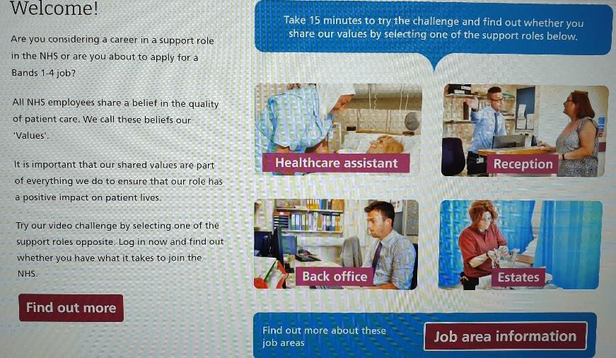
Values Challenge - click the slide to begin!
Values of the NHS Constitution
If you're applying for a job either directly in the NHS or in an organisation that provides NHS services, you'll be asked to demonstrate the values of the NHS Constitution and how they would apply in your everyday work.
You can find out more about NHS values here.
Complete the values challenge to see if you share the NHS’ values!
Save or screenshot your results and include them in your Personal Statement or future job applications.

Slide 4
This programme is more than one day…
By joining this webinar, you are now a part of the Creating Careers family.
This includes The Liverpool City Region Careers Hub, Health Education England , GM Higher and Shaping Futures’ commitment to give you access to opportunities that enable you to train towards a career in Health and Social Care.
You can also independently sign up to Cheshire and Warrington Higher Horizons, Lancashire Future U & Cumbria Hello Future who can help you to access these webinars and support you going forward.
Do you have any questions?
You can ask us about GCSE options, Sixth-Form or College choices and everything university related. Talk to the Shaping Futures team via live chat here or click on any of the above links for your area.
Creating Careers: Ask Us Anything - Health and Social Care Webinars
Build your knowledge around all things Health and Social Care! Even if you have an interest in one career role its an opportunity to see how the 350+ roles interlink to ensure that we have a world class Health & Social care system.
The webinar series will be back in September 2021. More details are coming soon!

