Slide 1
National Apprenticeship Week 2022 Liverpool City Region Cornerstone Employers
Housekeeping Cameras and mics off
Ask questions via the chat box
Ask as many questions as you’d like!
@LCRCareersEnt
TikTok @lcr_careers_hub

Slide 2
National Apprenticeship Week 2022
7th – 11th February with Cornerstone Employers
Monday 7th February @ 10am ASK - What is an apprenticeship? | Tuesday 8th February @10am Housing Sector | Wednesday 9th February @ 10am Engineering/ Rail Sector
Thursday 10th February @ 10am Green Skills | Friday 11th February @10am Construction/ STEM Sector – Including Women into engineering construction | Times: All sessions are between 45 mins to 60 mins: 10:00am-11:00am. Join the session at any time - we appreciate that lesson times vary. Teacher notes: Although this is focused on Years 11 and 13, all year groups are welcome to join us and listen to apprentices from Liverpool City Region share their experiences. Click this Zoom link to join all sessions Meeting ID: 895 4186 1077 Passcode: 473082

Slide 3
National Apprenticeship Week 2022
7th – 11th February with Cornerstone Employers: Pre work and useful links
What’s the difference between T Levels, Traineeships and Apprenticeships? - Click here The Learning Foundry - Click here Jamie-Leigh’s journey from school to trainee to apprentice - Click here Rory’s story as a trainee - Click here We Are The Learning Foundry: not like school or college - Click here | The Regenda Group - Education, Training and Careers - Click here The Sovini Group Careers - Click here | United Utilities Apprenticeships - Click here Alstom Careers - Click here
United Utilities Apprenticeships - Click here Keepmoat Homes Apprenticeships - Click here | Jaguar Land Rover Careers Apprentices - Click Here EFT Group Ltd Apprenticeships - Click here United Utilities Apprenticeships - Click here | The Pay Index helps students, professionals, educational institutions and businesses make informed decisions by providing transparency and analysis through its salary comparison reporting tool. Their up-to-date market data and cutting-edge software puts important salary and career prospect information into the hands of those who need it. The Pay Index for Colleges and Students - Click here The Pay Index - Sign up here

Slide 4
Introduction to Construction & STEM Sector
Welcome
Introduction to 3 Businesses:
EFT Group Ltd
Jaguar Land Rover
United Utilities
Meet the Apprentices
Finish

Slide 5
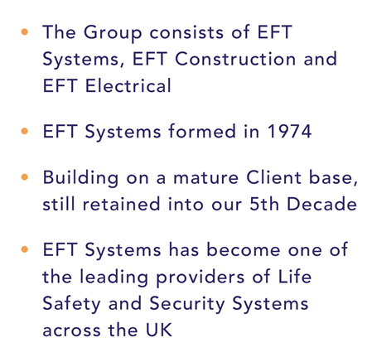
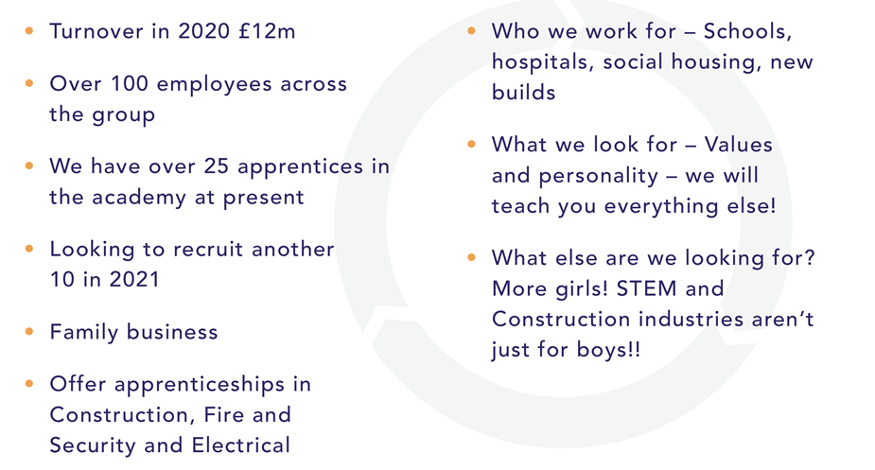
WHO WE ARE …

Slide 6
OUR VALUES …

Slide 7
OUR VALUES …

Slide 9
jaguar land rover halewood

Slide 10
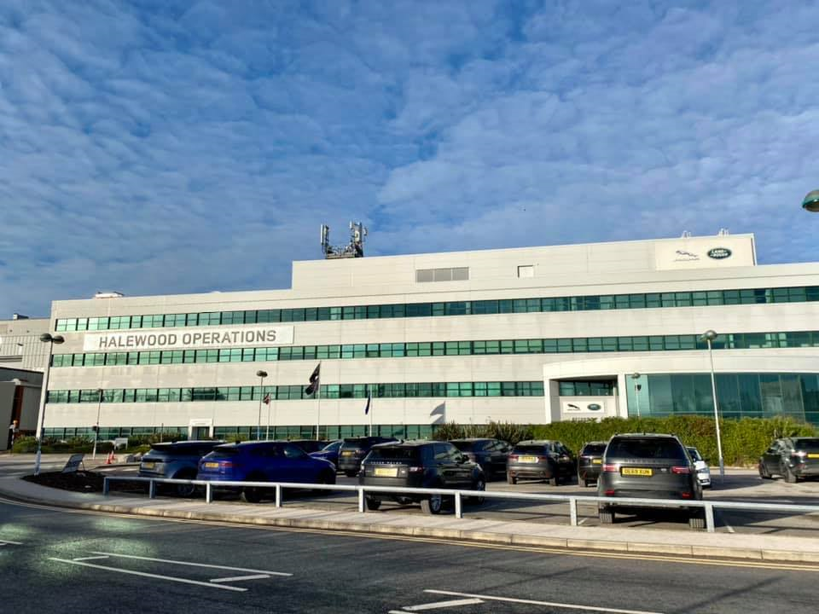
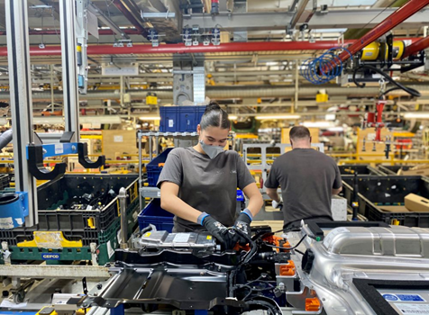
JAGUAR LAND ROVER HALEWOOD – TODAY
ABOUT US:
Merseyside is home to Jaguar Land Rover Halewood – a 300-acre production site.
Jaguar Land Rover Halewood produces the award-winning Range Rover Evoque and the Land Rover Discovery Sport, which includes plug-in and hybrid models.
The factory employs 3700 people directly, supporting a further 1000 people indirectly through its suppliers and contractors.
Over £750m has been invested in infrastructure at Halewood in recent years, including: £250m for its Range Rover Evoque, the fastest selling Land Rover model of all time and £200m for the Discovery Sport.
During this time, Jaguar Land Rover Halewood has also seen the installation of two £60m state-of-the-art servo press lines, over 300 new robots and over an acre of new building space, car parks and employee facilities.
or use with video

Slide 11
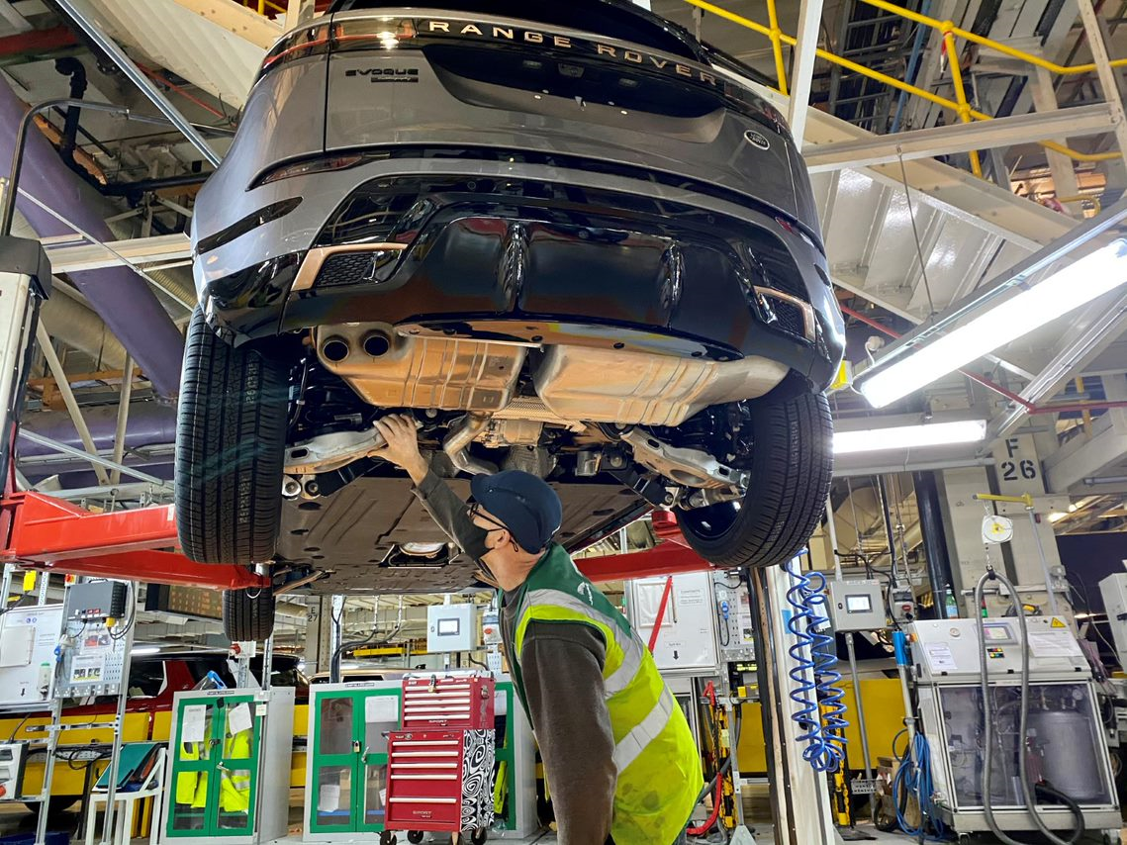
JAGUAR LAND ROVER HALEWOOD - TODAY
Currently running production across two shifts.
Halewood is home to a new Stamping Die Manufacturing Centre, following a £1.7M investment. The centre will manufacture press tools on site for the first time in its 58-year history to support production of future models across JLR’s sites.
JLR is passionate about investing in home grown talent
The new Die Manufacturing Centre will mean our associates and apprentices will be trained in the new processes and hand skills required to build and operate dies, so Halewood can maintain and attract the best talent, as well as build skills across the region.
or use with video

Slide 12
E
JAGUAR LAND ROVER HALEWOOD – THE FUTURE
Earlier this year, as part of Jaguar Land Rover’s new global Reimagine strategy, the company announced Halewood and its other factories, would be converted to produce fully electric cars, over the next few years as the company drives forward with the complete electrification of its Jaguar and Land Rover brands, by 2039.
A new electric architecture is destined for Halewood in the coming years – Electrical Modular Architecture (EMA).
This is an electric biased platform which will also support electrified internal combustion engines (ICE) as we evolve our product line-up in the future.
Positive investment in Halewood, so our facilities are equipped to build cars on this new platform.
We will start to see facility changes as we begin the process of upgrading to this new architecture in the near future.
Still not confirmed which vehicles will be built on the new EMA platform and exact timings but we have a bright and exciting future for Halewood.
CONFIDENTIAL ©2021

Slide 13
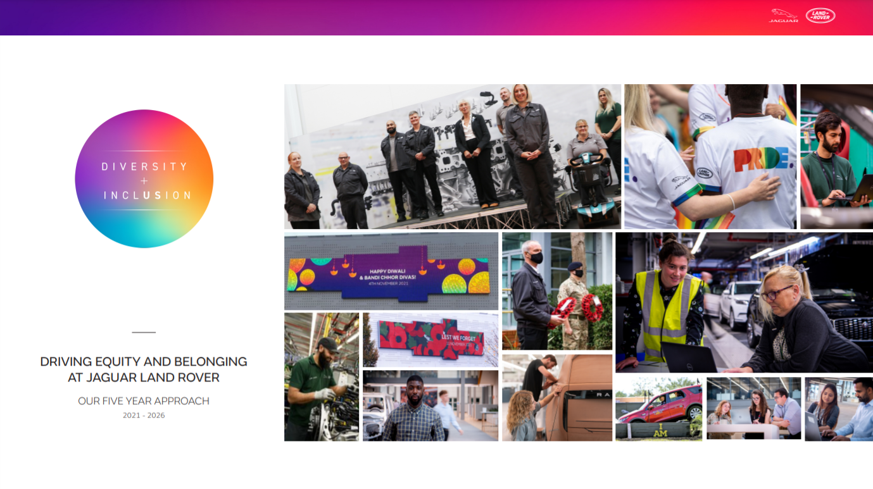

Slide 14
OUR ASPIRATION AND THREE PILLARS
At Jaguar Land Rover we are passionate about our people. We are committed to fostering a diverse, inclusive and unified culture that is representative of our customers and the society in which we live; a culture where every one of our employees can bring their authentic self to work and feel empowered to reach their full potential. Over the next five years our D&I activity will be aligned to 3 key pillars:
With people at the heart, we will have a culture where everyone feels they belong
We will increase engagement with our people through a regular drumbeat of communications, demonstrating and encouraging inclusive behaviours as well as establishing a culture where everyone is treated equally and valued for their differences.
We will cultivate an understanding of Diversity & Inclusion by developing a comprehensive learning curriculum.
Driven by our leaders, we will embed our progressive culture throughout our business, ensuring consistency of employee experience
and promoting inclusive behaviours.
We will improve our employee data collection and analysis to ensure we provide the best employee experience to all our colleagues
1. SHAPE A CULTURE OF UNITY
BELONGING, INCLUSION AND RESPECT
Educate, communicate and measure inclusive behaviours regularly
and systematically, improving the employee experience for all
Attracting, recruiting, developing and retaining a diverse talent pool
Review and remove barriers from recruitment, assessment and succession practices
Provide tailored support which recognises the needs of a diverse talent pool, helping people to achieve their full potential
Ensure our policies are reflective of our diverse workforce and relevant to everyone
Review our reward practices to highlight any inequalities and work to close any gaps
Offer industry-leading benefits to ensure we attract and retain a wide range of people
Analyse our attrition rates, with a focus on diverse talent, developing a retention strategy to retain our existing talent
2. IMPLEMENT PROGRESSIVE POLICIES,
PRACTICES, BENEFITS AND SUPPORT
Review and improve practices and policies to remove barriers,
enable inclusion and realise equity
We all benefit from diversity & inclusion
We will support individual employee networks to grow and thrive, introducing inclusion councils and working with local experts on how to include everyone on our journey.
We will continue to work with our designated diversity partnerships, ensuring our achievements within this space remain
current and relevant for all colleagues.
We will ensure all colleagues feel empowered to change our culture, helping to accelerate progress –
including through support for an ally programme and via our employee networks.
3. ENGAGE OUR EMPLOYEES AND
EXPERTS TO ACCELERATE PROGRESS
Collaborate with our networks, colleagues and experts to
create real, positive change
Notes:
Thierry recently launched our approach to improving D+I and you will start seeing more on this in the coming weeks and months.
We also launched our elearning on an Intro to D&I, - complete this and ask your teams to do the same.

Slide 15
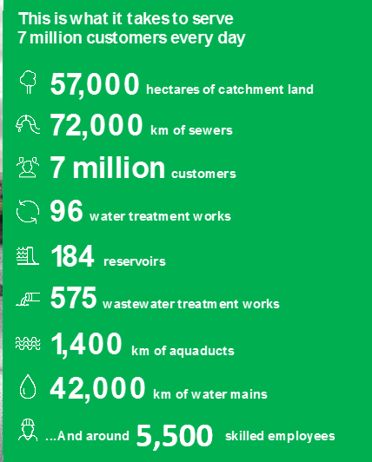
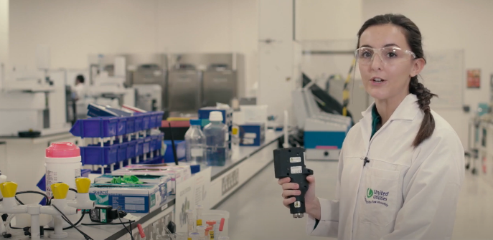
Who are United Utilities?
We are responsible for the water and wastewater services across the North West of England. We provide an essential service to our customers across the region, whilst being at the forefront of tackling some of the biggest climate and environmental challenges in a generation. All our people are essential in achieving our net zero targets and creating a more resilient North West.
As an apprentice, you will not only be a part of the 7th ranked most Inclusive UK Company as awarded by Inclusive Companies, but you could also be working towards an Ofsted awarded apprenticeship programme. Our employees rated us 4.5/5 on glass door, we really are a fantastic place to work.
Hear what our CEO Steve Mogford has to say about a career at United Utilities.
We’re more than just a water company. Check out all the amazing facilities we have available!

Slide 16
Our Goals and Pledges
Our purpose is ‘to provide great water and more for the North West’, and this purpose is what keeps our people focused on what matters most to those we serve. United Utilities is more than a business, it’s a vital part of the community – and we deliver so much more than water, including all of our fantastic work to make sure that the North West is greener, healthier and stronger.
Our core values
We are more than just water …
Customer Focus – Customers are at the heart of everything w do, and we aim to provide a great and resilient service at the most efficient cost.
Supporting our communities to be stronger
Protecting and enhancing the environment
Caring for customers through trusted relationships
Delivering a sustainable return to investors
Innovation – We continually look for new ways to make our services better, safer, faster and cheaper.
Creating a great place to work for all our employees
Innovating in partnership with suppliers
Trustworthy – we make promises and knowingly keep them, behaving with integrity towards all of our stakeholders.

Slide 17
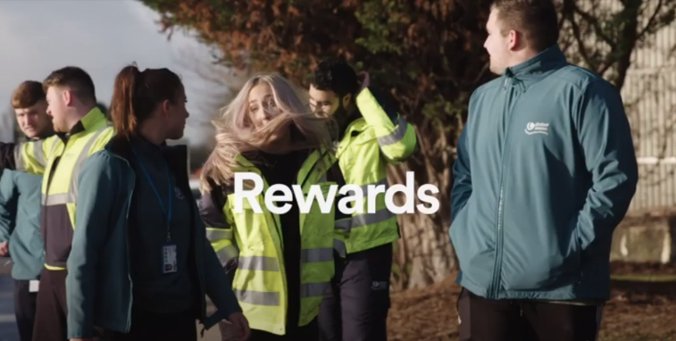
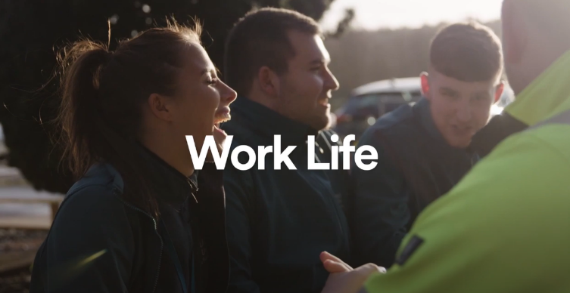
Benefits of being a UU Apprentice
As an apprentice at United Utilities, you will have the opportunity to fulfil your potential, starting work in FTSE100 company. After successfully applying for the role of your choice, you will be immersed into professional training relating to your role, learning new skills and exploring exciting areas of the business.
What’s in it for you? Aside from the amazing development opportunities on offer, check out the above video to learn all about the rewards we offer our apprentices.
Salaries start from £12,500 with up to £5,000 annual performance based increases.
You will start with 26 days of Annual Leave, with the option to buy or sell more!
Learning to drive? We will pay for up to 10 driving lessons to help you get on the road!
Join our private healthcare scheme to help cover medical and dental costs. We even have an onsite gym!
Don’t just take it from us. Check out the above video to see what our current apprentices think of opportunities on offer!

Slide 18
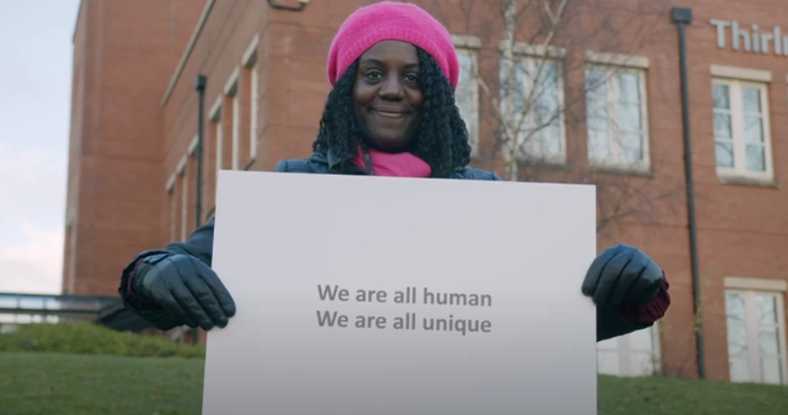
Diversity and Inclusion at United Utilities
We value diversity, providing equality of opportunity and constantly recruiting and promoting on merit. Our aim is to create a workforce that is representative of the communities we serve, and it is vital to us that we’re able to create an inclusive and supportive working environment where our employees feel they can bring their whole selves to the work place, and fulfil their full potential.
Employee Networks
Our employee networks have been created to assist in supporting our employees feel comfortable and confident to go about their day jobs. These Networks are ran by employees who all share a common experience and wish to support one another, whilst also driving the diversity and inclusion agenda within the business forward.
Gender Equality Network (GENEQ)
Multicultural Network
Identity LGBT+ Network
Armed Forces Network
Christians at UU
Ability Network
Early Careers Network
Click here to see more.

Slide 19
Apprenticeship roles available
Find out more about our September 2022 opportunities

Slide 20
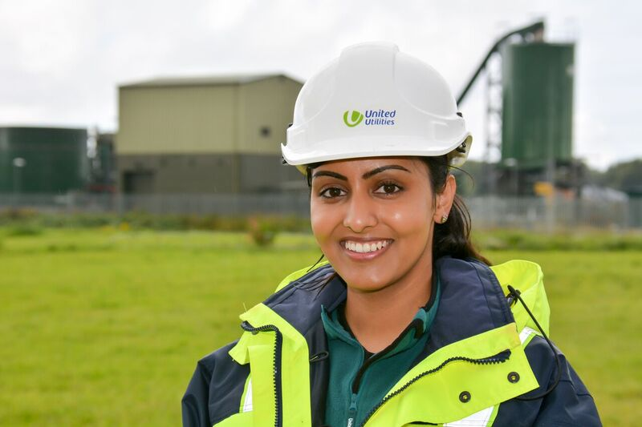
Apprentice Developer Services Assistant Engineer
You’ll learn how to assess new connections from developments to the water and wastewater network and also new assets for adoption
Identify and highlight potential risk to United Utilities assets, new and existing customers
You’ll learn how to assess new connections from developments to the water and wastewater network and also new assets for adoption
Understand key processes, procedures, regulatory and technical requirements and information
Identify and highlight potential risk to United Utilities assets, new and existing customers
Understand key processes, procedures, regulatory and technical requirements and information
Point of contact for key stakeholders and provide relevant and appropriate site based information
Ensure all new adoptable assets are designed correctly and existing assets are protected
Point of contact for key stakeholders and provide relevant and appropriate site based information
Ensure all new adoptable assets are designed correctly and existing assets are protected
Click here to apply for the role or to find out more information

Slide 21
Apprentice Financial Analyst
Assist with the production of accruals, monthly accounting and other requirements in line with regulatory guidelines
Work as part of the financial analyst team to support the lead management accountant and business areas
Liaise with HR to ensure alignment to the resource plan and reconciliation of headcount and will need to meet strict month end deadlines
Own and control relevant financial models used to assist business performance
Prepare all year-end reporting schedules
Click here to apply for the role or to find out more information

Slide 22
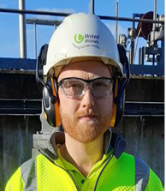
Apprentice Field Service Engineer Mechanical (Water & Wastewater)
Assist with the production of accruals, monthly accounting and other requirements in line with regulatory guidelines
Work as part of the financial analyst team to support the lead management accountant and business areas
What advice would you give to some body applying for the apprenticeship scheme?
“Do some research on the company and research your chosen discipline. Knowing background information on the job you’re applying for will always impress the interviewer.”
Own and control relevant financial models used to assist business performance
Liaise with HR to ensure alignment to the resource plan and reconciliation of headcount and will need to meet strict month end deadlines
- George, Apprentice FSE (Mechanical)
Click here to apply for the role or to find out more information

Slide 23
Apprentice Laboratory Scientist
Learn key scientific skills and how to ensure that the water that comes out of the tap is of the highest quality
What is your favourite thing about your current role?
Ion Chromatography
Colorimetry
“Everything I’m learning day to day is directly applied. That’s something that frustrated me so much during school, that I’d learn things that I’d have no idea how or when to actually use, but in my current role I can make use of everything I’ve learnt right away.”
Spectrometry
During your five year apprenticeship, you’ll get to grips with lots of different systems and activities that take place in our science department including …
- Evan, Apprentice Scientist
Click here to apply for the role or to find out more information

Slide 24
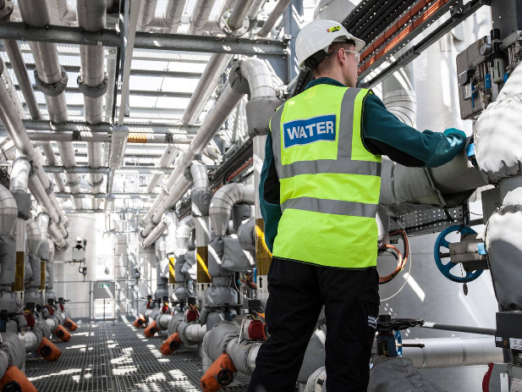
Apprentice Network Asset Engineer (Mechanical)
Ensure that our assets are available and are working correctly, helping to keep services running smoothly for our customers
Work as part of a dedicated team focussed on ensuring our plants continue to operate at maximum efficiency
Work with a wide range of equipment, identify any faults and carry out maintenance and repairs, following the company’s health and safety standards
Schedule maintenance activity and organise your workload effectively
Learn how to spot mechanical faults on our wastewater assets
Click here to apply for the role or to find out more information

Slide 25
Apprentice Production Engineer
Learn how to make our Bioresource treatment processes run smoothly
Learn how to operate our systems and equipment to maximise the energy potential from the Bio solids
Be involved across the full asset life cycle from commissioning new innovative technologies to decommissioning existing assets
Play a key role in designing, planning and implementing new processes and procedures
Be proactive in identifying and supporting engineering solutions to challenging problems, be able to identify areas for business improvement and propose innovative ideas
Click here to apply for the role or to find out more information

Slide 26
Apprentice Data Scientist
Create insight from data, predicting future trends by connecting data sources and manipulating different data types
Work with business teams to identify requirements and understand where analytic insight can add value
Develop analytic insight based on functional designs and user requirements
Develop a technical understanding and knowledge of key infrastructure and analytics tools
Communicate findings via data visualisation to a range of technical and non-technical audiences
Click here to apply for the role or to find out more information

Slide 27
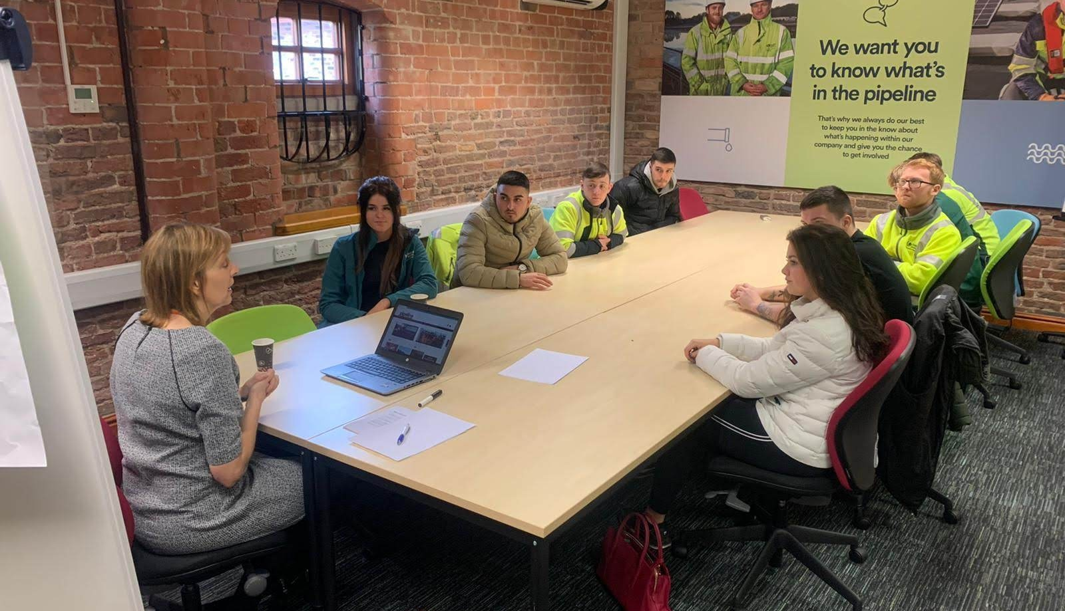
Apprentice Data Analyst
Work as part of a dedicated team focused
Manipulate and link different data sets as required
Interpret and apply data and information security standards, policies and procedures to data management activities
Collect and compile data from different sources
Identify, collect and migrate data to/from a range of internal and external systems
Click here to apply for the role or to find out more information

Slide 28
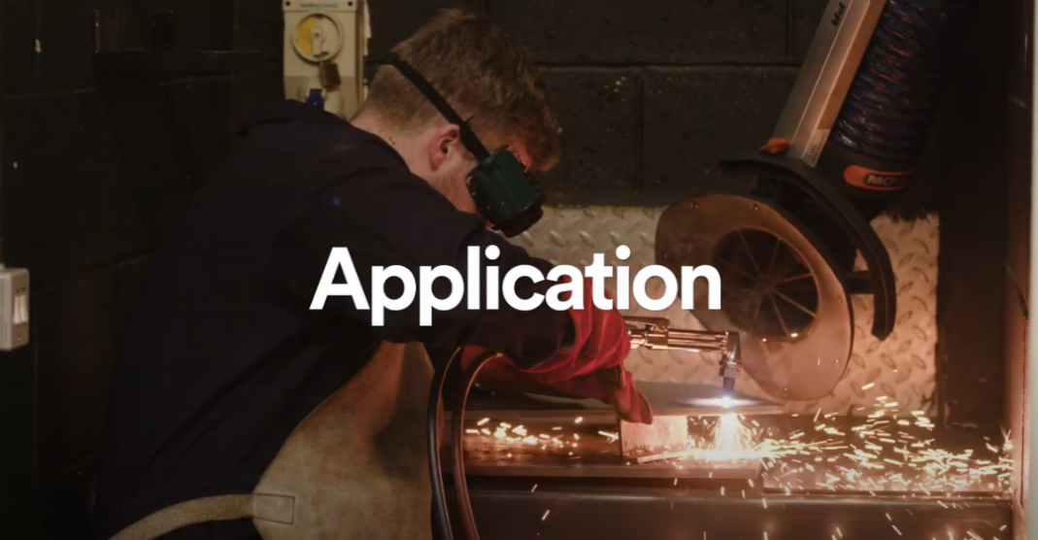
The Application Process
1. Application Submission and Review
2. Online Situational Judgement Test
3. Video Interview
4. Online Aptitude Test
Want to know how our current apprentices’ found their application process? Check out the above video to learn more!
5. Virtual Assessment Centre
To see our application process in more detail, head to our website

