Slide 1
Creating Careers: Ask Us Anything
Season Two
Estates and Facilities
Thursday 23rd June 2022
4.30pm – 5.30pm
Student Pre-work

Slide 2
350 Careers, One NHS, Your Future
Non-clinical roles (not directly treating patients) are essential to the success of the NHS and offer a huge variety of rewarding career pathways. This can include analysing accurate data records in informatics or working in finance to ensure that NHS budget is spent wisely. You could also work in communications and digital promoting the NHS through social media.
This webinar focuses on non-clinical NHS careers in estates and facilities.
1a) Research the different roles within estates and facilities.
b) In your own words, explain what we mean by estates and facilities AND why their services are so important to NHS staff and patients.
2 a) Using this link, watch the NHS video and explore the wider website to find out the benefits of working for the NHS.
b) Explain why you think people in non-clinical roles would choose to work in the NHS rather than work for other types of organisations/businesses that offer the same career?
Extension Task: Take the Step into the NHS Careers Quiz to identify which of the 350 NHS roles are most suited to your interests and skills.
Review your results and click the links to find out more about the non-clinical careers that are matched to you.
Do any of these roles interest you? Explain your reasons.
Questions to ask
Using what you have learned from your pre-work, think of three questions that you would like to ask at our event.
Is there anything you don’t understand or would like more information on? You may even come up with more questions as you watch the webinar.
1.
2.
3.
Useful careers tips
Whilst listening, note down any inspirational or interesting advice that you hear which could help you on your careers journey
Now head over to your Creating Careers Roadmap to evaluate today’s event…

Slide 3
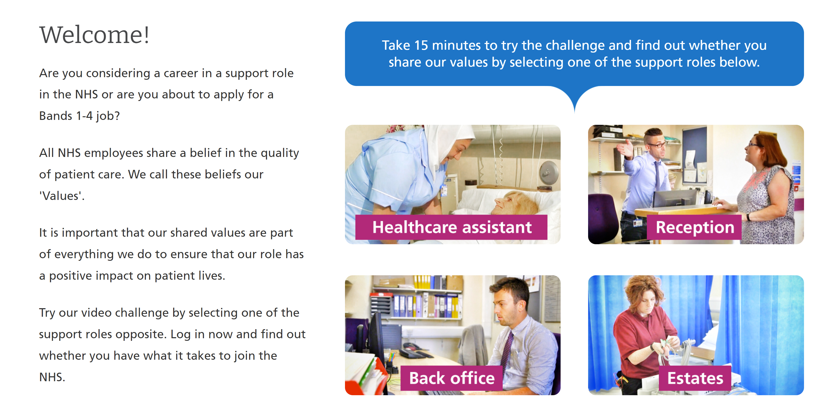
Values Challenge - click here to begin!
Values of the NHS Constitution
If you're applying for a job either directly in the NHS or in an organisation that provides NHS services, you'll be asked to demonstrate the values of the NHS Constitution and how they would apply in your everyday work.
You can find out more about NHS values here.
Complete the values challenge to see if you share the NHS’ values!

Slide 4
This programme is more than one day…
By joining this webinar, you are now a part of the Creating Careers family.
This includes The Liverpool City Region Careers Hub, Health Education England, GM Higher, Shaping Futures, NHS Careers NW, Lancashire Future U, Cumbria Hello Future and Cheshire and Warrington’s commitment to sharing opportunities that enable you to train towards a career in health and social care.
You can also independently sign up to Cheshire and Warrington Higher Horizons, Youth Hub by Be More and Cheshire and Warrington Opportunities who can help you to access these webinars and support you going forward.
Do you have any questions?
You can ask us about GCSE options, Sixth-Form or College choices and everything university related. Talk to the Shaping Futures team via live chat here or click on any of the above links for your area.
Creating Careers: Ask Us Anything - Health and Social Care Webinars
Build your health and social care knowledge! Even if you have an interest in one career role, these webinars are an opportunity to see how the 350+ NHS roles interlink to create a world-class health and social care system.
For more information, please see the next slide.

Slide 5
Creating Careers: Ask Us Anything
Season Two
Healthcare Science
What is Healthcare Science?
Healthcare science staff play a vital role in the prevention, diagnosis and treatment of a huge number of medical conditions through scientific research and technology.
Areas in healthcare science include:
Clinical Bioinformatics
Life Sciences
Physical Sciences
Biomedical Engineering
Physiological Sciences
Click here to find out more about careers in healthcare science.
Thursday 7th July 2022
4.30pm – 5.30pm
Year 9-13 students, North West England
Teachers, parents and carers are welcome
Sign up here
Find out more about the 350+ exciting careers in the NHS here.
Additionally, watch our Creating Careers video series to learn about the interesting health and social care career pathways that Liverpool City Region has to offer.
Don’t forget to check out the pre-work and Creating Careers Roadmap that accompany each episode!
For the latest careers updates & events, follow our Twitter page @LCRCareersEnt

