Slide 2
AHP Taster Day Timetable
10.00-10.30: Welcome with AHP Guest Speaker
10.30-10.40: AHP Pathways into Employment
10.40-11.00: NHS Values, Behaviours and Attitudes
11.00-11.10: Break
11.10-12.00: AHP Speed Meet Session
12.00-13.00: Break
13.00-14.00: AHP Speed Meet Session
14.00-14.45: Student AHP Q&A
14.45-15.00: Closing

Slide 3
This programme is more than one day…
By joining this taster day, you are now a part of the Creating Careers family.
This includes The Liverpool City Region Careers Hub, Health Education England and Shaping Futures’ commitment to give you access to opportunities that enable you to train towards a career in Health and Social Care.
Do you have any questions?
You can ask us about GCSE options, Sixth-Form or College choices and everything university related. Talk to the Shaping Futures team, via live chat, here.
Coming soon…Creating Careers Monthly Health and Social Care Webinars
Build your knowledge around all things Health and Social Care!
For more information, please see the flyer on the next page.

Slide 4
Creating Careers: Ask Us Anything
Health and Social Care Webinars
Sign up here:
Thursday 18th March:
AHP Taster Day
Follow Up Session
Thursday 22nd April:
Step into Social Care
Thursday 20th May:
Careers in Nursing
Thursday 17th June:
Non-Medical NHS Careers
Thursday 15th July:
Careers in
Healthcare Science
Designed to teach you more about careers within Health and Social Care, our monthly webinar series allows you to ask key questions, hear from professionals and develop your understanding of the sector.
Each session will run live from 4.30-5.30 pm
Open to Year 11-13 students and parents, carers or guardians.
For further support, you can find out more about the 350+ exciting careers in the NHS here.
Additionally, watch our Creating Careers video series to learn about the interesting Health and Social Care career pathways that Liverpool City Region has to offer.
Don’t forget to check out the pre-work and Creating Careers Roadmap that accompany each episode!
For the latest careers updates & events, follow our Twitter page: @LCRCareersEnt

Slide 5
Pre-work Task: NHS Values
The NHS do not recruit using the traditional CV method but instead use Values Based Recruitment. In their application, each candidate gives examples to show that their personal/professional values* match the values of the NHS. *Values = a belief of how you should behave.
This is the same when you are applying for courses linked to NHS careers - you’ll need to demonstrate these values and more:
Click to watch a short video about each value.
Task: Take 15 minutes to try this challenge and find out whether you share NHS values.
After the challenge you will be provided with a report, please save this document or take a screenshot so you have a record of completing this task.

Slide 6
Use this diagram to explain how, in your personal or school life, your values match NHS values.
Suggestions of when you may have demonstrated these values:
school projects, exams, school trips, supporting and caring for friends and family, pets, part-time work, volunteering, after-school clubs and team events.
Insert your appropriate values here
Insert your appropriate values here
Insert your appropriate values here
Insert your appropriate values here
Insert your appropriate values here
Insert your appropriate values here

Slide 7
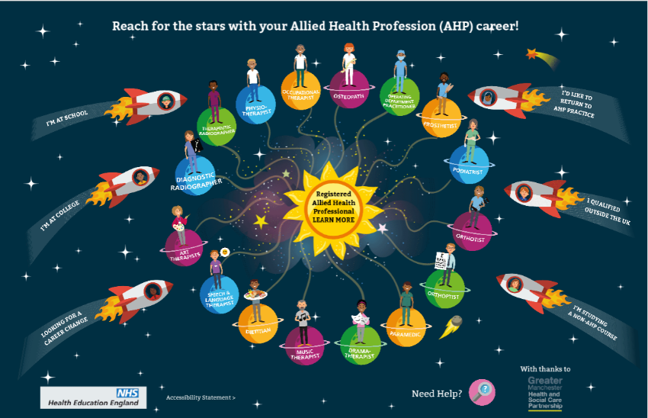
Useful Links
North West AHP Apprenticeships and Fee-Paying Courses Overview
Health Sector Glossary – explanations of key terms used in healthcare
Health and Social Care Careers Guide (open link in chrome)
Financial Grants for Health Courses Explained
Attend national and regional events to help build your personal statement portfolio and demonstrate your commitment to a future career in Health and Social Care:
I See the Difference – Updates on opportunities within AHP.
Health Careers Events Calendar
What Career Live? – Saturday 20 March (11-3pm)
WorldSkills UK Spotlight Talks – Thursday 25th March 10.45-11.15, NHS session
Click below to learn more about AHP roles

