Slide 1
What you need to learn to have a positive career
NEW
Adapted from Tristram Hooley

Slide 2
Work clothes (example of a topic web)
Fashion industry
Design a new uniform for a school or a company
Health and safety - signs
Building and construction – hard hats, hi vis jackets, etc.
Protective clothing
Organisational culture
Indicator of status
Formal/casual
Dressing down Friday
Uniforms
Work clothes
Clothing industry
Social prestige – e.g. ‘fossilised’ uniforms of judges
Public relations / corporate identity
Authority, e.g. army officers
Materials science
Manufacturing and production
Properties of textiles
Costs, e.g. of fabrics

Slide 3
A lifelong career development framework
For careers leaders, careers advisers, counsellors, HR specialists and individuals to use in all contexts.

Slide 4
The development process

Slide 5
We know what careers programmes in schools and colleges should look like…
1. A stable careers programme
2. Learning from career and labour market information
3. Addressing the needs of each student
4. Linking curriculum learning and careers
5. Encounters with employers and employees
6. Experiences of workplaces
7. Encounters with further and higher education
8. Personal guidance
Gatsby tells us how to organise the delivery
but not what the outcomes should be

Slide 6
Why do we need a framework at all?
Clarifies what individuals need to know, understand and be able to do.
Provides a unifying vision of what career education and guidance is about.
Serves as a curriculum development tool for careers education addressing issues such as breadth, balance, coherence, sequencing and progression.
Provides a basis for negotiating interventions into the wider curriculum (essential skills, subjects and co-curricular activities).

Slide 7
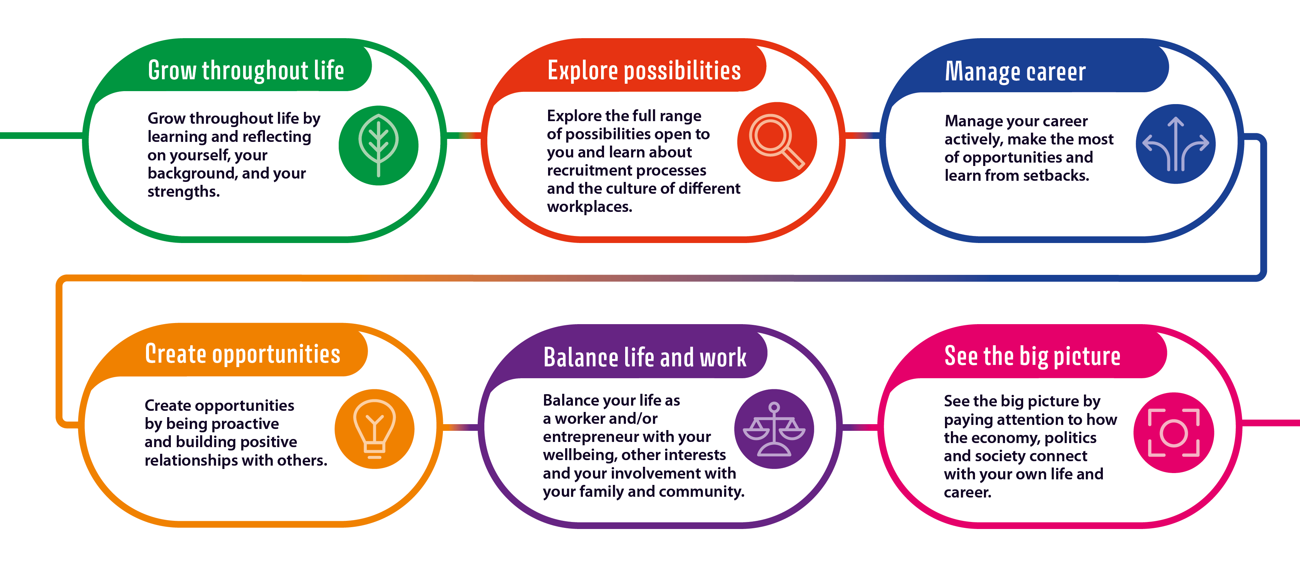
The learning areas

Slide 8
Practitioners recognise the six areas

Slide 9
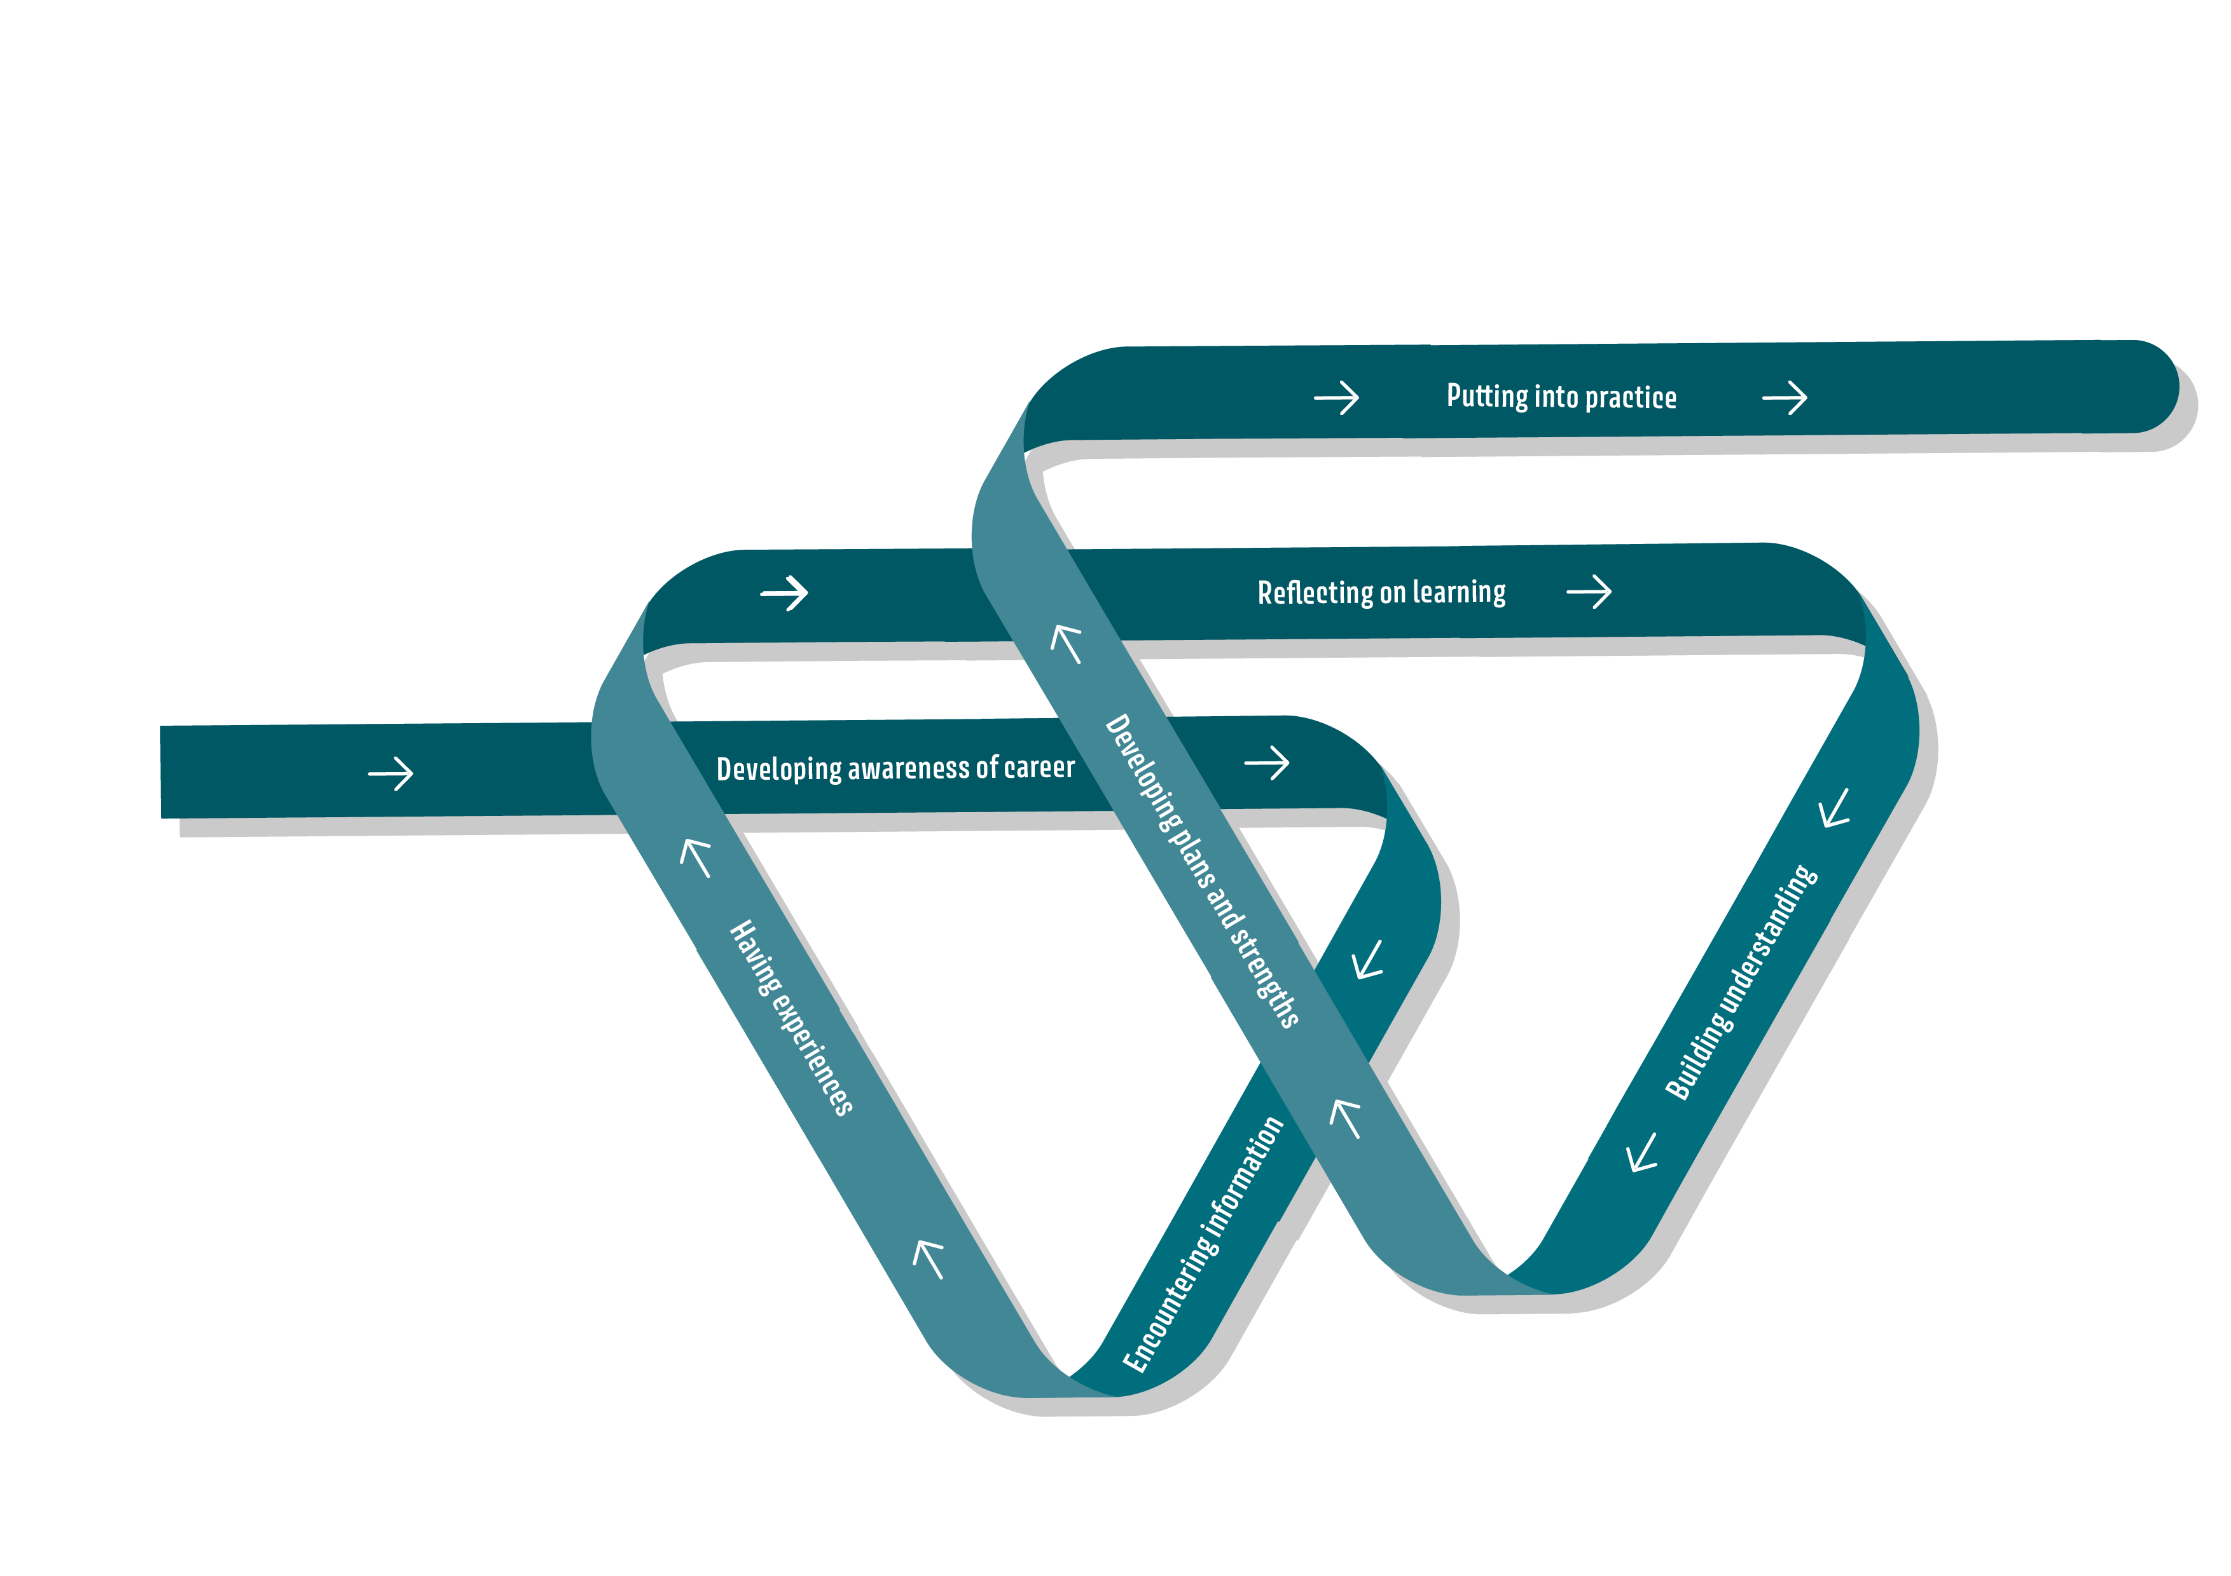
How are these skills learnt?

Slide 10
Grow throughout life
People need to grow throughout life by learning and reﬂecting on themselves, their background, and their strengths. Careers practitioners should address this by engaging learners in:
Making use of help, support and feedback
Recognising how learning, skills and experience contribute to career
Reflecting on and recording achievements, experiences and learning
Committing to lifelong learning and development
Challenging themselves and trying new things
Considering the impact of heritage, identity and values

Slide 11
Explore possibilities
People need to explore the full range of possibilities open to them and learn about recruitment processes and the culture of diﬀerent workplaces. Careers practitioners should address this by engaging learners in:
Thinking about what jobs and roles to pursue
Finding and making use of labour market information and information about the education system
Understanding learning pathways and how to access and succeed in them
Recognising the relationship between learning, qualifications and work
Building awareness about workplaces, workplace culture and expectations
Analysing and preparing for recruitment and selection processes

Slide 12
LMI in the careers curriculum
(Wendy Hirsh, 2017)

Slide 13
Manage career
People need to manage their career actively, make the most of opportunities and learn from setbacks. Careers practitioners should address this by engaging learners in:
Understanding the concept of career
Being confident and optimistic
Planning, prioritising and setting targets
Assessing risk and reward and making decisions
Managing opportunities, changes and transitions
Being resilient and learning from setbacks

Slide 14
Create opportunities
People need to create opportunities by being proactive and building positive relationships with others. Careers practitioners should address this by engaging learners in:
Building and maintaining relationships and networks
Being proactive
Being creative and agile
Representing themselves and others
Acting as a leader, role model or example to others
Considering entrepreneurialism

Slide 15
Balance life and work
People need to balance their life as a worker and/or entrepreneur with their wellbeing, other interests and their involvement with their family and community. Careers practitioners should address this by engaging learners in:
Considering work-life balance
Attending to physical and mental wellbeing
Planning and managing personal finances
Considering how to be involved in family and community
Understanding different life stages and life roles
Being aware of rights and responsibilities in the workplace and in society
Dealing with prejudice, stereotypes and discrimination

Slide 16
See the big picture
People need to see the big picture by paying attention to how the economy, politics and society connect with their own life and career. Careers practitioners should address this by engaging learners in:
Evaluating different media, information sources and viewpoints
Exploring and responding to local and national labour market trends
Exploring and responding to trends in technology and science
Exploring and responding to the relationship between career and the environment
Exploring and responding to the relationship between career, community and society
Exploring and responding to the relationship between career, politics and the economy

Slide 17
See the big picture
KS3 | KS4 | P16
Child labour Greenwashing by companies Uniforms and work clothes Job adverts Stereotyping of jobs Interdependence Role models Green jobs | Unequal pay Harassment at work Sexism Modern slavery Health and safety Aesthetic labour Automation / robotics Happenstance Decent work Employability | Productivity Investment Industrial relations Globalisation Cost of a degree Widening HE participation Pregnancy discrimination Institutional racism Sustainable living and working Entrepreneurialism

Slide 18
CDI Framework Resources https://www.thecdi.net/New-Career-Development-Framework
Guides/Papers:
A guide to the Framework for careers practitioners (12 pages, Pdf)
Using the Framework to support career education and guidance in secondary schools (Key stage 3 - post-16) (24 pages, Pdf, Word)
A 24-page handbook for secondary schools (Pdf)
A paper detailing the development of the Framework (Pdf)
Videos:
The New CDI Framework - How We're Using It video (Youtube)
Templates:
Career Development Audit against the CDI Framework (Word template)
Career Development Plan against the CDI Framework (Programme planner - Word template)
Other:
Case studies
Key Stage 3 - Post 16 "I Can Do" Statements

Slide 19
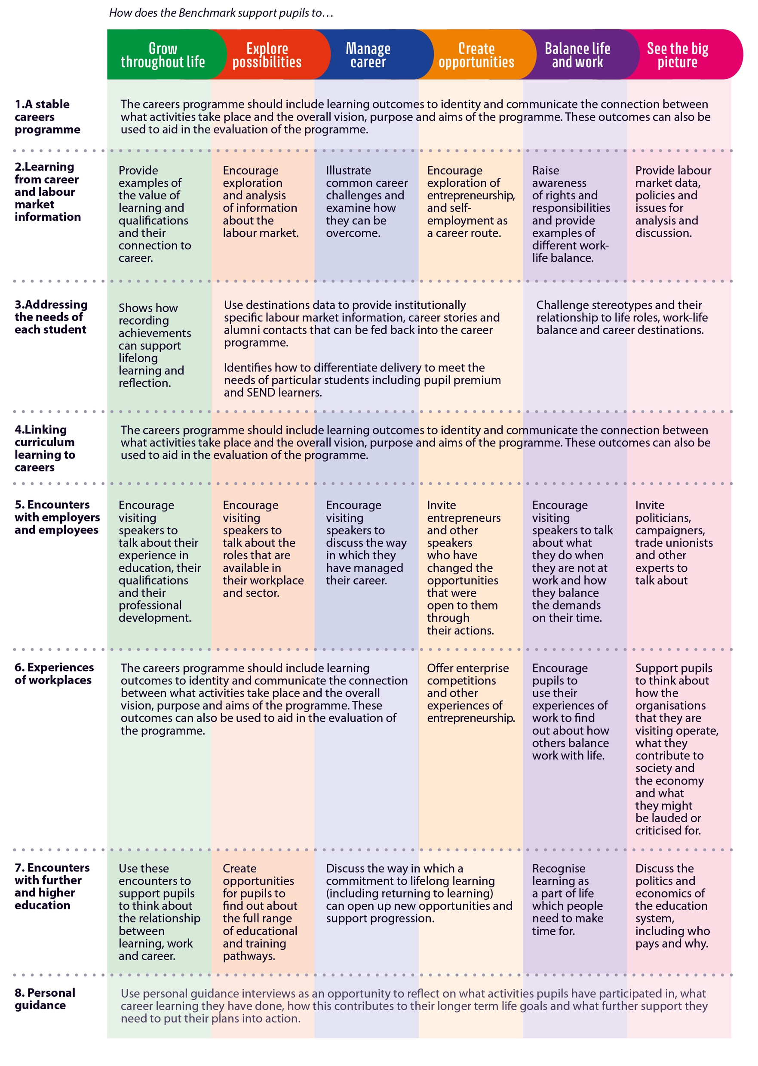
Mapped onto the Gatsby Benchmarks Using the Framework to support career education and guidance in secondary schools (Key stage 3 - post-16)

Slide 20
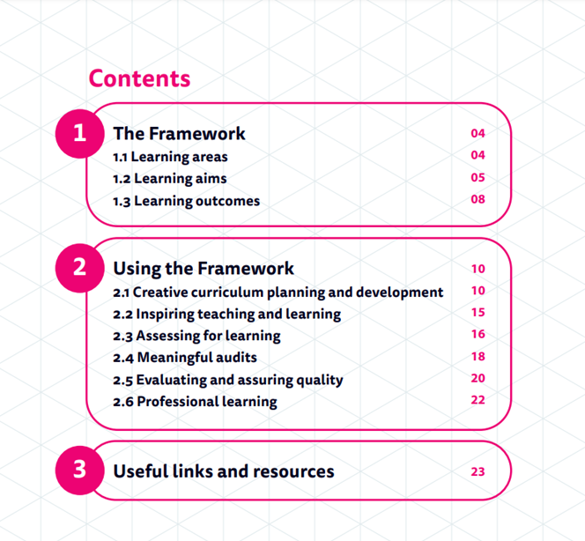

Slide 21
But what are the outcomes?
Tracking and Destinations data
Gives us a means of looking at what the practical or economic outcomes of career development are
CDI framework
Gives us a means of looking at what the learning outcomes of career development are
NB. The synergy between career learning and skills- and subject-based learning

Slide 22
Writing learning outcome statements
Learning outcome statements should have:
a stem giving the context, environment or focus of the learning intervention, e.g. This Year 11 unit on options at 16+ will enable you to...’
an active verb expressing a cognitive or behavioural skill, e.g. ‘decide…’
•an out-turn or output that can be assessed, e.g. ‘between the options open to you.’

Slide 23
Barriers to achieving Benchmark One
Co-construction with stakeholders and partners is underdeveloped, e.g. engagement of parents/carers, learners and employers needs more work
The careers programme is not sufficiently embedded in the whole curriculum
Senior leadership teams and governors are not providing strong support
Careers leadership is vulnerable to staffing changes

Slide 24
The six Ps Careers Strategy
Priorities Review of previous priorities Present priorities Programme Calendar of main activities and events for the next 1-3 years Provision Careers education Careers information Careers guidance and support | Professional learning Careers Leader All staff Partnerships Parents and carers Careers Guidance provider World of work representatives Learning providers Performance Monitoring, review and evaluation Assessment of quality

Slide 25
Take-aways
The CDI Framework was developed through a robust process and has been endorsed by a number of important organisations
The CDI Framework is a check against the pressure to narrow down what careers in the curriculum is for
It is vitally important to use the CDI Framework strategically and not just operationally – there are still too many senior leaders, governors and staff who do not value careers enough
All pupils/students are entitled to a rich and balanced careers curriculum rooted in the six learning areas
The CDI Framework is flexible so make it work for you!

Slide 27
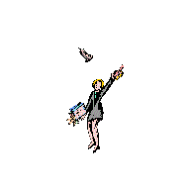
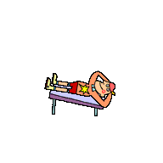
Career patterns - Barrie Hopson
Linear
Serial
Portfolio
Lifestyle

Slide 28
Preparing to interview a visitor
Sending the invitation
Who do you want to interview?
How can you get in touch with them?
How will you word the invitation?
Does the visitor know what you hope to find out?
What do you already know about your visitor?
When they arrive
Who will welcome the visitor?
How should you welcome your visitor?
How will you introduce yourselves?
How will you get the conversation started?
Talking to your visitor
What do you want to find out?
How will you make the conversation an enjoyable one for your visitor?
What questions will you ask? Who will keep track of the time?
Do you need to make notes or record the conversation?
What can you do if your visitor talks too much about things that are not of interest to the group?
Saying goodbye and thank you
How will we bring the conversation to a close?
How will you thank your visitor?
Who will thank the visitor and show them out?
The follow-up
What were the most important and most interesting things you found out from your visitor?
How are you going to feed back your findings to the rest of the class and what are you going to say?
How well do you think it went?
What would you do differently next time?

